Slide 1



making innovation matter

Slide 2
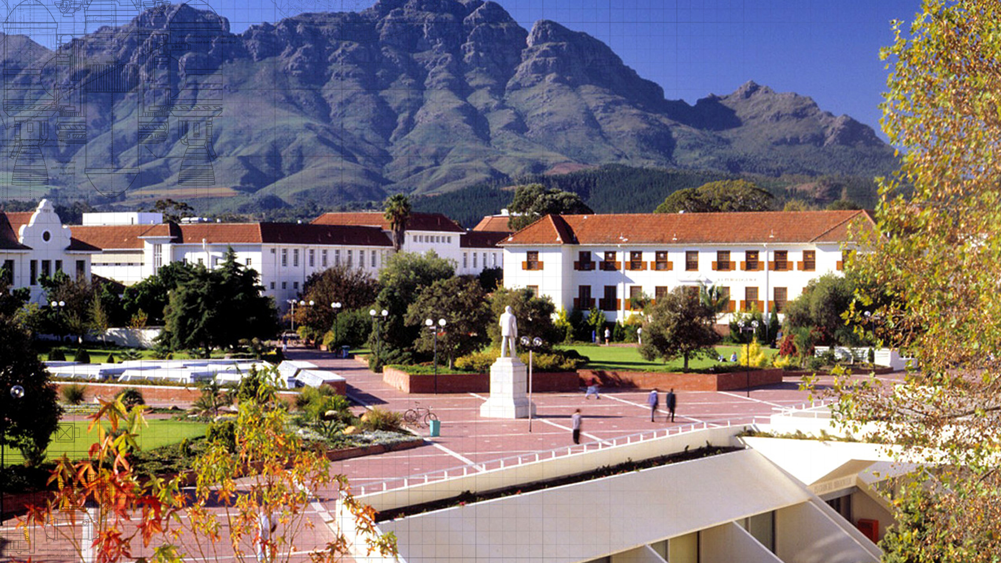

Slide 3






Characteristics of great universities
High quality & relevant research
Strong programmes & research teams
Number of employable graduates
Successful postgraduates
Impact on society
Notes:
Characteristics of great universities
Amount of researchers
Number of graduates
The contribution they make to society
“And, on that note, I’d like to tell you a story…”

Slide 4


Stellenbosch University
Ranked among the top 350 universities in the world*
30 000 students
33% are postgraduate
>4300 international students from >100 countries
Research intensive university
10 Faculties on 5 campuses
>1000 academic staff
*Times Higher Education

Slide 5
Innovus
Innovus is Stellenbosch University’s university-industry interaction platform for the commercialisation of SU’s assets. Innovus is both a division within SU as well as company. Innovus, the company, holds the shareholding in SU’s group of more than 20 companies.
Innovus, as an SU division, is responsible for the university’s commercial activities (SU’s fifth income stream). This includes technology transfer, which is the commercialisation and the management of the University's intellectual property portfolio through patent protection, licensing and the formation of spin-out companies.
Innovus also supports entrepreneurial staff, students and entrepreneurs from outside the University through our Nedbank Stellenbosch University LaunchLab business incubator to start and grow new ventures.
Innovus is also responsible for the management of SU’s trademarks.
The University’s Short Courses and Copyright division and SUNCOM, the commercial services division of SU, also fall within Innovus.
SUNCOM is responsible for campus-based residential services, SU's student centers, the Matie Shops, the Botanical Garden, Maties Dairy, Compliance and Food Services, Maties Copy and Print, and the Conference and Event Support division and the rental of all SU facilities.

Slide 6
Technology Transfer
LaunchLab
New Initiatives
Innovus (Pty) Ltd
> 20 Companies
Residential Services
Matie Shops
Botanical Garden
Maties Dairy
Short Courses and Copyright
SunCom
Student Centers
Maties Copy and Print
Compliance and Food Services
Conference and Event Support
Trademarks
New Channels
Facility Rentals

Slide 7
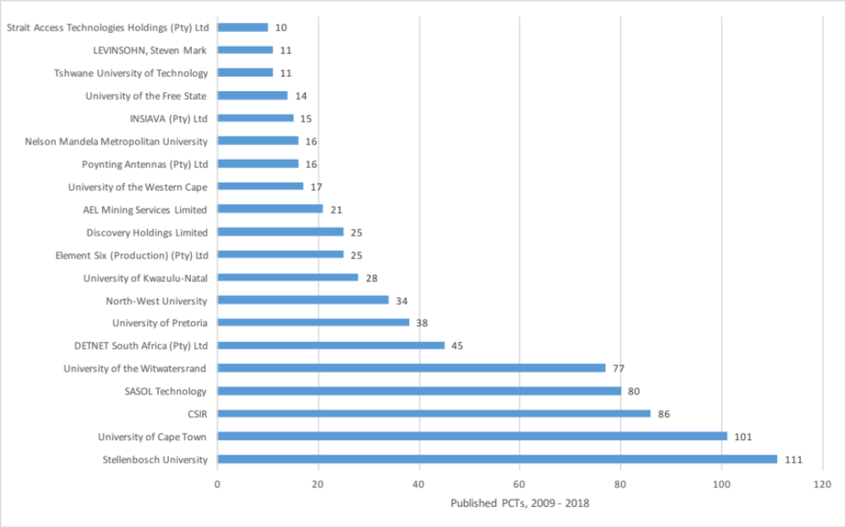
Responsible for more innovations in SA than anyone else

Slide 8
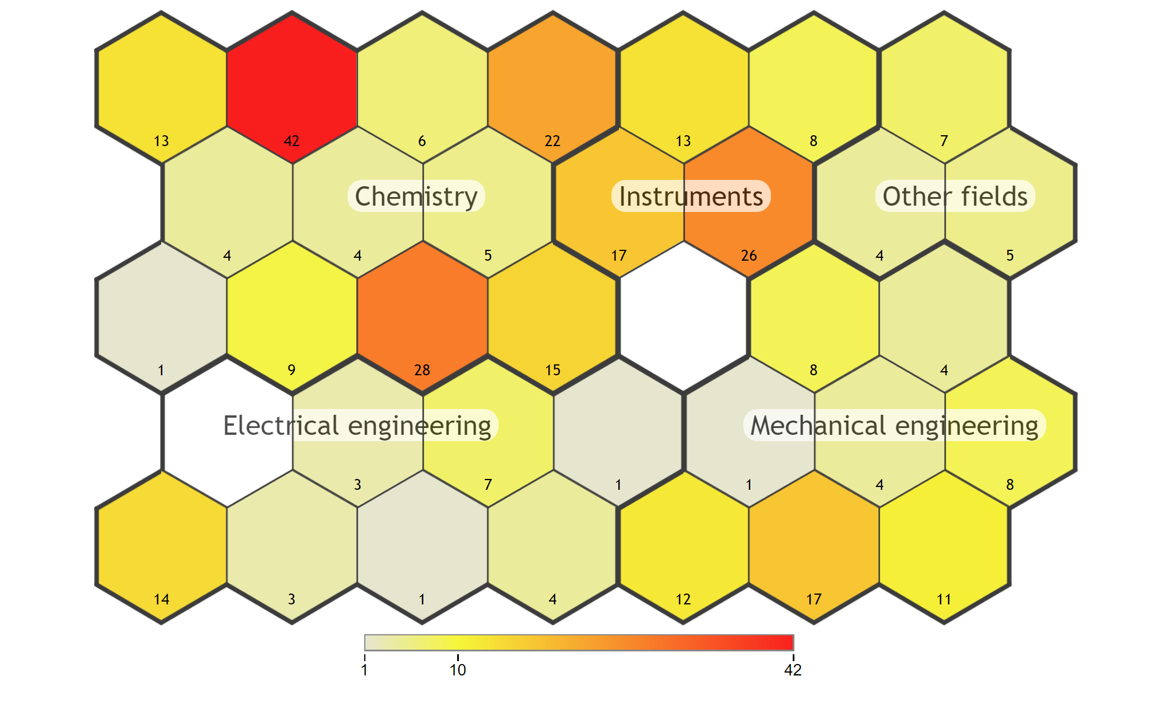
Main Clusters

Slide 9
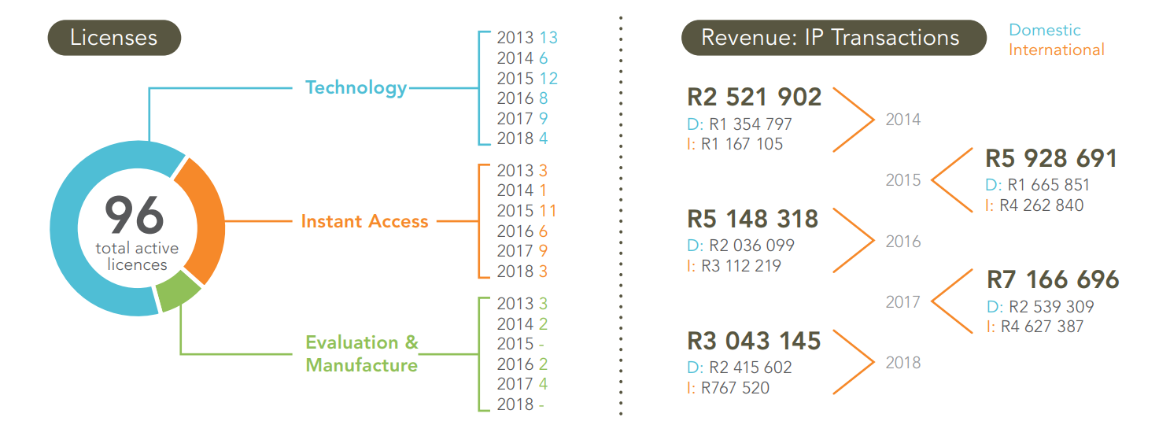
Commercialisation

Slide 10
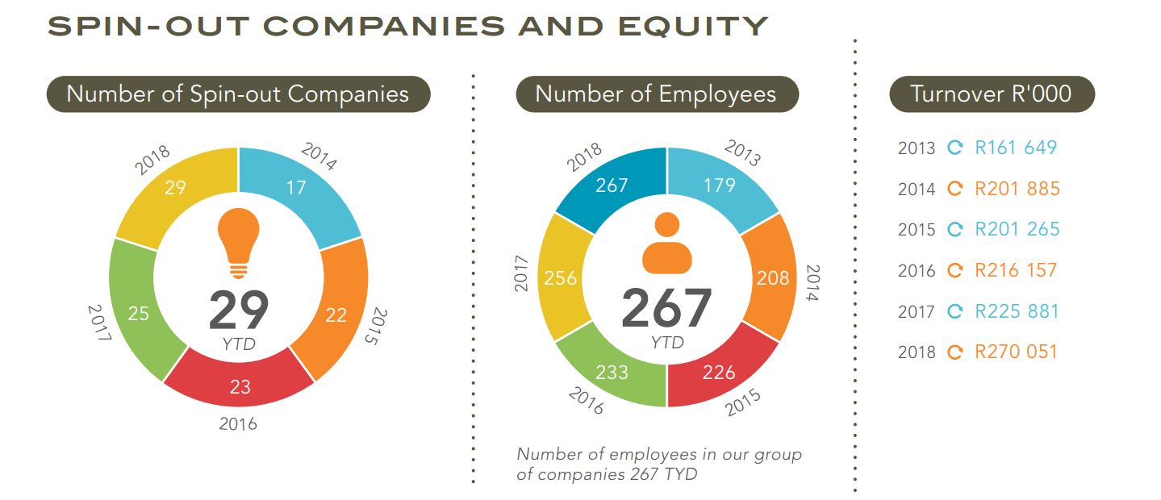
Spin-outs

Slide 11
















SU Group of Companies
SUN Magnetics (Pty) Ltd
Factory 209 (Pty) Ltd
Surfactant Medical Technologies (Pty) Ltd

Slide 12
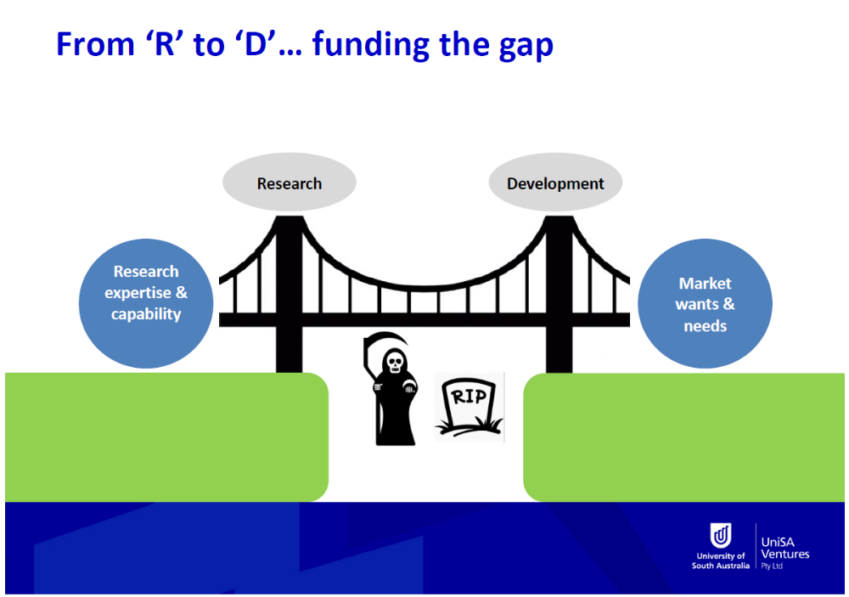
How?
Source: Presentation at KCA 2018 by Stephen Rodda (CEO – UniSA Ventures)

Slide 13
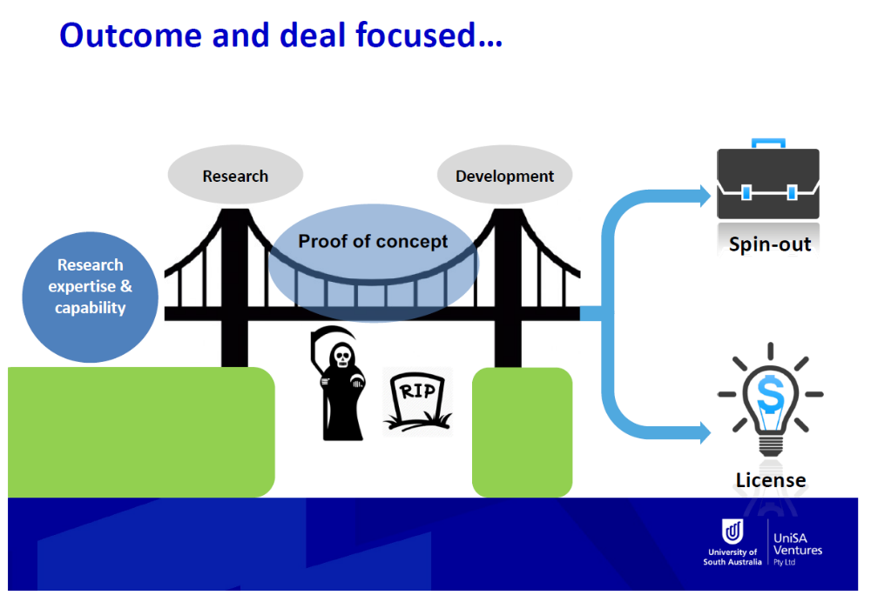
How?
Source: Presentation at KCA 2018 by Stephen Rodda (CEO – UniSA Ventures)

Slide 14
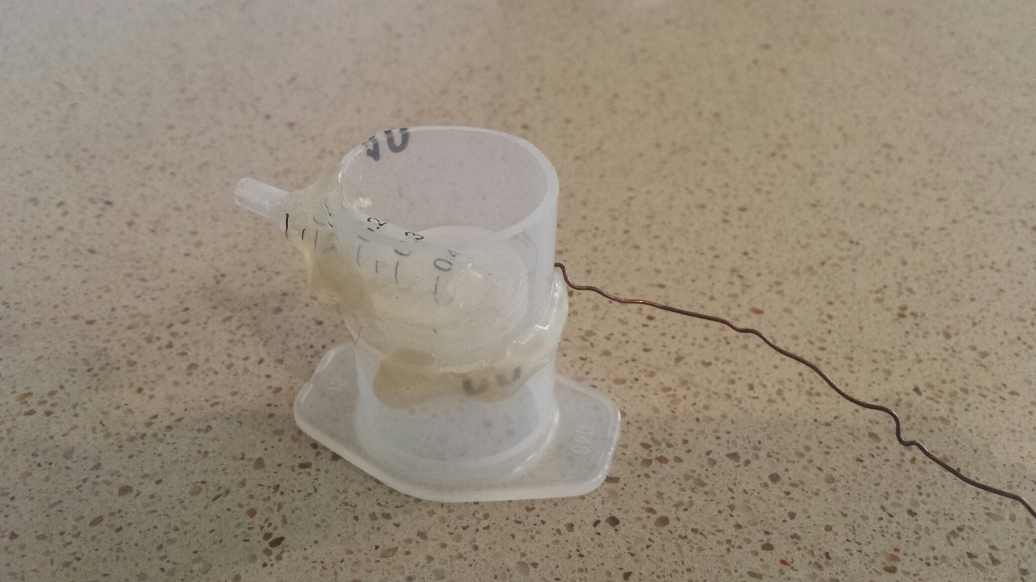
Not an easy task
Copper Wire
Syringes
Glue
Academic proofs of concepts often satisfies the research question asked, but rarely presents themselves as tangible products or prototypes with a clear route to market

Slide 15
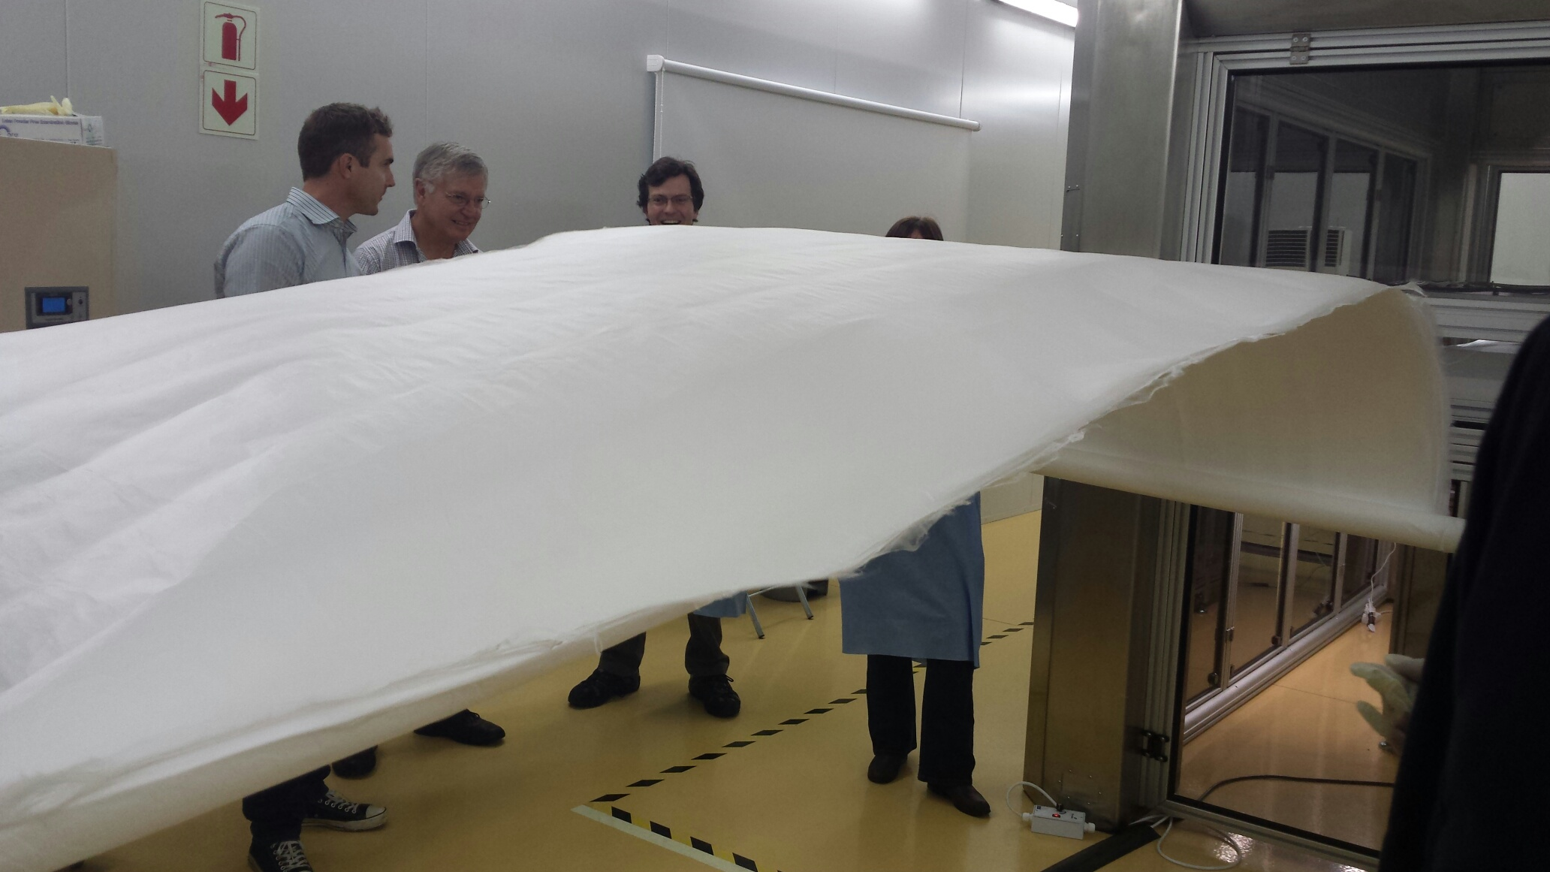
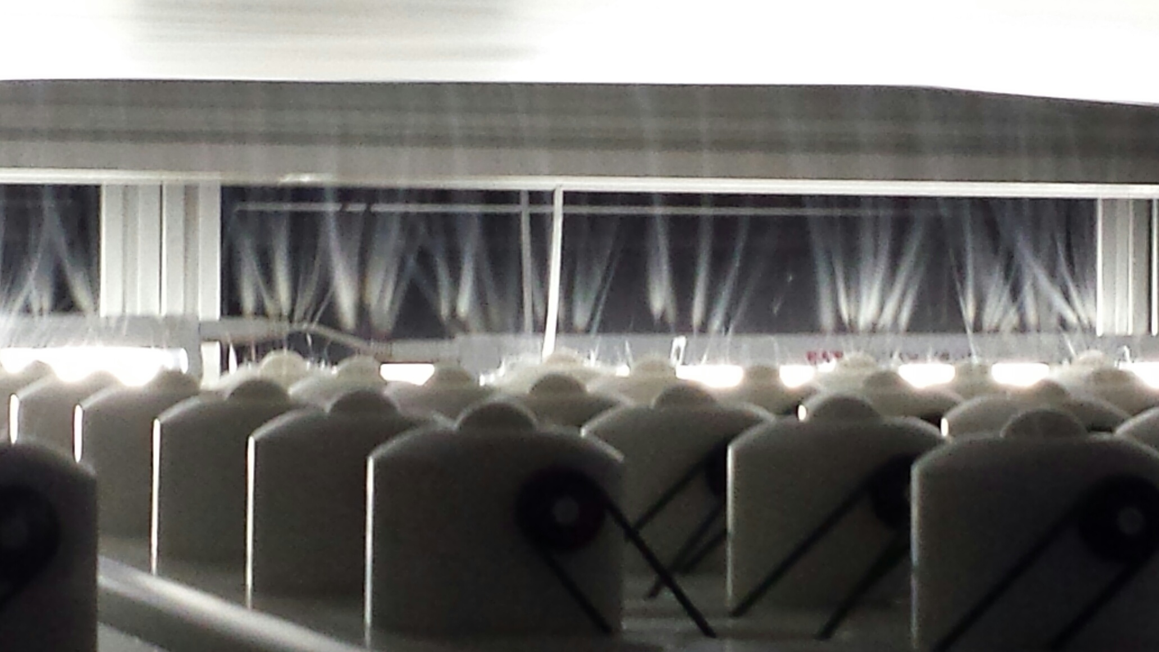
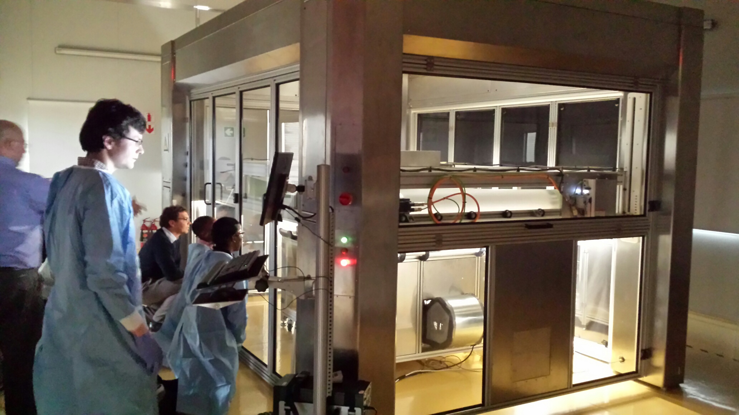
7 years later…

Slide 16
Bridging the gap
Early stage technology
  Technological risks/uncertainties
  Commercial risks/uncertainties
Assumptions need to be tested
  Actually, assumptions first need to be identified
Limited funding – need to prioritise assumption testing – what are the showstopper?

Slide 17

Creating Knowledge Regions

Slide 18


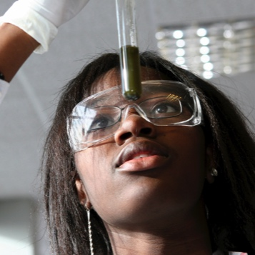

The changing role of universities
Teaching
Research
Innovation
Knowledge Regions
Graduates
Graduates
Publications
Graduates
Publications
IP
Industry
Researchers
Entrepreneurs

Slide 19














Attract entrepreneurs
Knowledge Regions
Attract VCs and angel investors
Attract multinationals
Critical mass of spin-off companies

Slide 20
Knowledge Regions:
WHY
STELLENBOSCH?

Slide 21
Facilitating
Valuable
Connections

Slide 22

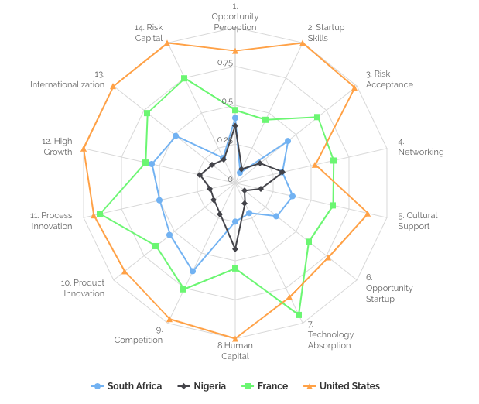
Where we focus
GLOBAL ENTREPRENEURSHIP DEVELOPMENT
INSTITUTE
www.thegedi.org/tool
Notes:
Focusing on these 2 themes from GEDI as challenges
First startup skills. And if you get that right you can build a sustainable business. Risk capital is not the goal, but it does follow sustainable and scalable businesses.

Slide 23
Coaching
What we do
Startup Skills
Value Proposition and Business Model Design
Due Diligence Development
Risk Capital
Funding and Support Network

Slide 24
Undergrads
SU Spinouts
Ecosystem
Who is the LaunchLab Community?
25%
10%
65%
Concepts to Prototype
Prototype to Post-revenue
Growth
50%
20%
30%

Slide 25
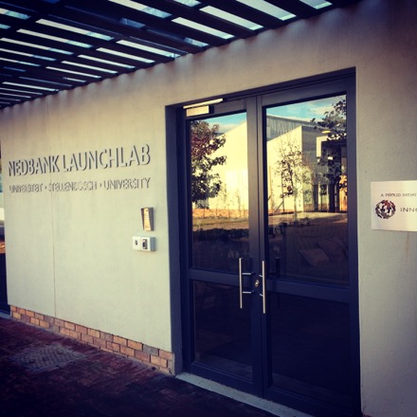
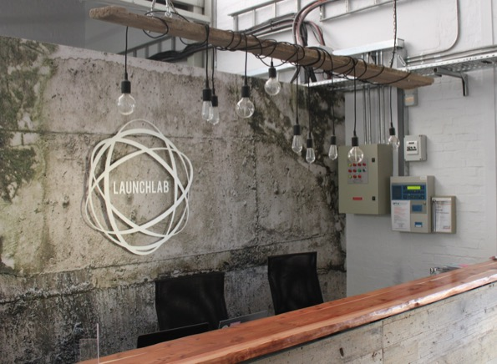
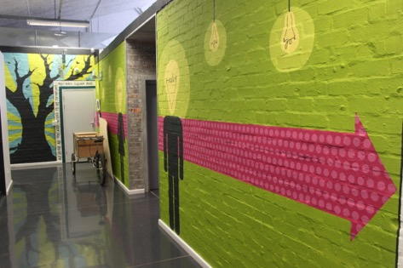
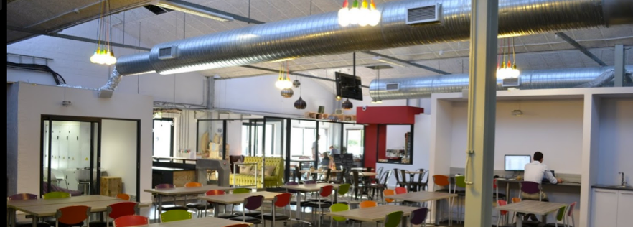

Slide 26

Contact
Joubert de Wet
Technology Transfer Manager
sjdewet@sun.ac.za
www.innovus.co.za
Brandon Paschal
Incubation Manager
brandon@launchlab.co.za
www.launchlab.co.za

