Slide 1

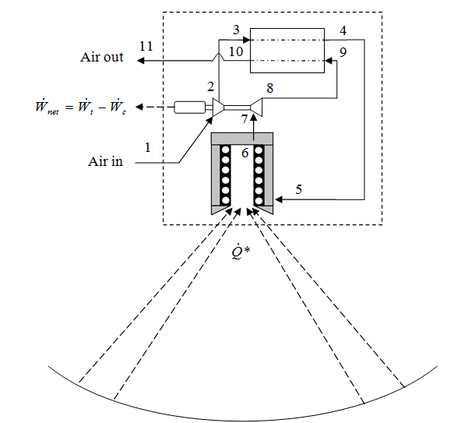
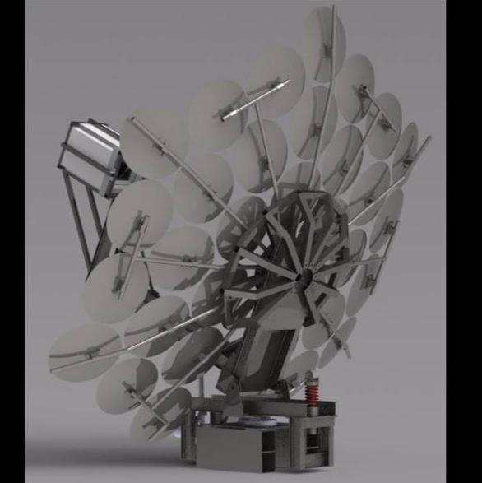

Recuperated solar-dish Brayton cycle with turbocharger and short-term thermal storage
Dr WG Le Roux
Department of Mechanical and Aeronautical Engineering,
University of Pretoria

Slide 2
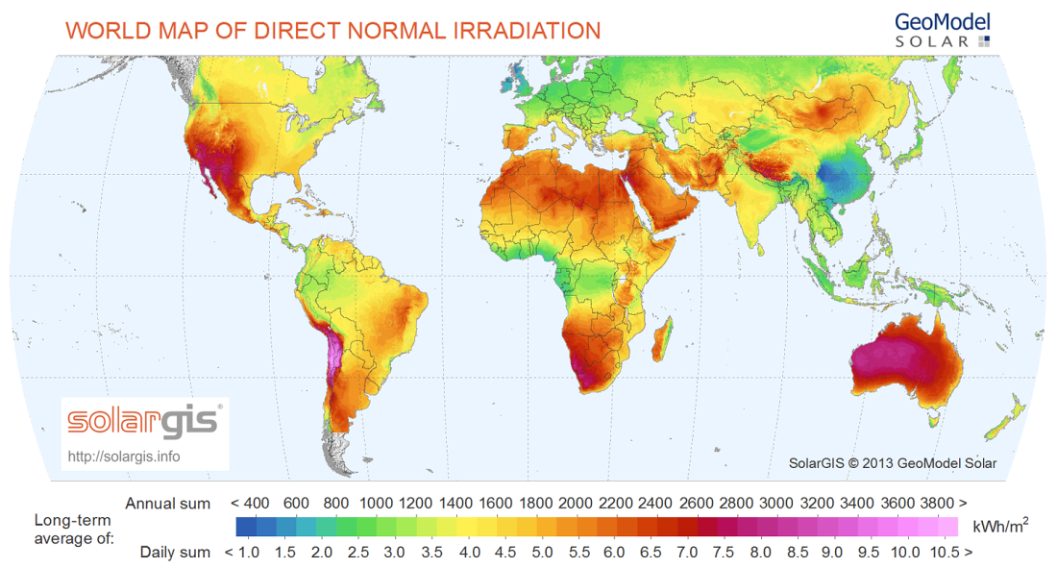
Background
Long-term average of direct normal solar irradiance on a world map showing the potential of solar power generation in southern Africa (GeoModel Solar, 2014)
2

Slide 3
Background
South Africa has one of the best solar resources in the world and this resource is free to use and study for all South Africans, who should take the lead in this field in terms of
  skills development,
  training and
  product manufacturing.
The research and development of solar dish technologies is a new and exciting research field in which all South African researchers of all age, race and gender can take the lead.
3

Slide 4
Background
Power generation
Water purification
Fuel production
4

Slide 5
Presentation Outline
Introduction and Background
Problem and Purpose
Methodology
Results and Discussion
Conclusion
Progress to date (Solar@UP)
  Solar radiation in Pta
  New dish concept
  Moonlight testing
  Receiver testing
  Recuperator testing
5

Slide 6
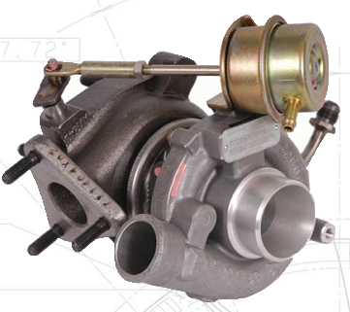

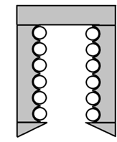

1. Introduction
3
4
11
10
9
Air out
2
8
7
1
6
Proposed turbocharger to use as micro-turbine
(Image extracted from Garrett, 2014)
Air in
Solar-Dish Brayton Cycle
small-scale
dish-mounted
with recuperator
1-20kW
turbocharger
open-cavity tubular receiver
5
6

Slide 7
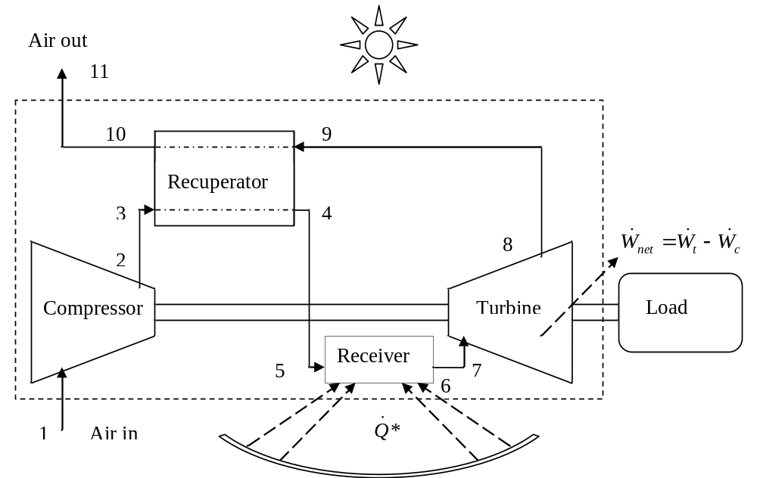
1. Introduction
The small-scale dish-mounted solar thermal Brayton cycle with recuperator (STBC)
7

Slide 8
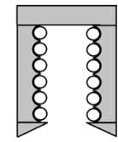
1. Introduction
Solar thermal Brayton cycle
advantages
Air as working fluid
Turbocharger as micro-turbine
Can also be powered with gas (hybrid system)
Water heating (cogeneration)
High efficiency potential (reheat and intercooling)
Mobility
Cost benefits (bulk manufacturing)
Thermal storage
Quicker to commercialise (prototyping is quicker and cheaper)
Large-scale local manufacturing – good for the economy (good for South Africa)
Micro-grids
11
3
4
Air out
10
9
2
8
7
Air in
1
6
5
8

Slide 9
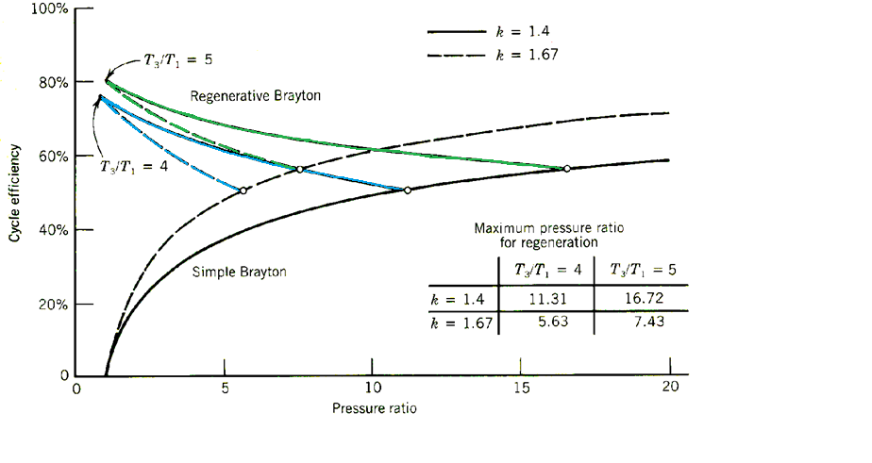
1. Introduction
Solar thermal Brayton cycle advantages
Recuperator
  allows for higher efficiency at lower compressor pressure ratios
  allows for a less complex receiver (operating at lower pressure and smaller temperature increase)
Image extracted from: Stine, B.S., Harrigan, R.W., 1985, Solar energy fundamentals and design. New York: John Wiley & Sons, Inc.
9

Slide 10
1. Introduction
Solar thermal Brayton cycle advantages
Turbocharger
  The maximum inlet temperature of an off-the-shelf turbocharger is about 1223 K (Garrett, 2014; Shah, 2005) and 1323 K intermittently.
Proposed turbocharger to use as micro-turbine
(Image extracted from Garrett, 2014)
10

Slide 11
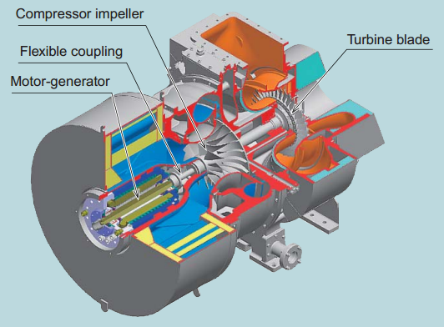
1. Introduction
Turbocharger
  Generator coupling
Range extenders in electric vehicles
Generator coupling – simple, robust, easy to maintain
(Image extracted from Shiraishi and Ono, 2007)
11

Slide 12
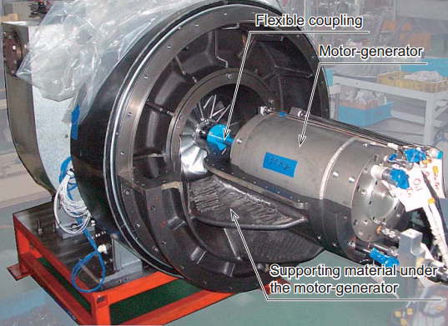
1. Introduction
Turbocharger
  Generator coupling
Generator coupling – simpe, robust, easy to maintain
(Image extracted from Shiraishi and Ono, 2007)
12

Slide 13
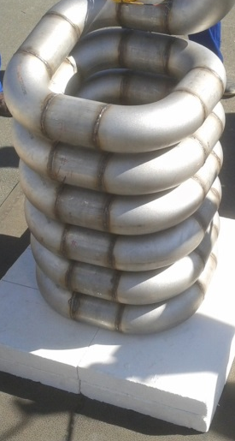
1. Introduction – Open cavity tubular receiver
Receiver dimensions optimised in a previous work (Le Roux et al., 2014)
13

Slide 14
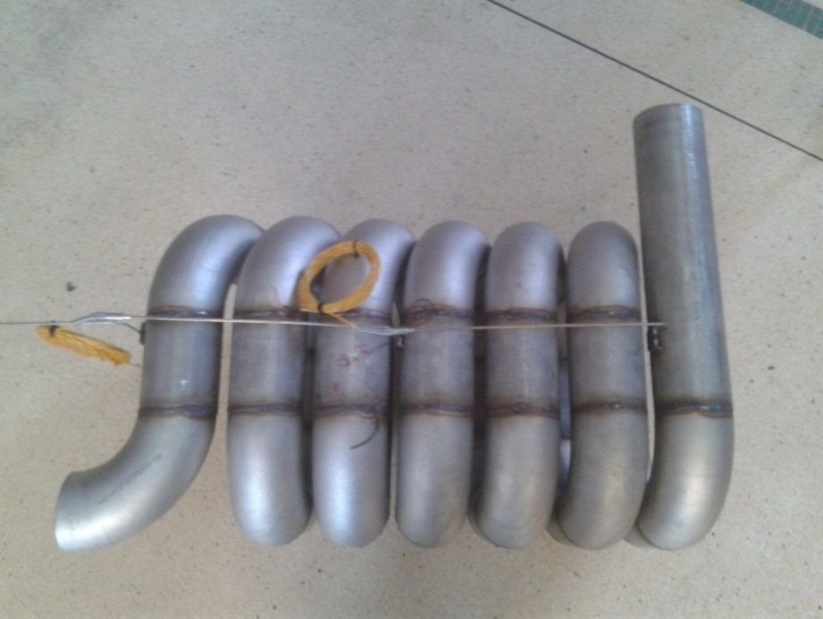
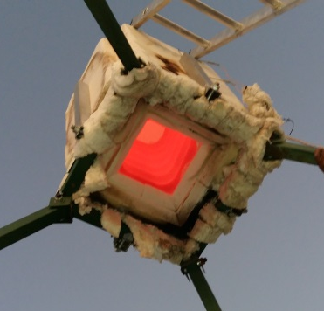
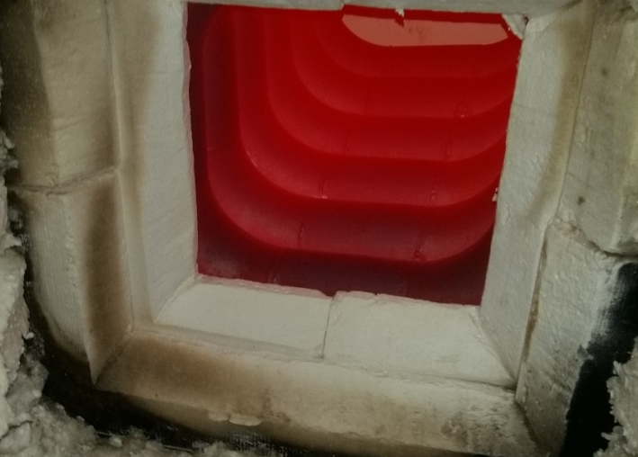
1. Introduction – Open cavity tubular receiver
Heat up insulated receiver to 857 °C
  using 86 kW LPG flame from Sievert burner
Inlet
Outlet
14

Slide 15
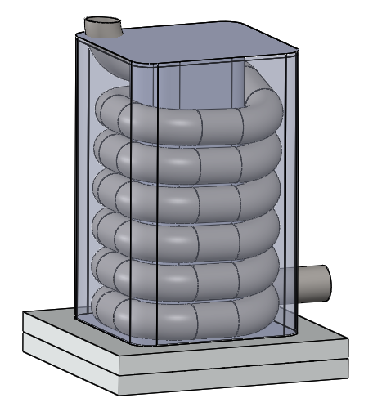
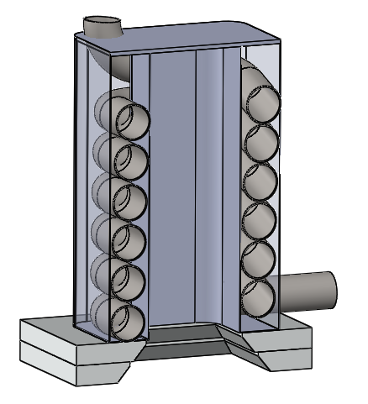
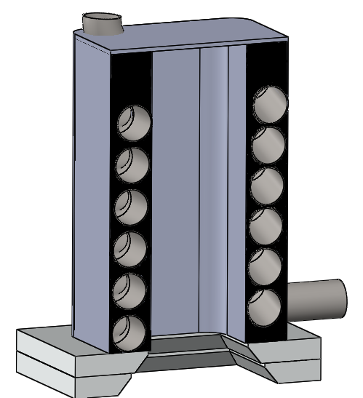
1. Introduction – Brayton cycle thermal storage
15

Slide 16
1. Introduction – Brayton cycle thermal storage
16

Slide 17
1. Introduction
Thermal storage
  Lithium fluoride (Cameron et al., 1972; Asselman, 1976)
  Packed rock beds (Allen, 2010; Ozturk et al., 2019),
  Encapsulated sodium sulphate (Klein, 2016)
  Phase-change materials can be used to provide a stable turbine inlet temperature;
    however, most phase-change materials have a low thermal conductivity of around 0.5 W/mK (Liu et al., 2012).
    metallic phase-change materials have higher thermal conductivities.
    Other materials such as salt composites and inorganic salts have limited applications because of large volume changes during melting as well as corrosion issues (Liu et al., 2012).
17

Slide 18
1. Introduction (Solar-dish Brayton cycle)
– Metallic phase-change materials (Liu et al. 2012)
Phase-change material | Composition (wt%) | Melting temperature (K) | ρ (kg/m³) | c_{p,solid} (J/kgK) | c_{p,liquid} (J/kgK) | k (W/mK) | Latent heat, L_{f} (kJ/kg)
Mg |  | 921 | 1740 | 1270 | 1370 |  | 365
Al |  | 933 | 2700 | 900 | 1100 | 186 | 397
Zn–Cu–Mg | 49/45/6 | 976 | 8670 | 420 |  |  | 176
Cu–P | 91/9 | 988 | 5600 |  |  |  | 134
Cu–Zn–P | 69/17/14 | 993 | 7000 |  |  |  | 368
Cu–Zn–Si | 74/19/7 | 1038 | 7170 |  |  |  | 125
Cu–Si–Mg | 56/27/17 | 1043 | 4150 | 750 |  |  | 420
Mg–Ca | 84/16 | 1063 | 1380 |  |  |  | 272
Mg–Si–Zn | 47/38/15 | 1073 |  |  |  |  | 314
Cu–Si | 80/20 | 1076 | 6600 | 500 |  |  | 197
Cu–P–Si | 83/10/7 | 1113 | 6880 |  |  |  | 92
Si–Mg–Ca | 49/30/21 | 1138 | 2250 |  |  |  | 305
Si-Mg | 56/44 | 1219 | 1900 | 790 |  | 70 | 757
18

Slide 19
2. Problem and Purpose
Problem
  the phase-change temperature affects the solar conversion efficiency
Purpose of the study
Determine maximum thermal efficiency of the cycle for
  an off-the-shelf turbochargers
  various recuperator geometries
  fixed receiver geometry
  Metallic phase-change material at different solar receiver temperatures
19

Slide 20
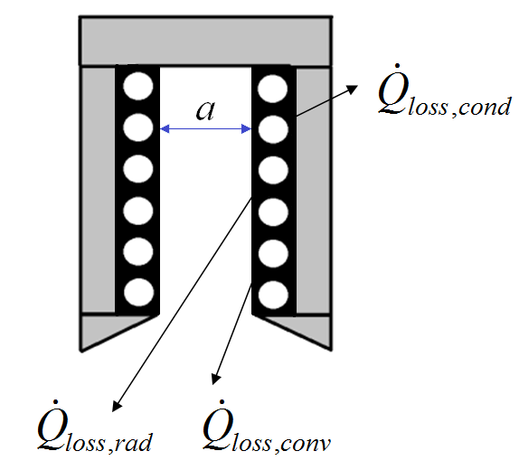
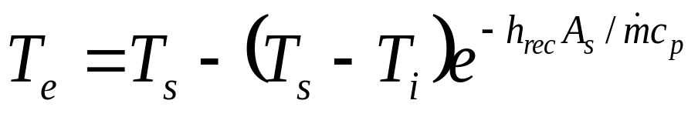
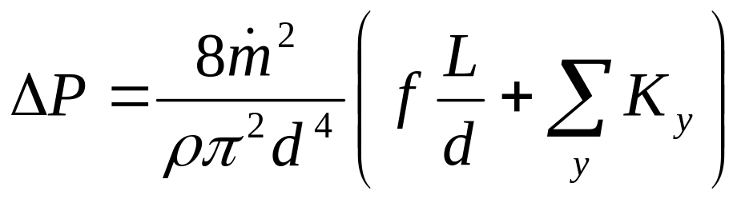
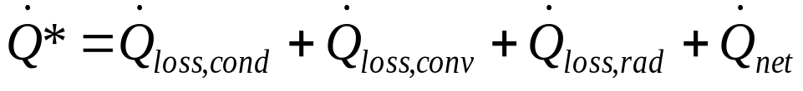
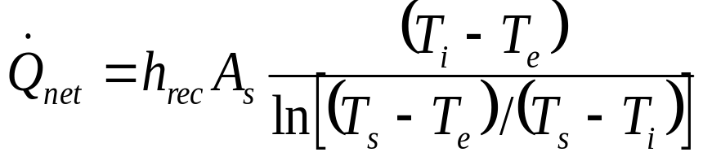
3. Methodology - Receiver
Assumptions for receiver:
Constant surface temperature tube, at steady state (T_{s} = PCM temperature
Koenig and Marvin heat loss model for cavity receiver
20

Slide 21
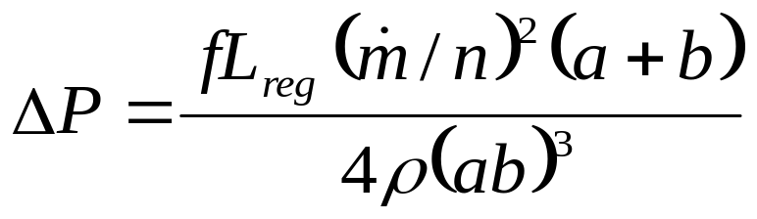
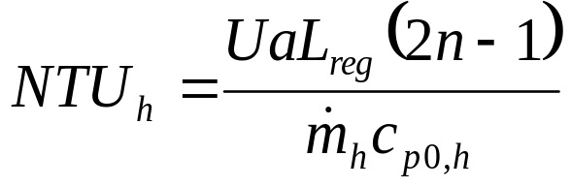
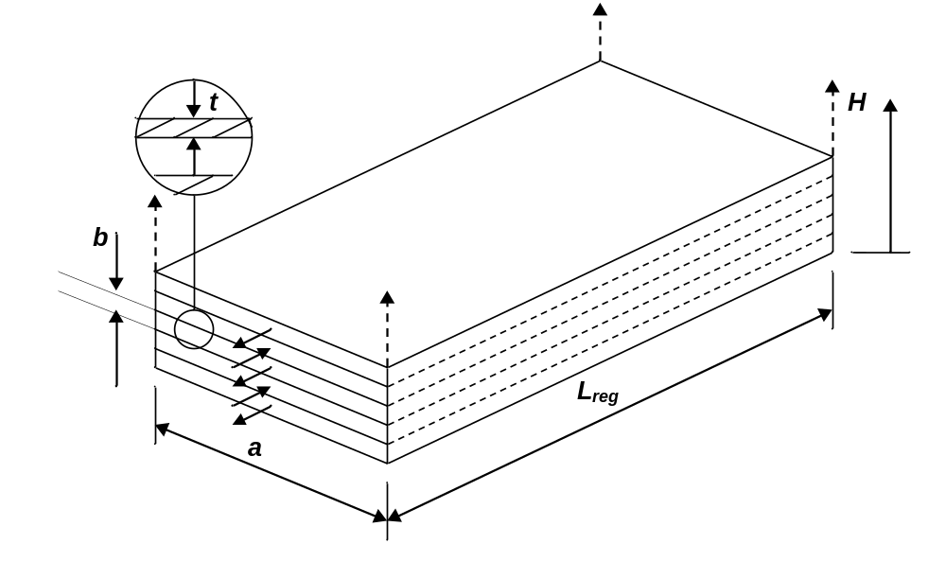
3. Methodology - Recuperator
Assumptions for recuperator:
Effectiveness-NTU model including heat loss to the environment (Nellis and Pfotenhauer, 2005)
21

Slide 22
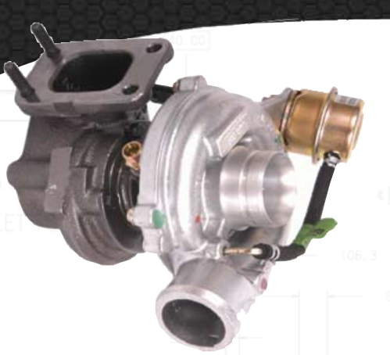
3. Methodology - Turbocharger
Assumptions for turbocharger:
Determine mass flow rate and pressure ratios from the compressor map and turbine map (GT2052)
22

Slide 23
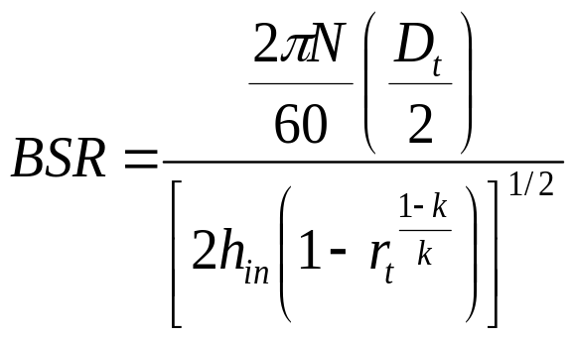
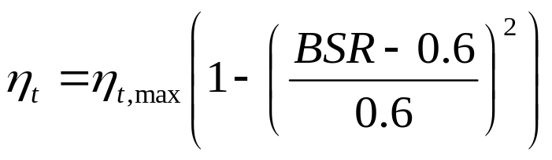
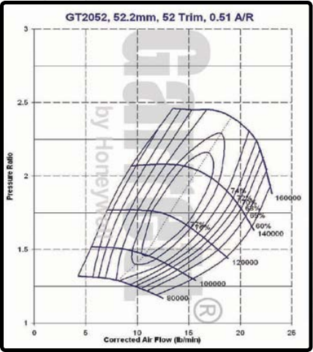
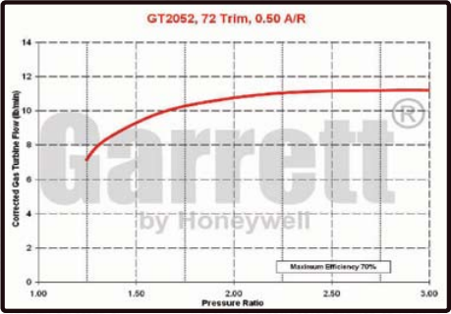
3. Methodology - Turbocharger
Assumptions for turbocharger:
Determine mass flow rate and pressure ratios from the compressor map and turbine map
23

Slide 24
3. Methodology – Parameters
Power output calculation:
The MATLAB program has the following stucture:
For Ts = 900:100:1200,
For each turbine pressure ratio (rt) in the operating range of the turbine,
For each recuperator design (625 different combinations),
Find net power output and efficiency
of cycle.
24

Slide 25
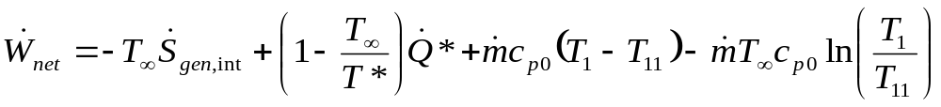
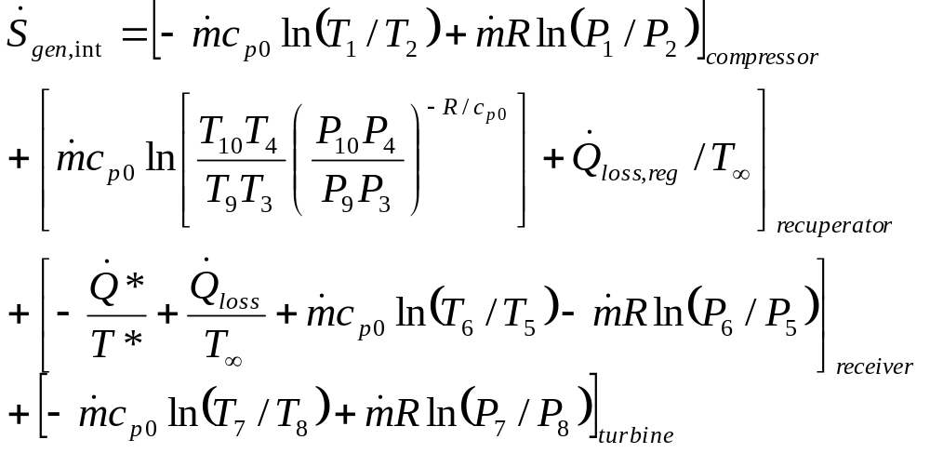
3. Methodology – Net power output
Entropy generation minimisation to optimise geometries of components for a common goal
25

Slide 26
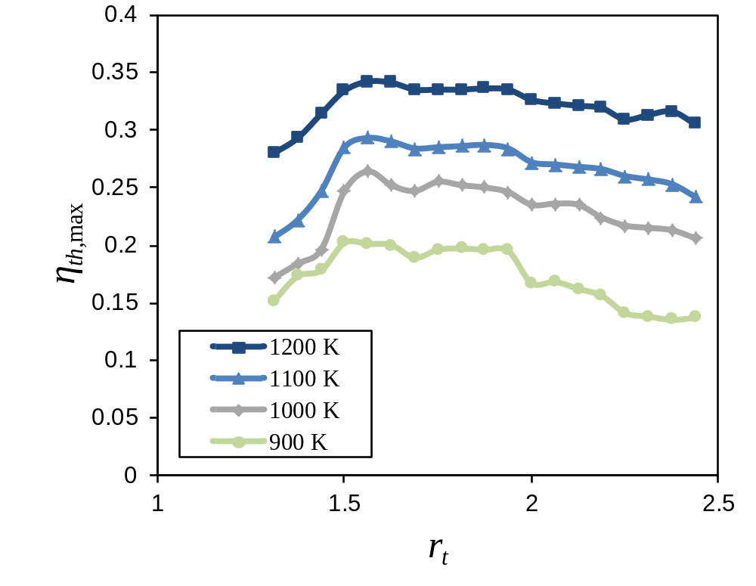
4. Results and discussion- thermal efficiency
Maximum thermal efficiencies of 20.2% to 34.2%
Maximum thermal efficiency of the cycle for different turbine pressure ratios and receiver tube surface temperatures (for GT2052).
26

Slide 27
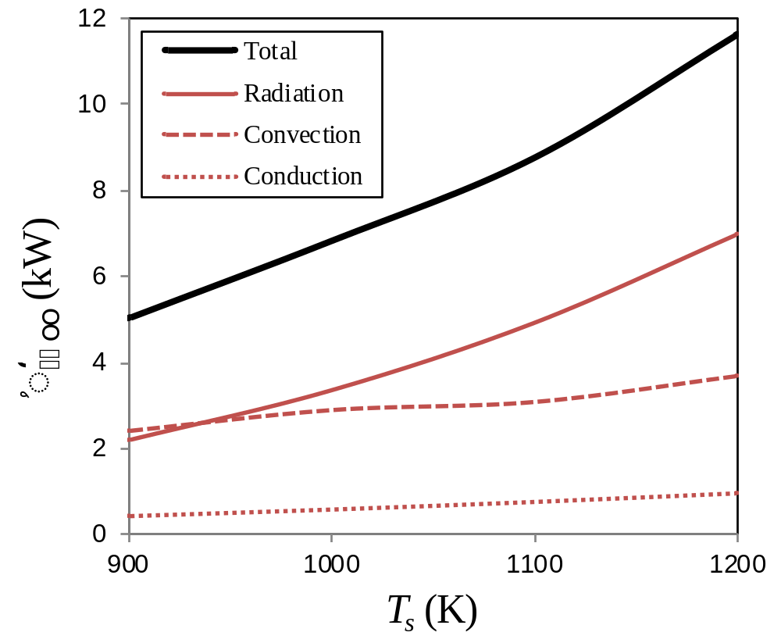
4. Results and discussion – receiver heat loss
Heat loss rate from the solar receiver as a function of tube surface temperature.
27

Slide 28
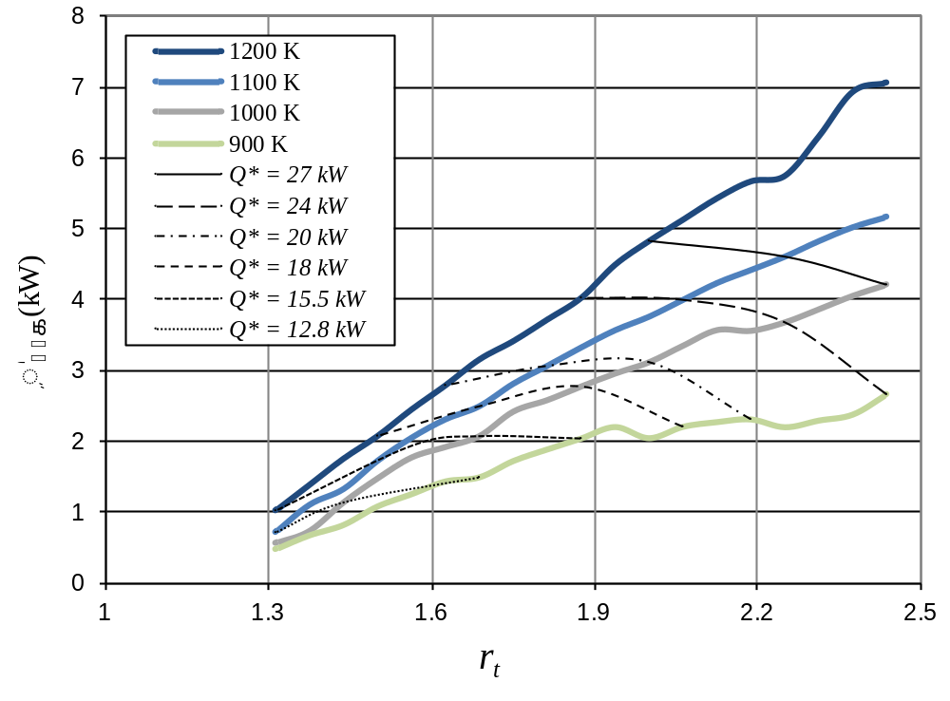
4. Results and discussion – performance map
Net power output at maximum thermal efficiency for GT2052 as a function of dish size
28

Slide 29
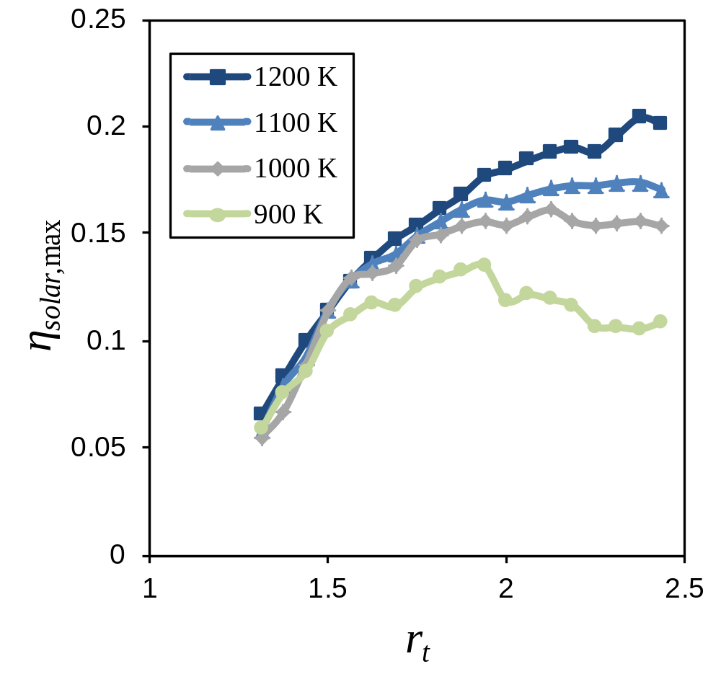
4. Results and discussion – solar conversion efficiency
Maximum solar conversion efficiencies of 13.5% to 21% can be achieved at receiver temperatures of between 900 K and 1200 K.
Maximum solar conversion efficiency for GT2052.
29

Slide 30
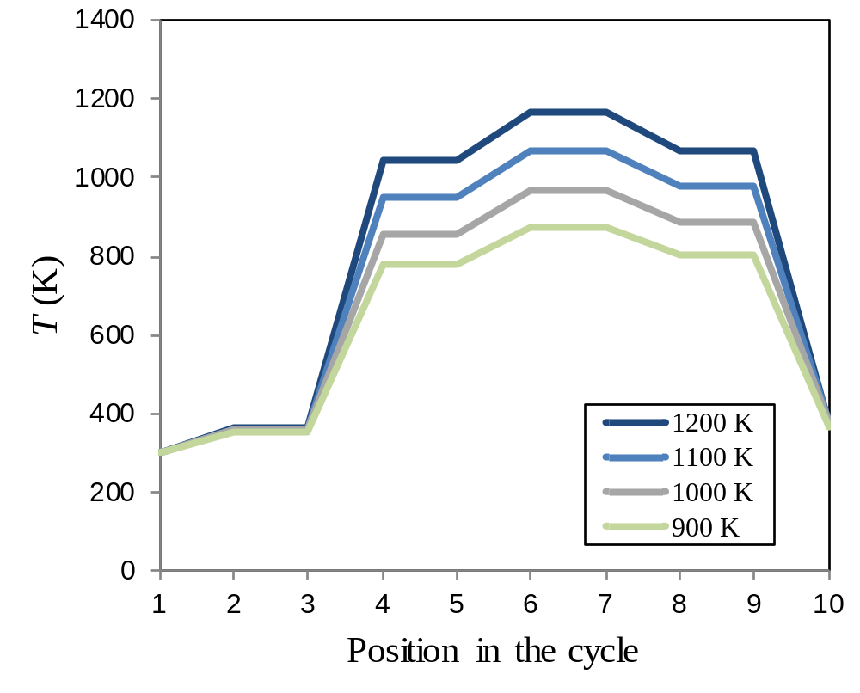
4. Results and discussion
Temperature in the cycle at different receiver surface temperatures for maximum thermal efficiency (for GT2052).
30

Slide 31
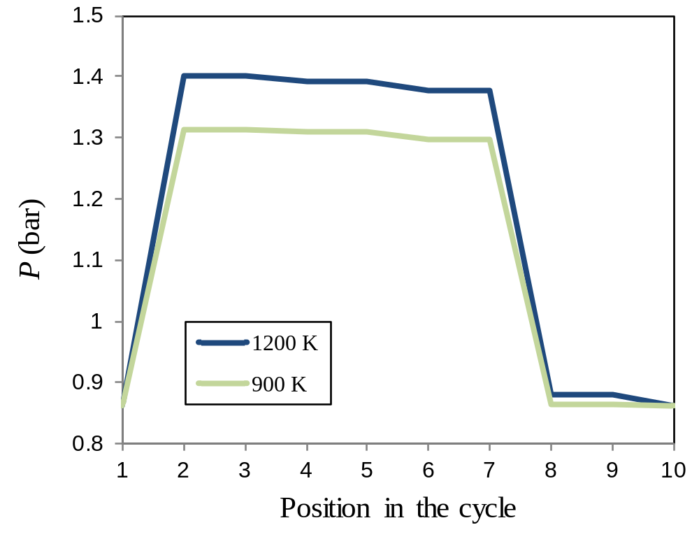
4. Results and discussion
Pressure in the cycle at different receiver surface temperatures for maximum thermal efficiency (for GT2052).
31

Slide 32
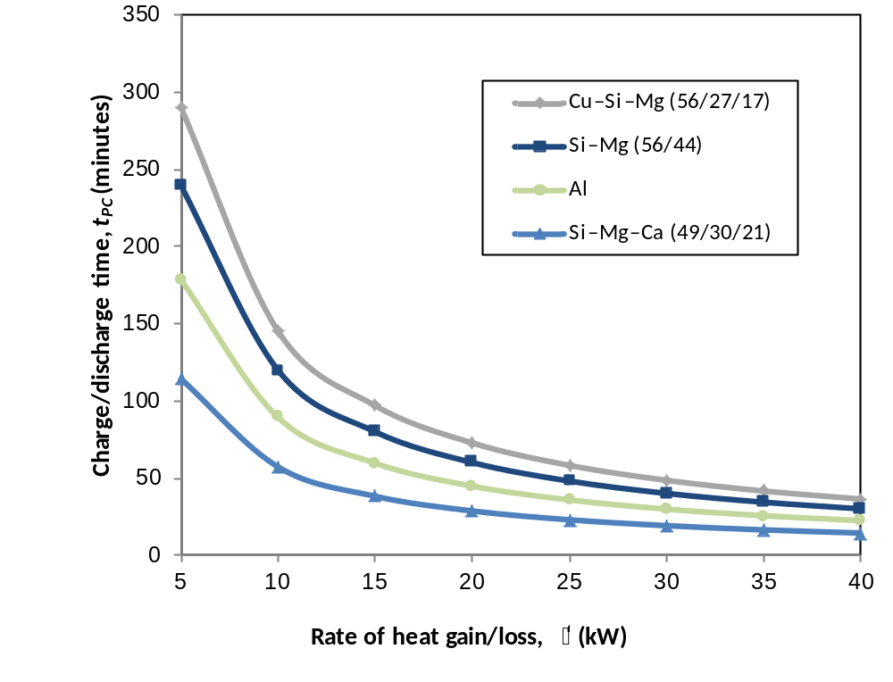
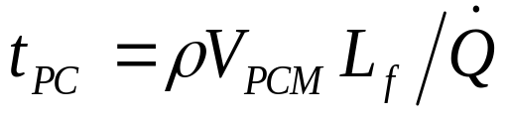
4. Results and discussion – storage time
Thermal storage time available at the phase-change temperature.
For V_{PCM} = 0.05 m³
32

Slide 33
4. Results and discussion – storage time
For V_{PCM} = 0.05 m³
Molten aluminum in the receiver at 933 K, could be worth investigating further as a simple and low-cost solar-dish Brayton cycle configuration.
33

Slide 34
5. Conclusion
Solar-dish Brayton cycle advantages:
  air as working fluid
  cogeneration
  hybridisation
  thermal storage
  cost benefits, benefits for the economy
Problem - the phase-change temperature affects the solar conversion efficiency
Purpose
  Determine maximum thermal efficiency of the cycle for
    off-the-shelf turbocharger
    various recuperator geometries
    fixed receiver geometry
    metallic phase-change material at different solar receiver temperatures
34

Slide 35
5. Conclusion
Maximum thermal efficiencies of 20.2% to 34.2%
Maximum solar conversion efficiencies of 13.5% to 21% can be achieved at receiver temperatures of between 900 K and 1200 K.
Overall, the results show that an open-cavity tubular solar receiver with metallic phase-change thermal storage material can be used together with an off-the-shelf turbocharger for power generation in a recuperated solar-dish Brayton cycle.
The GT2052 operating with molten aluminium in the receiver is recommended for further analytical and experimental investigation.
35

Slide 36
Solar@UP
Dr WG Le Roux
TIA funded project:
Building a prototype:
Recuperated solar-dish Brayton cycle with turbocharger
Department of Mechanical and Aeronautical Engineering,
University of Pretoria

Slide 37
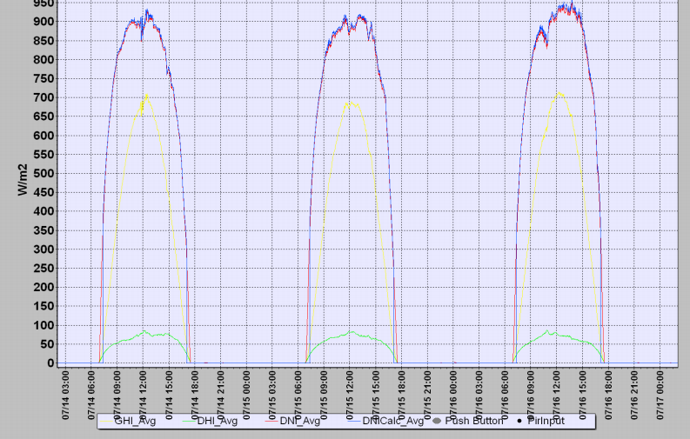
Solar @ UP – Very good DNI (SAURAN)

Slide 38
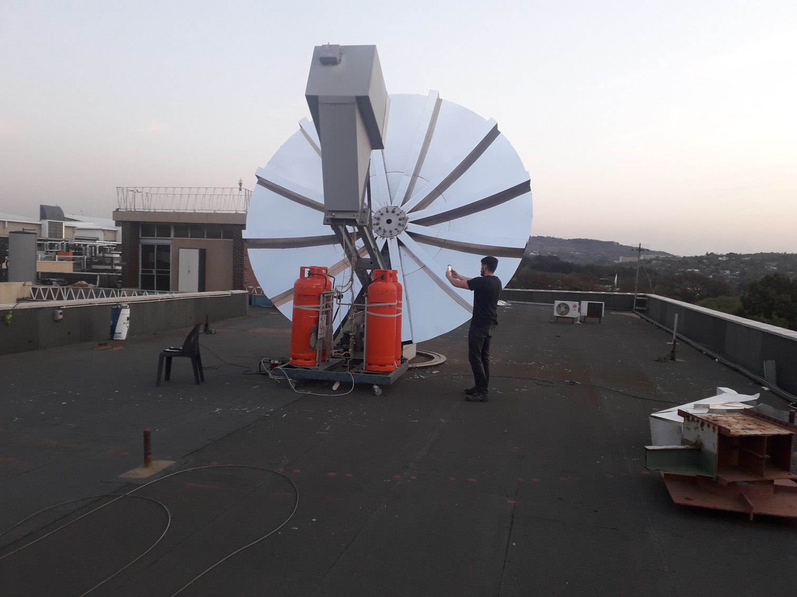
Solar @ UP – old dish

Slide 39
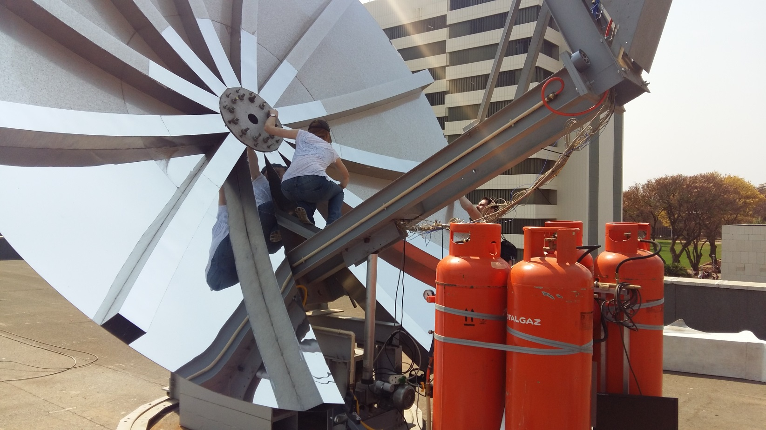
Solar @ UP – old dish

Slide 40
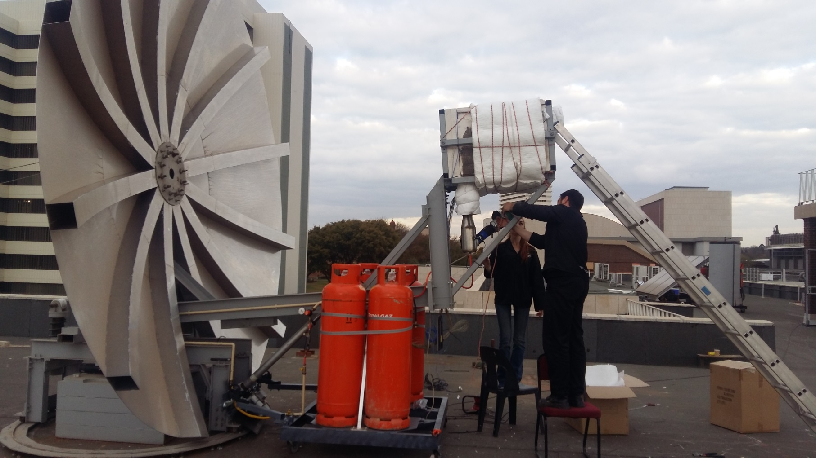
Solar @ UP – old dish

Slide 41
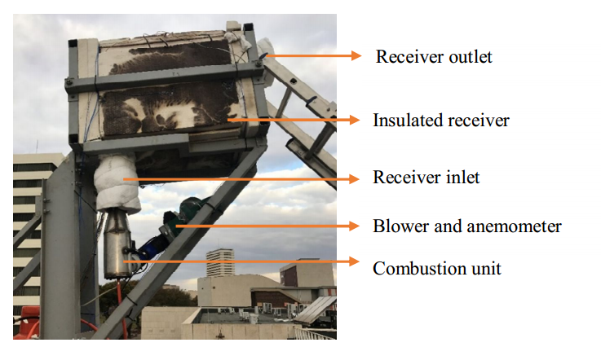
Solar @ UP – Solar receiver testing

Slide 42
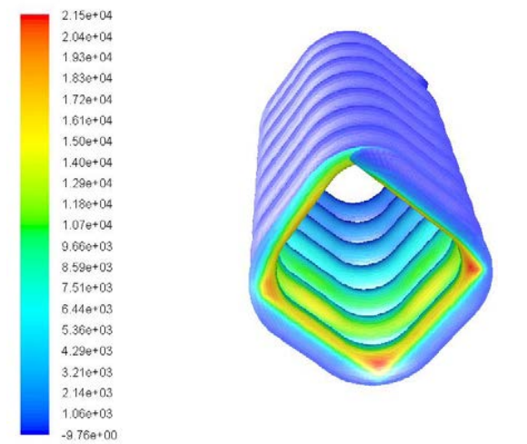
Solar @ UP – CFD (Prof. Ken Craig)

Slide 43
Solar @ UP – new dish

Slide 44
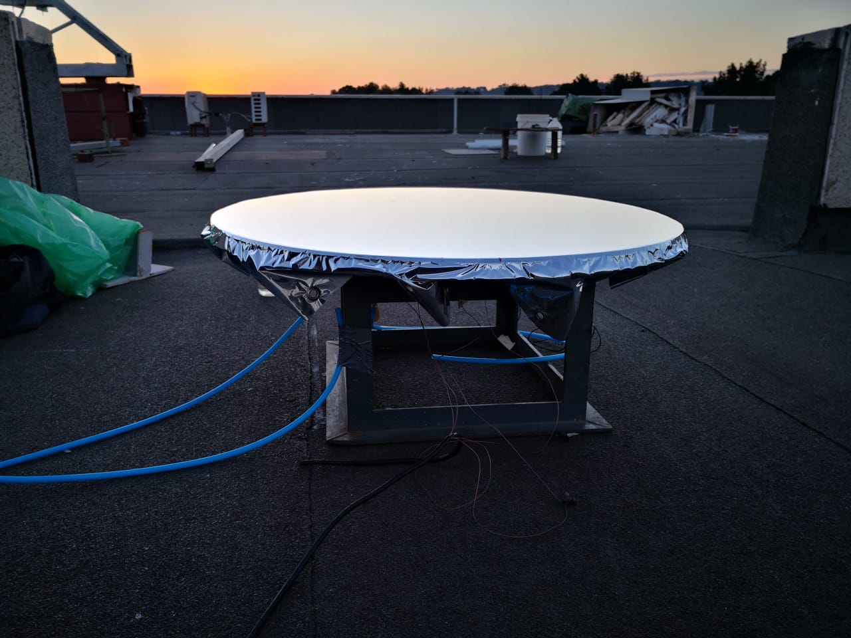
Solar @ UP – new dish

Slide 45
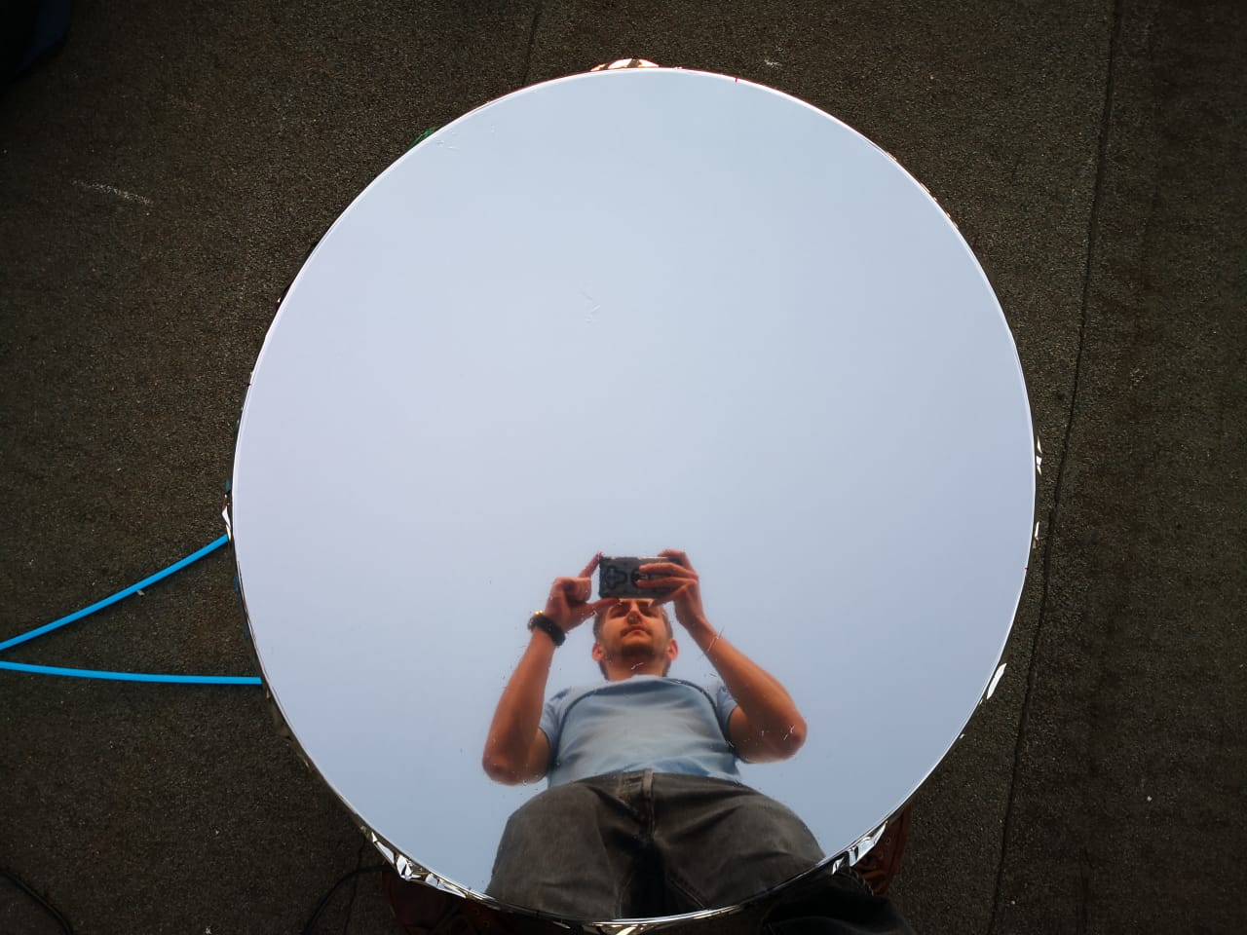
Solar @ UP – new dish

Slide 46
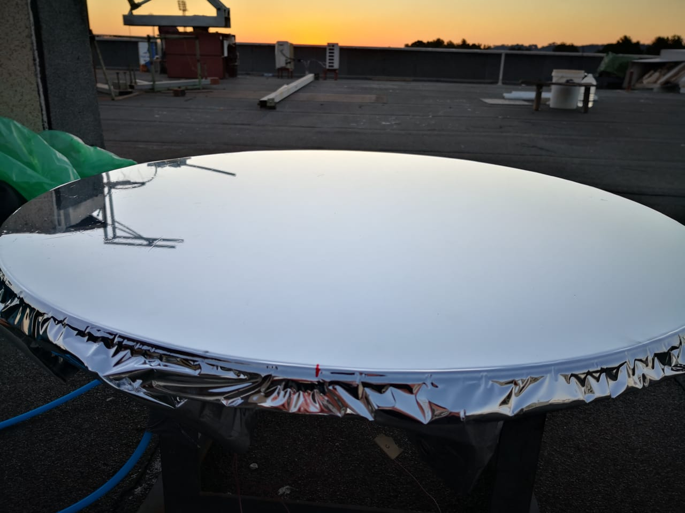
Solar @ UP - new dish

Slide 47
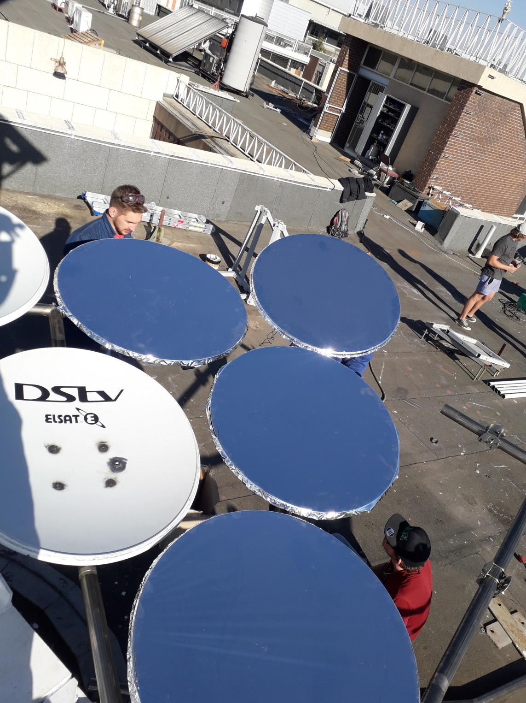
Solar @ UP – new dish

Slide 48

Solar @ UP – new dish (photogrammetry)

Slide 49

Solar @ UP – New dish (Moonlight testing)

Slide 50

Solar @ UP – New dish (Moonlight testing)

Slide 51

Solar @ UP

Slide 52

Solar @ UP – New dish (Moonlight testing)

Slide 53

Solar @ UP – New dish (Moonlight testing)

Slide 54

Solar @ UP – New dish (Moonlight testing)

Slide 55

Solar @ UP – Smaller dish setup (moonlight testing)

Slide 56

Solar @ UP – Smaller dish setup (moonlight testing)

Slide 57

Solar @ UP – Smaller dish setup (moonlight testing)

Slide 58

Solar @ UP – Smaller dish setup (moonlight testing)

Slide 59

Solar @ UP
– Moonlight testing for flux mapping

Slide 60

Solar @ UP
– Moonlight testing for flux mapping

Slide 61

Solar @ UP – Recuperator testing

Slide 62
Acknowledgements
This work is based on the research supported by the
  Technology Innovation Agency (TIA),
  National Research Foundation (NRF),
  Royal Society, UK,
SAURAN is acknowledged for the data used (temperature and wind measurements)
62

Slide 63
Thank you
Questions?
willem.leroux@up.ac.za
63

