Slide 1
The design and construction challenges of utility scale PV plants
Abri Stegmann - July 2019

Slide 2
Introduction
My background:
Stellenbosch studies
Scatec Solar
  An Independent Power Producer who develops, designs, builds, owns and operates utility scale PV plants all around the world.
  ~1 GW of PV in operation
  Projects in South Africa, Rwanda, Egypt, Brazil, Honduras, Malaysia, Ukraine, Argentina, Mozambique, Jordan, soon Vietnam.
  Targeting 3.5 GW by 2021
Today I’ll speak about:
The typical challenges that we face in the utility scale solar industry.
  Design challenges
  Construction challenges
  Examples
  25 min presentation and 5 min for Q&A
Notes:
Studies here under the CRSES, first in wind energy and then I saw the light.
Dr. Straus, Dr. Rix, Prof van Niekerk, Prof Kamper, etc.

Slide 3
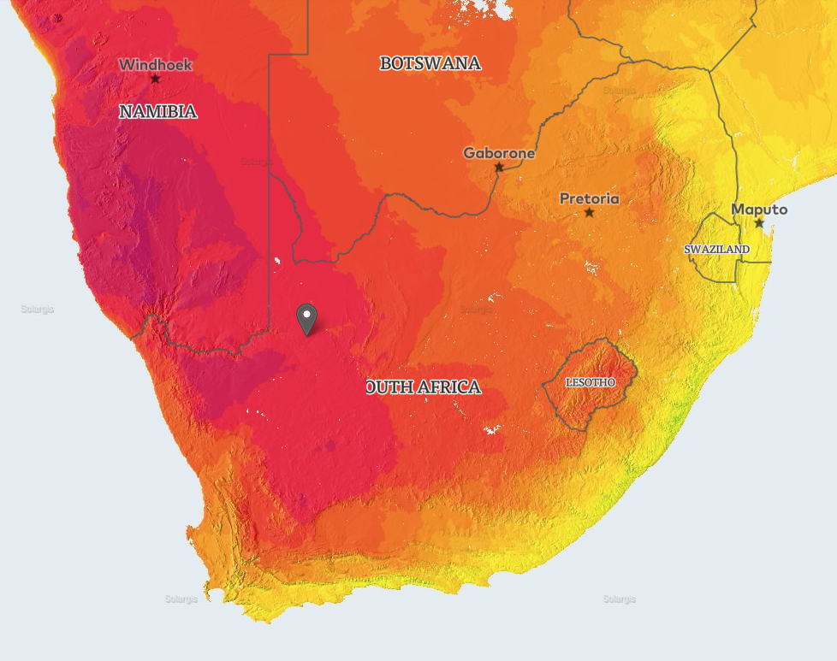
Introduction
Snapshot of a Utility Scale PV Plant
REIPPP R4 Upington sites:
3 x 86 MWdc plants located in close proximity
~700 000 PV modules
1 020 000 km of DC cable
180 x 1.45 MW inverters
60 x 4.7 MW transformers
720 x single-axis tracker drive systems
130 000 tracker sub-structure posts
24 weather stations
30 000 SCADA signals
600 Ha of land covered
Notes:
TT

Slide 4
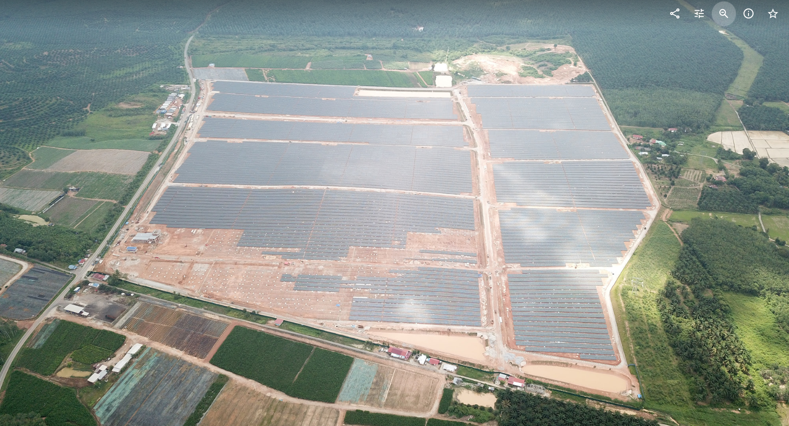
Introduction
Snapshot of a Utility Scale PV Plant
65 MWp
Gurun Malaysia
Notes:
TT

Slide 5
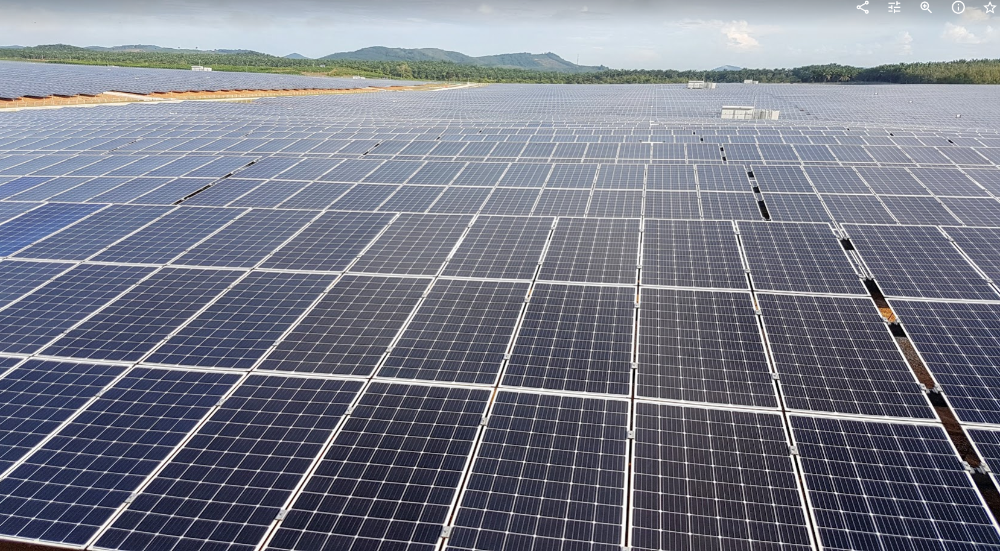
Introduction
Snapshot of a Utility Scale PV Plant
65 MWp
Gurun Malaysia
Notes:
TT

Slide 6
Design challenges
Notes:
TT

Slide 7
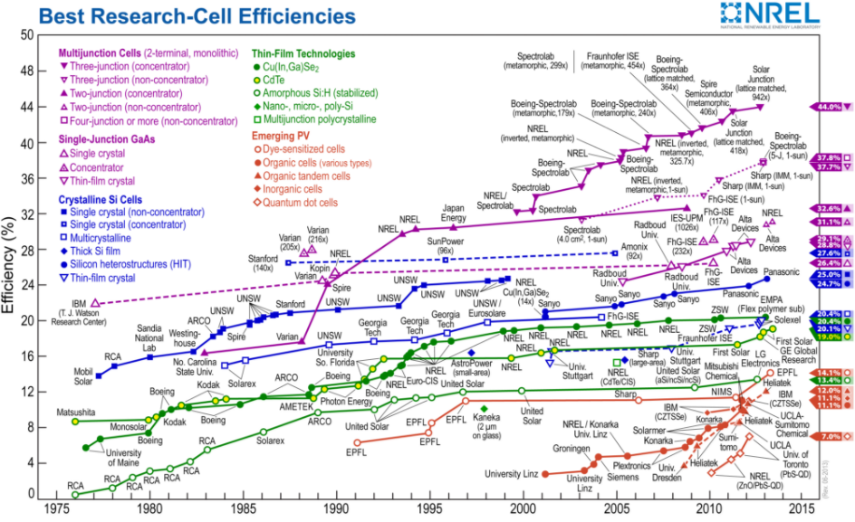
Design challenges
Constantly new technologies: PV Modules
Notes:
TT

Slide 8
Design challenges
Constantly new technologies: PV Modules
2013 – 240Wp modules
2019 – 410Wp modules
Ordering a module in 2013: Please give me a poly-Si 240Wp module
Ordering a module in 2019: Please give me a mono-Si, PERC, Bi-facial, Double glass, 1 500Vdc rated module with an anti-reflective coating, light reflective film, half cut cell, triple busbar, 1.2m long 4mm² string cable with MC4-compatable cable terminations. Don’t even specify the watt-class…
Manufacturers have so many options that it is difficult to compare them to each other.
Manufacturer: What do you want? Me: What do you have? Manufacturer: What do you need? Me: I don’t know what I need. What do you offer? Manufacturer: We offer whatever you require.
Notes:
TT

Slide 9
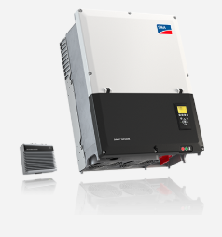
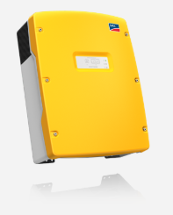
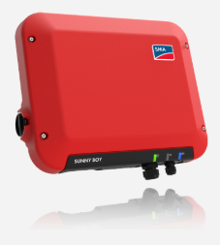
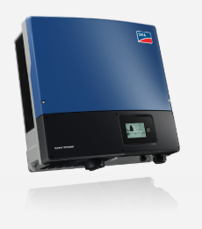
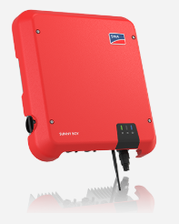
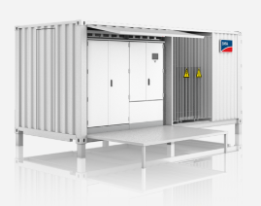

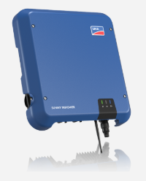
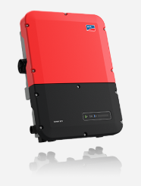
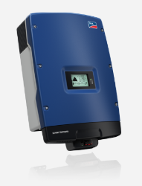
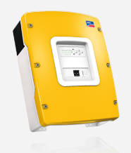
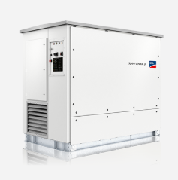
Design challenges
Constantly new technologies: Inverters
2013 – up to 10 kW String and 850 kW Central inverters
2019 – up to 250 kW String and 5 MW Central inverters
Central vs string inverters, battery storage, plant control, DC systems, etc.
Notes:
TT

Slide 10
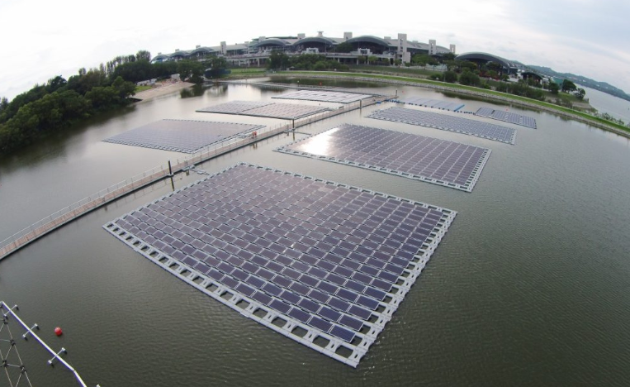
Design challenges
Constantly new technologies: Misc.
Floating solar systems
Bifacial systems
Hybrid systems
Etc.
Notes:
TT

Slide 11
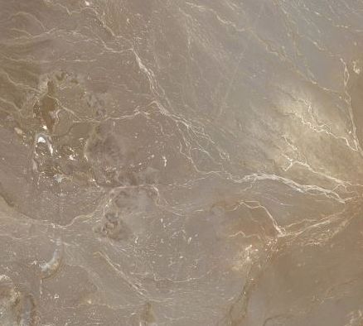
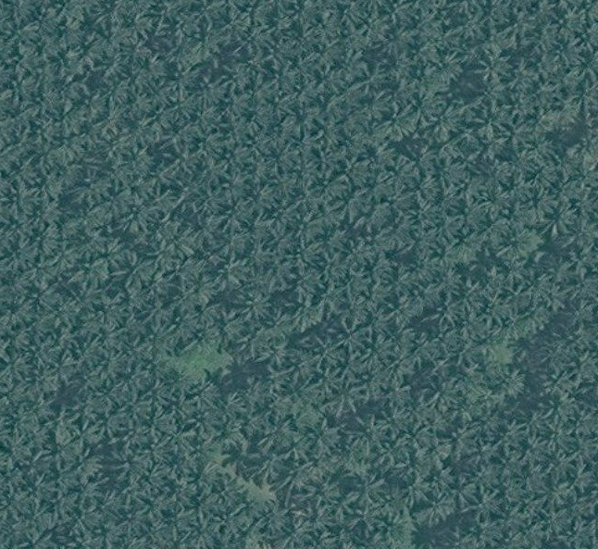
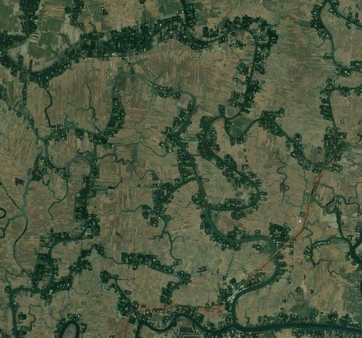

Design challenges
Difficult locations and environments
We’ve either built or is in the process of designing plants in:
Bangladesh: Swamp land – Waterlogged areas
Egypt: Desert – Dry, remote, hot and dusty
Brazil: Jungle – High vegetation growth, environmentally sensitive
Malaysia: Monsoon – High rainfall >2.1 m/annum
Ukraine: Snowfall and sub-zero temperatures
Rwanda: Remote, weak grid, high lightning area
South Africa’s “Droë” Karoo
Egypt Malaysia Bangladesh DRC
Notes:
TT

Slide 12
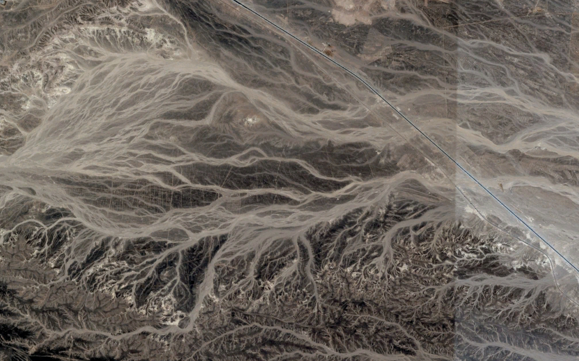
Design challenges
Drainage
Notes:
TT

Slide 13
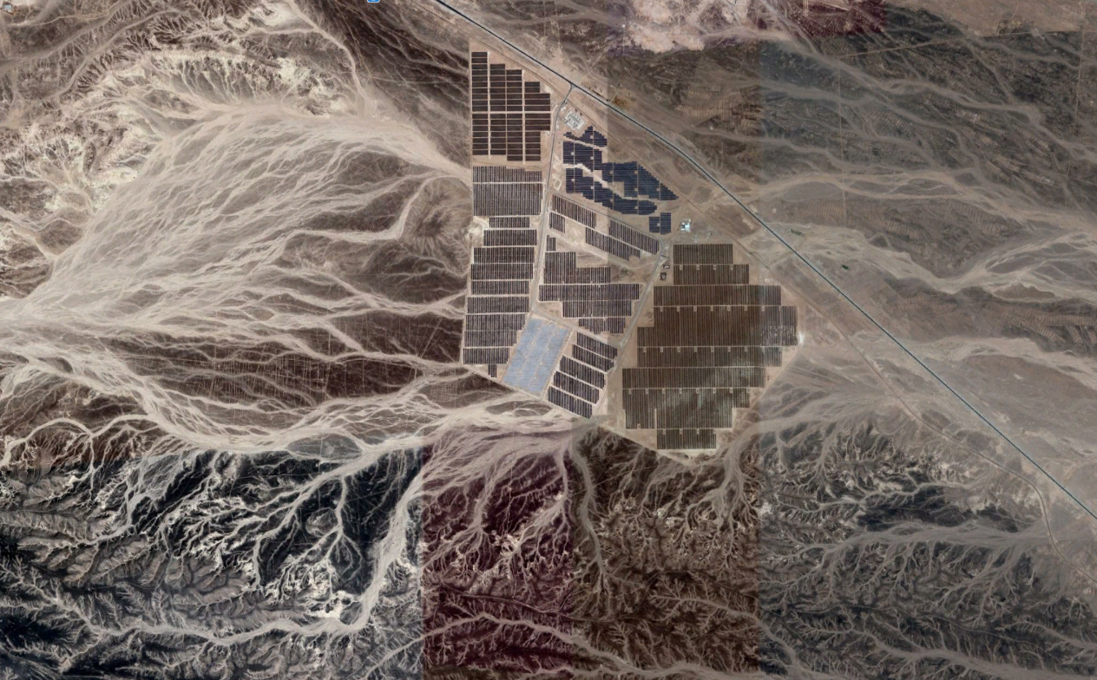
Design challenges
Drainage
Notes:
TT

Slide 14
Design challenges
Difficult locations and environments
Often very limited or bad quality information from site. To assess a potential project site, we have to know as a minimum:
Geotechnical conditions (sub-soil condition, soil types, earth quakes, etc)
Environmental conditions (rainfall, irradiation, wind speed, snow, dust, etc)
Site topography (accurate topo needed to assess shading and sub-structure)
Grid condition (spare capacity, extensions planned, grid impact study)
Local legislation, contracts, standards, etc.
Local expertise (companies, labour, etc)
Specific local requirements (eg. airports, radio interference locations, etc.)
Notes:
TT

Slide 15
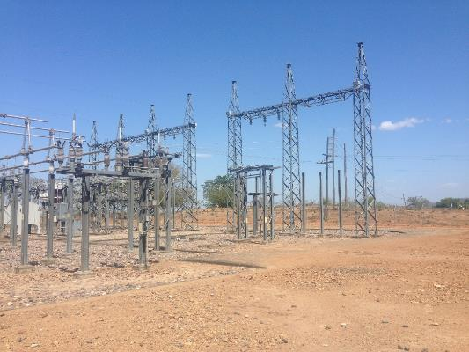
Design challenges
Customers
Utilities:
Don’t know how solar works
Resistant to change and competition
Inadequate or vague grid codes
Unstable or unreliable grids
Old infrastructure and poor maintenance
Mines:
Don’t know their own systems
Don’t know what they require
Private PPAs:
Islanded systems or reliance on utilities
Notes:
TT

Slide 16
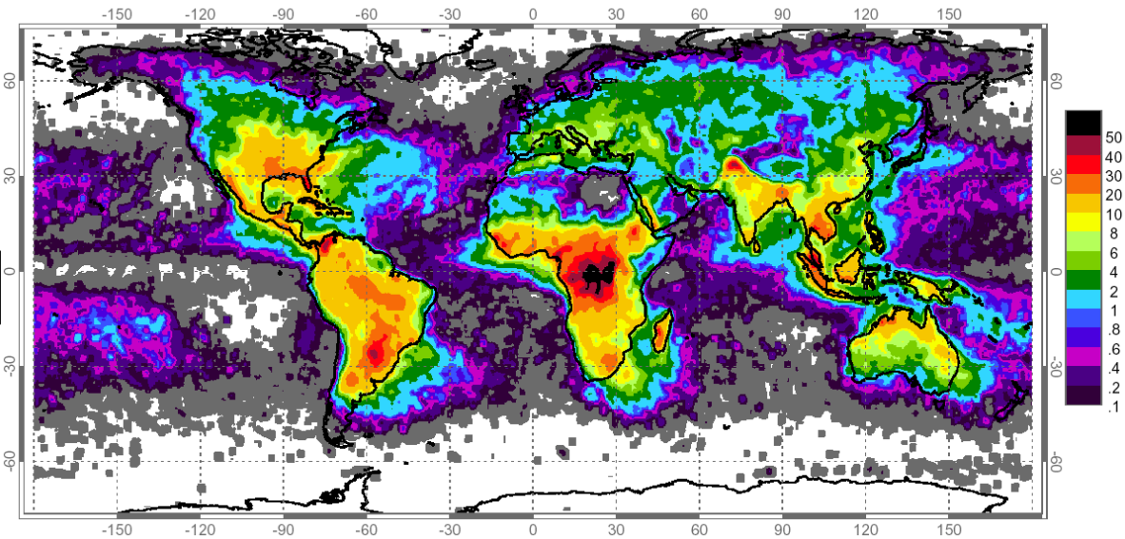
Design challenges
Lightning protection for large PV plants
Standards have not kept up with developments in PV. No single clear answer on how to adequately protect free field PV systems, only guidelines.
Notes:
TT

Slide 17
Construction challenges
Notes:
TT

Slide 18
Construction challenges
Logistics challenges:
During peak construction about 60 interlink trucks deliver material to site very day for 2-3 months.
Warehouse management system has to be in place (FIFO/FILO systems)
Need the correct materials to arrive at the correct time and location (JIT system)
Large quantities of people to manage (up to 1200 people on site)
Fast training programs to equip unskilled labour people
Communication on site (remote, no cellular network, no radios allowed)
Planning challenges:
Large quantities of unskilled labour, sometimes constantly changing
Short construction timelines
Accurate reporting back from construction personnel
Multiple contractors and equipment suppliers involved
Notes:
TT

Slide 19
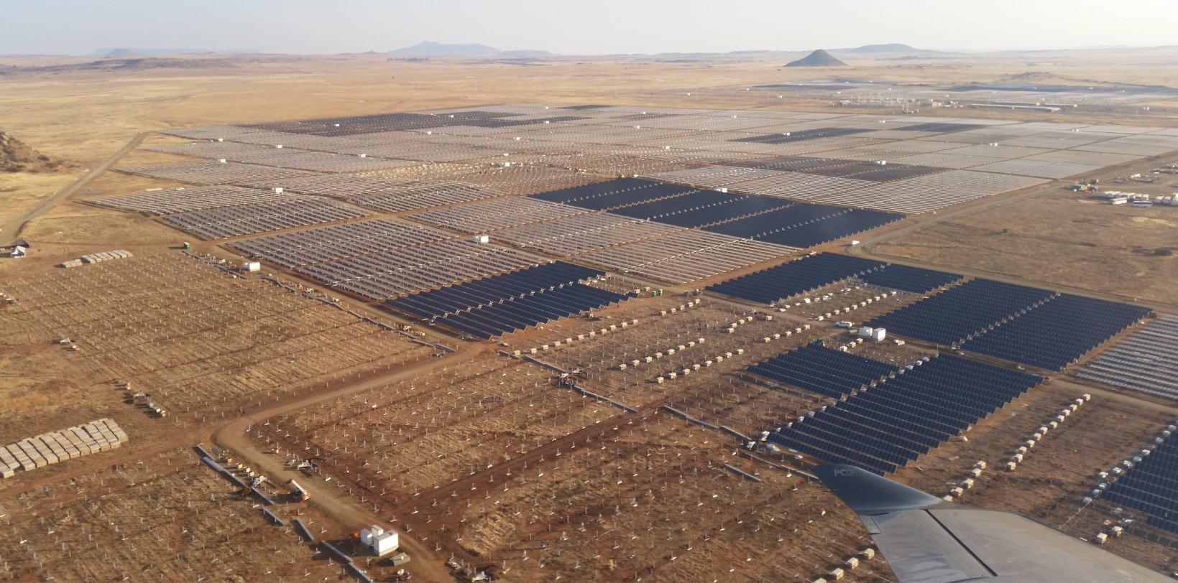
Construction challenges
Multiple processes running in parallel. Effectively tracking progress is important!
Notes:
TT

Slide 20
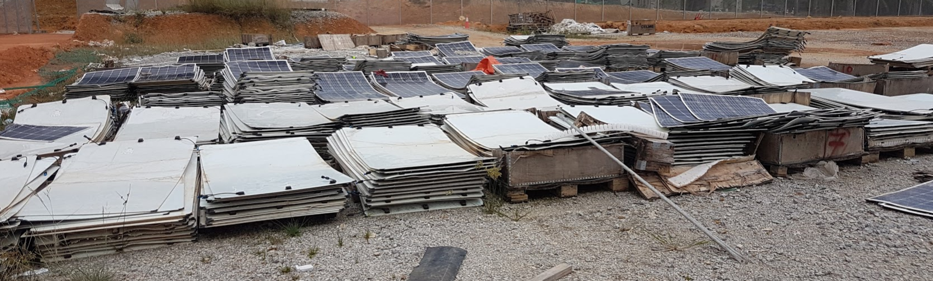
Construction challenges
Quality challenges:
How to keep a standard of quality across a large site, multiple teams, etc.
Examples:
Incorrect survey increases bulk earth work quantities by 800 000m³
Incorrect fastening of cables resulted in 1 000 000 cable tie replacements
Incorrect torqueing of bolts results in 3000 modules’ cracked glass
Notes:
TT

Slide 21
Construction challenges
PV construction is handled similarly to a manufacturing operation:
First make a prototype, then automate production.
Small efficiently improvements mean large project time impacts.
Example:
1 minute to mount a PV module
Mounting 700 000 modules would take ~12 weeks*
Shaving off 5 seconds off of the installation time:
55 seconds to mount a PV module
Mounting 700 000 modules would take ~11 weeks*
Shaving 1 week off installation time. This could be the difference between using a cordless drill versus a spanner to fasten the module’s holding bolts.
*Assuming 8 hour work day, 6 day work week, 20 x 2 person teams
Notes:
TT

Slide 22
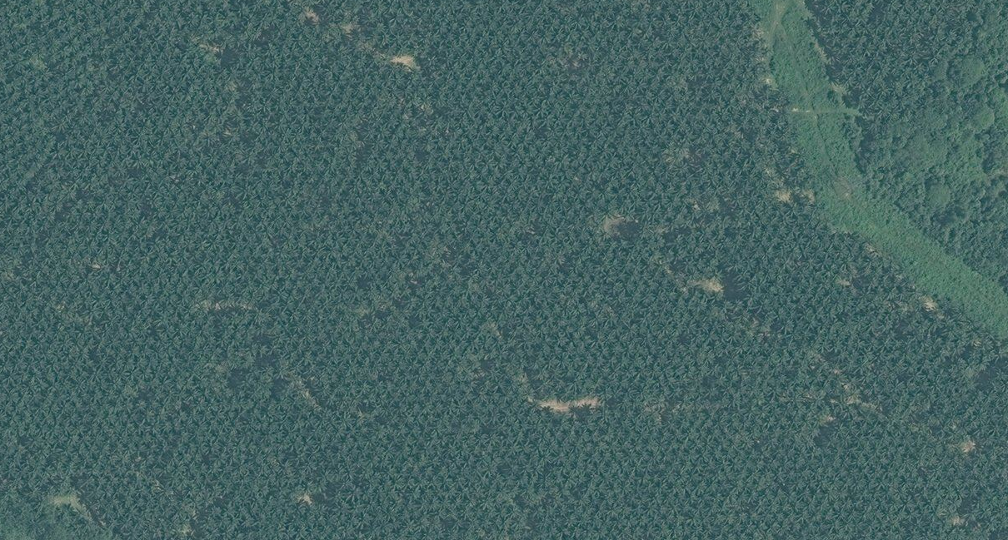
Construction challenges
Unique construction tasks: Removing 4 000 palm oil trees.
Notes:
TT

Slide 23
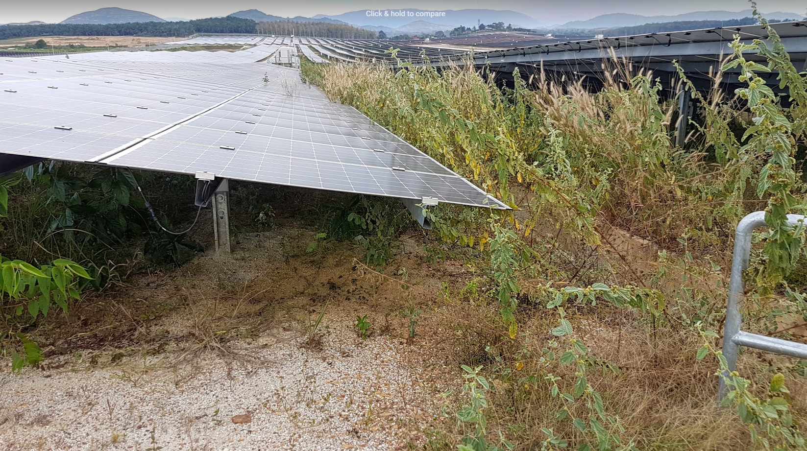
Construction challenges
Unique construction tasks: Fast growing vegetation
Notes:
TT

Slide 24
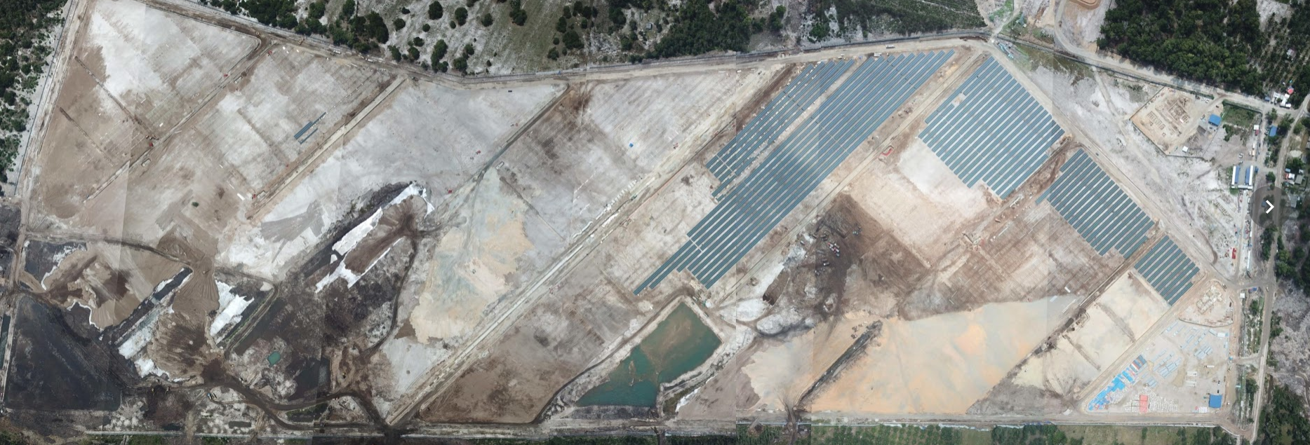
Construction challenges
Unique construction tasks: Complex civil works (water, sand, organic material)
66 MWp plant in Malaysia
Notes:
TT

Slide 25
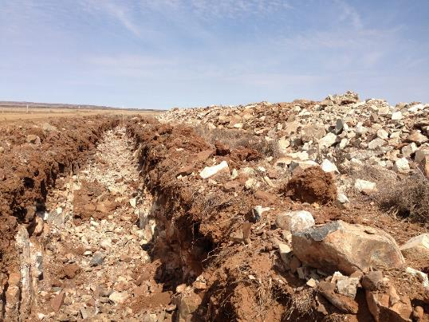
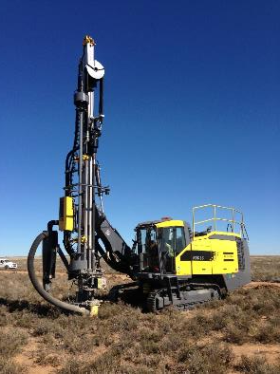
Construction challenges
Unique construction tasks: Hard ground
Notes:
TT

Slide 26
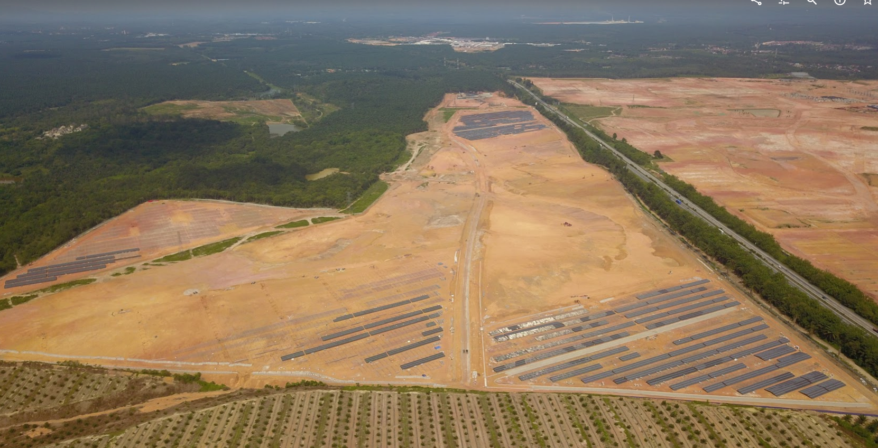
Construction challenges
Unique construction tasks: Irregular shapes
Notes:
TT

Slide 27
Construction challenges
Commissioning and plant testing:
Multiple parties on site during commissioning
1000V vs 1500Vdc system change – Testing technology behind
Some tests are weather dependent.
Testing with a utility can be “painful” but is unavoidable
Explaining to stakeholders how the plant operates and that it is healthy
My personal favorite:
  Explaining to stakeholders what reactive power is
Notes:
TT

Slide 28
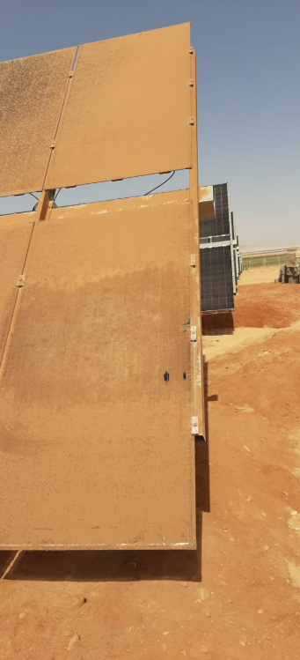
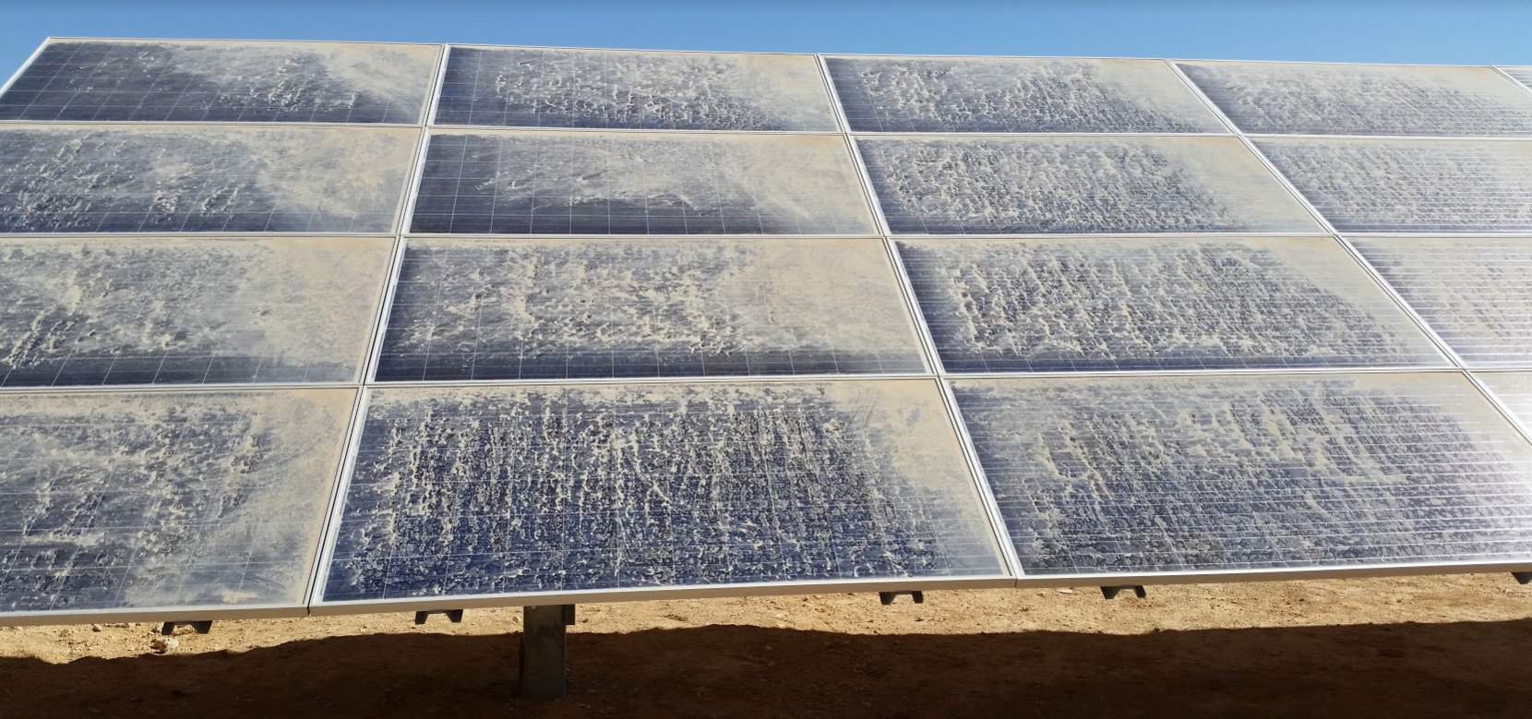
Construction challenges
Unique construction tasks: Soiling of PV modules
Notes:
TT

Slide 29
Conclusion
PV industry has many challenges,
but they all can be overcome.
Notes:
TT

Slide 30
Thank you
Fini
Finito
Fertig
Ferdig
Complevit
The End
Πεπερασμένος
Законченный
ಮುಗಿಸಿದರು
Iphele
完成
Notes:
TT

Slide 31
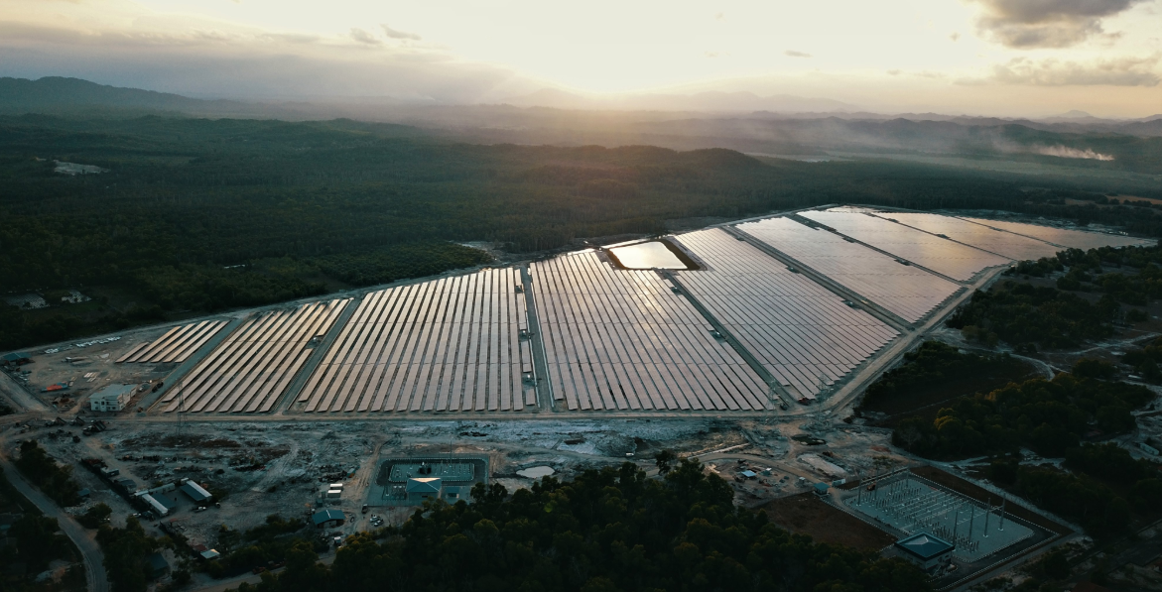
Questions?
66 MWp plant in Malaysia
Notes:
TT

