Slide 1

Design of a Hybrid Power Supply using a Genetic Algorithm
F. M. Daniel
Supervisor: Dr. A. Rix
Notes:
Good morning/afternoon. I will be discussing the design of a hybrid power supply using a genetic algorithm.

Slide 2


Overview
Introduction
Design Objectives
Sizing Methodologies
Genetic Algorithm
Results
HOMER software
Conclusion
Notes:
A brief overview of my presentation.
A short introduction to hybrid power supplies and then the design objectives. I will discuss different sizing methodologies and discuss the genetic algorithm implementation. The results of the implementation will be discussed and then compared with HOMER software. I will end off with the conclusion.

Slide 3



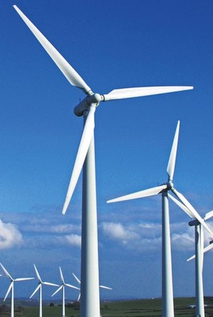
1. Introduction
Dispatchable
Emissions
Limited supply: eventually become unavailable
Intermittent: weather dependent
Cannot be depleted
Generates without emissions
Notes:
There are various means of generating electrical energy using fossil fuel or renewable sources. Fossil fuel, such as coal, crude-oil are dispatchable, which makes them ideal for supplying constant power, but they produce emissions which are harmful to the environment. In addition, it is in limited supply and will eventually become unavailable for use. Renewable energy, such as solar and wind, are intermittent because it is weather dependent, cannot be depleted and generates power without emissions. So how can we produce more sustainable and dispatchable energy?

Slide 4
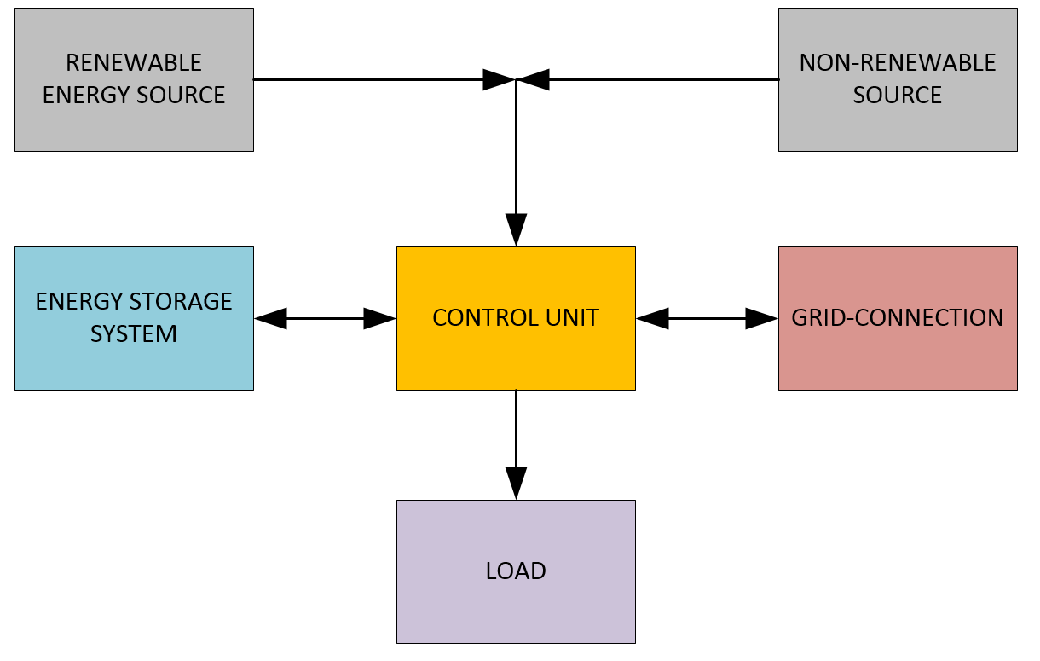
1. Introduction
Notes:
This is where a hybrid power supply is the solution. It combines 2 or more power sources, whether renewables and non-renewables. Energy storage can be included to increase the system’s dispatchability. A grid-connection can supply the deficit or the excess can be fed back to the grid. The power exchange and balance to the load is done by the control unit.

Slide 5
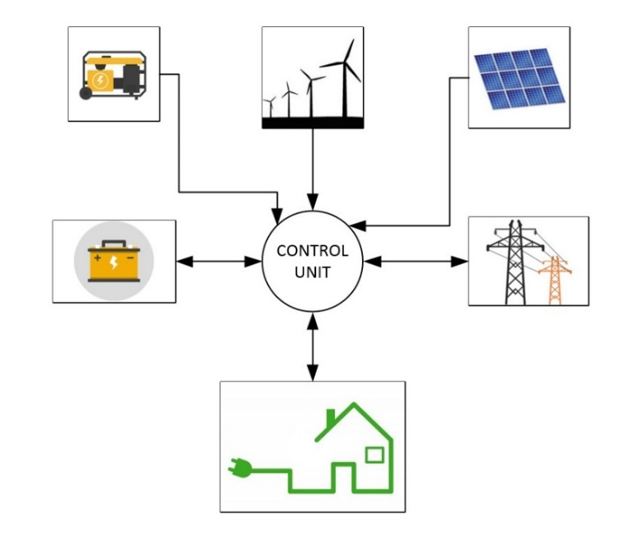
1. Introduction
Energy density increased
Weakness of one power source replaced by strength of another
Solar (daylight only) combined with generator reduces fuel consumption and increases capacity factor
Notes:
The energy density is increased in a hybrid power supply. The weakness of one power source is replaced with the strength of another. For example, combining solar power, which can only generate during sunlight hours, with a generator reduces the fuel consumption and increases the capacity factor of the power supply.

Slide 6
2. Design Objectives
How do we choose between different HPS configurations? What we want to achieve in the design?
  Trade-off analysis
  Multi-objective problem: Technical, economical and environmental
Technical: dispatchable
  Minimize loss of power supply probability (LPSP)
Economical: the investor’s money
  Minimize the capital and lifetime costs
  Maximize the lifetime savings and return on investment
Environmental: reduce emissions
  Maximize renewable energy source usage
Notes:
The problem with a hybrid power supply is how do we choose between different configurations? When is a certain power supply better? Should we compensate for additional storage, selling to the grid, reducing emissions? Investors have different objectives and value certain aspects as more important. There is a trade-off to each power source, which must be taken into account. Thus a hybrid power source can be defined as a multi-objective problem, being technical, economical and/or environmental. The technical objectives refers to the dispatchability and to minimize the loss of power supply probability. The economical objectives are to minimize the capital and lifetime costs, while maximizing the lifetime savings and return on investment for the investor’s money. The environmental objectives are to minimize the emissions and thus maximizing the usage of renewable energy sources.

Slide 7
3. Sizing Methodologies
Each HPS is unique
Dependant on location and weather (assuming renewables are incorporated)
Financial constraints of the investor
Sizing problem
Probabilistic and statistical
Software
Metaheuristic, iterative methods
Genetic Algorithms
Particle Swarm Optimization
HOMER
RETScreen
Notes:
This brings us to sizing methodologies. Each power source is unique and is dependent on location and weather, if we are assuming renewables are incorporated. In addition, there are financial constraints of the investor. All of these factors create a sizing problem. Sizing methods based on probability and statistics are the simplest design method, but are not ideal for finding an optimal solution. Commercially available software, such as HOMER and RETScreen, require large amount of time-series weather data and cannot be modified for specific user requirements. Since a hybrid power supply can be defined as a multi-objective problem, a metaheuristic and iterative method can be used to solve this type of combinational problem. It uses a recursive process to find the best design configuration according to the specification. These include genetic algorithms and particle swarm optimization. Genetic algorithms produces a list of robust and viable optimal solutions, where the particle swarm optimization produces one global solution. For this presentation, a genetic algorithm is incorporated.

Slide 8
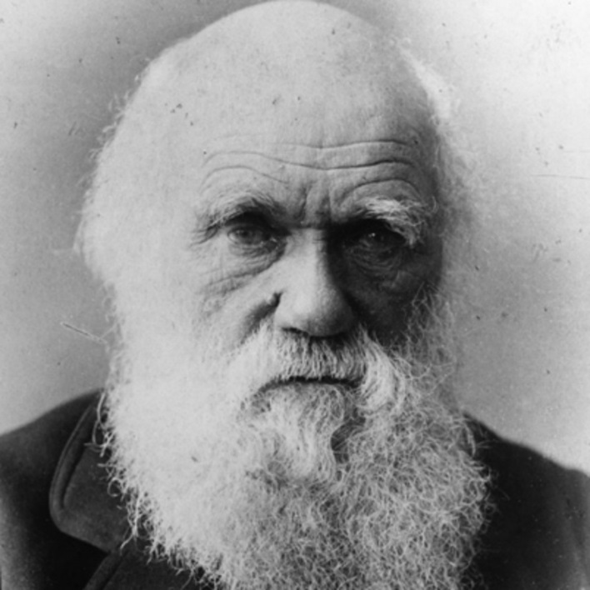

4. Genetic Algorithm
Stochastic global search and optimization technique
Theory of evolution by Charles Darwin
Elimination of inferior species gradually over time through natural selection
After a defined amount of generations, a fitter population is achieved
  Thus a list of viable solutions of HPSs are obtained
  Trade-off analysis based on investor’s objectives
Notes:
A genetic algorithm is a stochastic global search and optimization technique based on the theory of evolution by Charles Darwin. The idea is based on the elimination of inferior species happens gradually over time through a process called natural selection. For the algorithm: after a defined amount of generations, a fitter population is achieved. Thus a list of viable solutions of hybrid power supplies are obtained and a trade-off analysis can be done to choose which one is the best, based on the investor’s objectives.

Slide 9
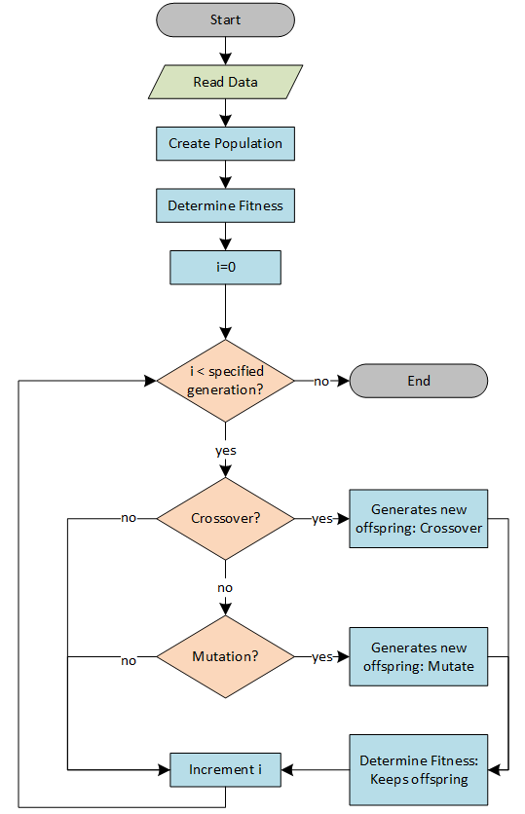
4. Genetic Algorithm
Notes:
The algorithm navigates through a large gene pool to search for optimal combination of genes. It starts by reading the data input with regards to the weather and load profiles, as well as a database of different components based on the power sources. The algorithm randomly generates structures in a population.

Slide 10

4. Genetic Algorithm
Structure with encoded solution: chromosome
  Similar to DNA strings
  Each DNA has information regarding system
  [T_{PV} N_{PV} T_{GEN} N_{GEN} T_{BAT} N_{BAT} T_{INV} N_{INV}]
  Types - integer represented
  Number of system components
Chromosome has 4 configurations:
  Combinations of solar, grid, battery and generator
  Internal local optimizer
Notes:
Each structure has an encoded a solution, named a chromosome, which is similar to DNA strings. Each DNA has information regarding the system: the types are integer represented and it also has the number of that specific type of system component. Each chromosome has 4 configurations which are different combinations of solar, grid, battery and generator power sources. The 4 configurations are rated against each other with an internal local optimizer.

Slide 11
4. Genetic Algorithm
Notes:
After the population is initialized, it is rated against a fitness function. The fitness function is an indication of how well the different objectives are met. It evaluates how well the configuration performs given the weather and load profile and the population member is given a certain fitness ranking. As each generation evolves, the algorithm improves the structures through crossover and mutation. Based on the offspring’s fitness, it then replaces the weakest population member. Through each generation, the overall fitness of the population increases. The algorithm runs for a specified amount of generation.

Slide 12
4. Genetic Algorithm
Population: 80
Generations: 40
Crossover rate: 80%
Mutation rate: 20%
Selection:
  Rank-based roulette wheel
Dispatch strategies are incorporated for the battery and the generators
Data input:
  Weather profile: Stellenbosch
  Load profile: farm
  Time series: hourly
Fitness function
  Weighted linear combination of different attributes
  Short-term and long-term assessment with regards to objectives (as previously discussed)
Notes:
I chose the population as 80, with 40 generations. The crossover and mutation rate was 80% and 20% respectively and the parents chosen for the mutation and crossover was done based on rank-based roulette wheel selection. Dispatch strategies are incorporated for the battery and generators. The weather profile was based on the Stellenbosch weather station and the load profile is a farm and both were hourly measurements. The fitness function is defined as a weighted linear combination of different attributes and takes into account the short-term and long-term assessment with regards to the objectives, as previously discussed.

Slide 13
5. Results
 | LPSP (%) | PV Penetration (%) | Capital cost (ZAR) | IRR (%)
Solar Grid (SG) | 58.8 | 22.8 | R1,313,985 | 15,5
Solar Grid Battery (SGB) | 42.6 | 51.1 | R2,172,083 | 16,2
Solar Grid Generator (SGG) | 10.8 | 76.4 | R1,373,100 | 23.6
Solar Grid Battery Generator (SGBG) | 10.5 | 78.8 | R1,894,675 | 20.6
SGB
  High capital cost
  No emissions, lower O&M
SGG
  IRR, LPSP, PV Penetration, capital cost
  O&M, fuel prices, emissions
SGBG
  LPSP, IRR, PV Penetration
  Fuel prices and O&M, emissions
Notes:
After the genetic algorithm was implemented, it produced a list of viable options of different hybrid power supply configurations. Each of the configurations performed well in their own merits. The Solar Grid Battery configuration has the highest capital cost, but has no emissions and a lower operational and maintenance cost than the generator configurations. The Solar Generator configuration has a good internal rate of return, loss of power supply probability, PV penetration and capital cost. However, the operational and maintenance of the power supply will be a factor, as well as escalating fuel prices and emissions. The Soar Grid Battery Generator configuration has a good loss of power supply probability, internal rate of return and PV Penetration. As with the previous configuration, the fuel price, operational and maintenance cost, as well as emissions are a trade-off in this design. Thus each configuration have trade-offs which must we weighed in on.

Slide 14

6. HOMER software
Hybrid Optimization Model for Electric Renewables
GA produces overall lower capital cost with a lower loss of power supply probability
GA can compare more types for diverse results
GA can fill in missing data, where HOMER cannot
Both produce accurate results
GA must be built and incorporated: time consuming
HOMER commercially available
Notes:
For this paper, I used the same load profile and weather and did a similar design with HOMER software. When the two’s results were compared, it showed that the genetic algorithm produces overall lower capital cost with lower loss of power supply probability. The algorithm also compares more types for more diverse results, as well as fill in missing data, where HOMER cannot. Both methods produced accurate and viable results. It can be noted that the genetic algorithm must be built and incorporating, which can be time consuming where as HOMER is commercially available.

Slide 15
7. Conclusion
Genetic Algorithm
  Viable method to design a hybrid power supply
Compared to HOMER
  GA produces more diverse and robust configurations
  GA is more accurate and faster design methodology
  GA has lower capital cost and better loss of power supply probability
Future work
  Larger database of components
  Additional power sources (wind, biomass, biogas, hydro…)
  Selling excess generated power back to the grid
Notes:
In conclusion, the genetic algorithm proves to be a viable method to design a hybrid power supply. When compared to HOMER, the genetic algorithm produces more diverse and robust configurations and is more accurate, as well as a faster design methodology. In addition, the capital costs were lower and had a better los of power supply probability. For future work, I recommend a larger database of components, adding other power sources, such as wind, biomass, biogas and hydro to the designs and also to take into account selling the excess generated power back to the grid.

Slide 16
Thank you
Notes:
Thank you.

