Slide 1

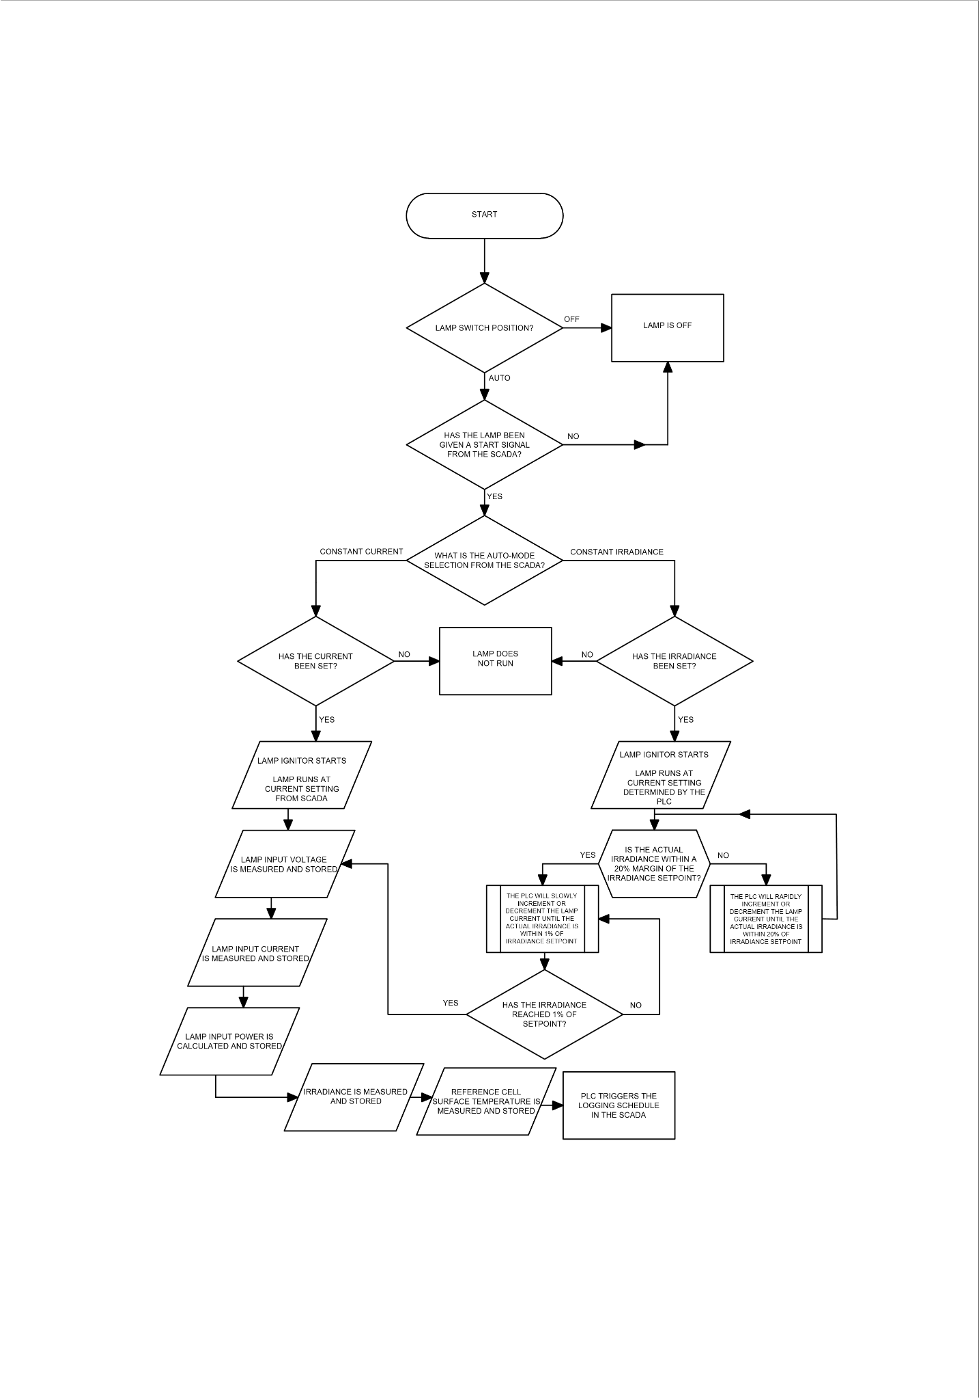
Methodology
9th Renewable Energy Postgraduate Symposium (REPS)
Stellenbosch University
13 – 14 September, 2018
Figure 3: Flowchart for the Xenon arc lamp solar simulator irradiance feedback control system

