Slide 1

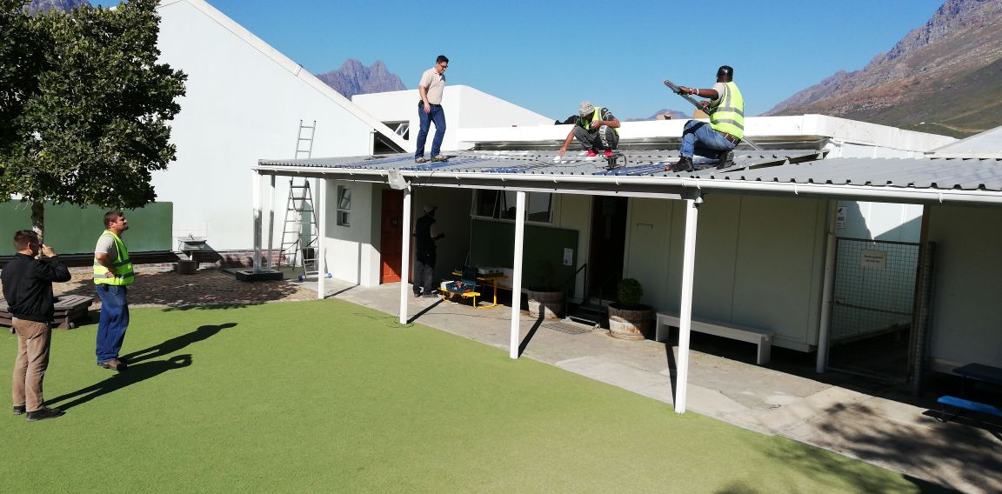
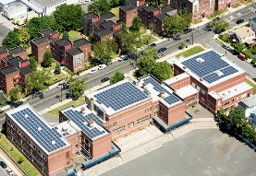


Managing peak demand and energy costs through PV and intelligent scheduling of water heaters at two schools in South Africa
Stefan Gerber, A. Rix, M.J. Booysen
REPS 2018 – 13 September 2018

Slide 2
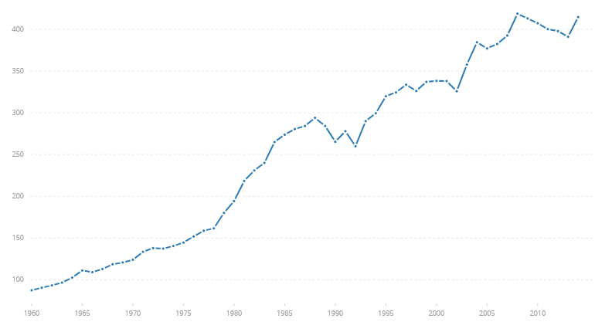
Introduction
Motivation:
Global emissions are increasing
South Africa is coal heavy
Many schools are underfunded and can benefit from solar intervention
      South Africa’s CO₂ emissions from solid fuel consumption (millions of tons); Site: Worldbank.org

Slide 3
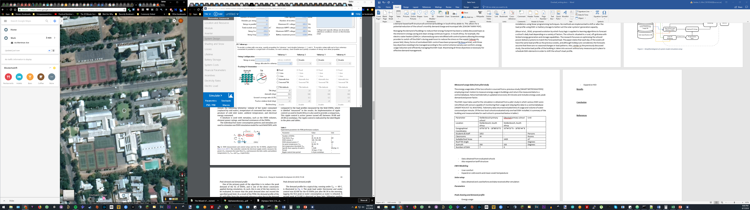
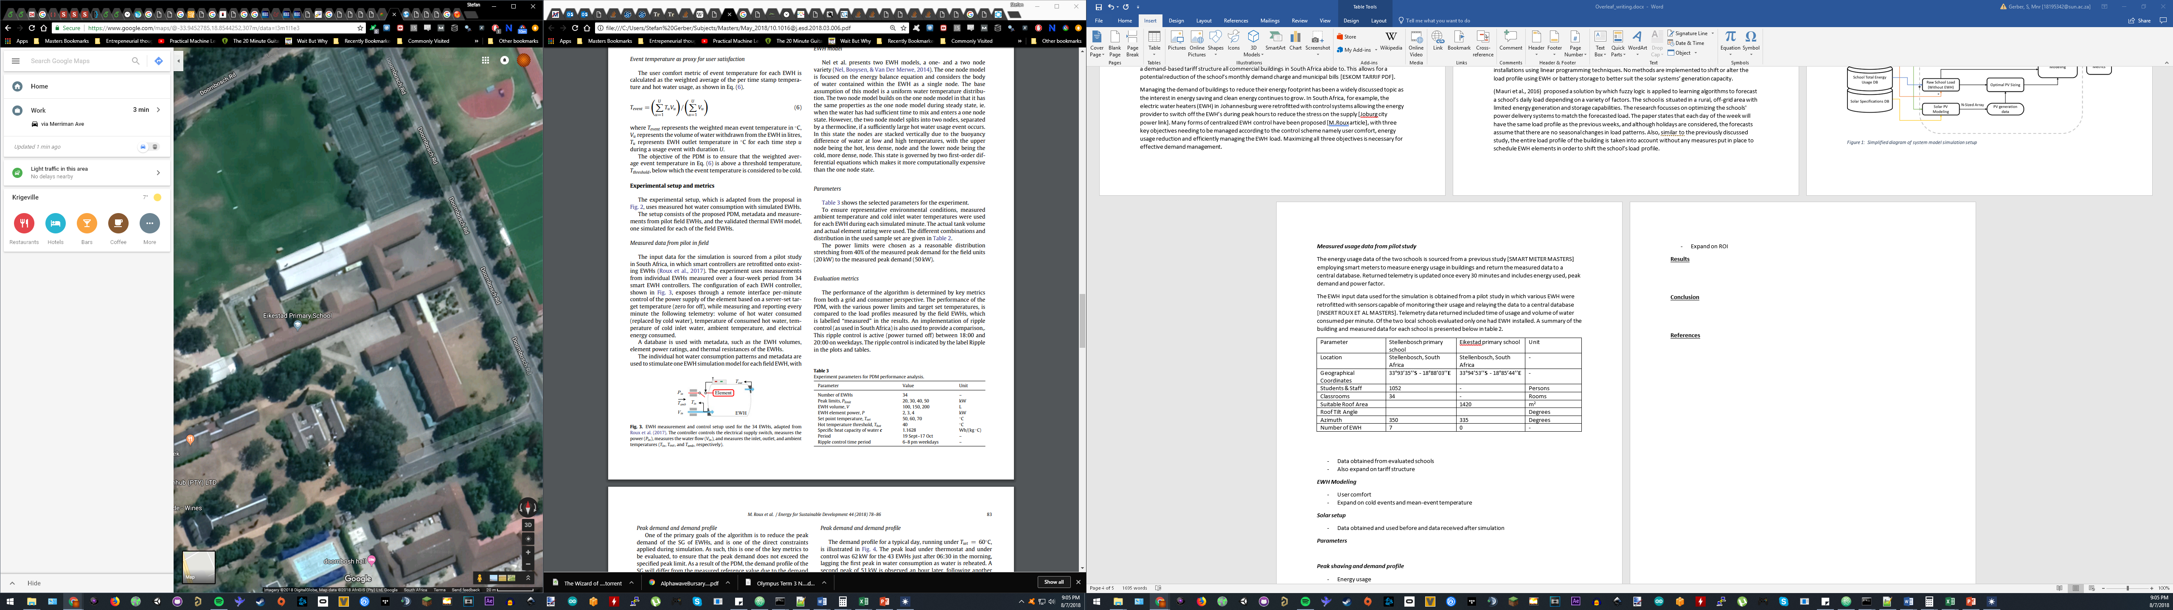

Introduction
Overview:
Two primary schools evaluated
Both employ a demand-based tariff structure
Primary objectives:
  Reduce emissions
  Reduce utility bill
100m
100m
      Stellenbosch Primary (with EWHs)
      Eikestad Primary (no EWHs)

Slide 4
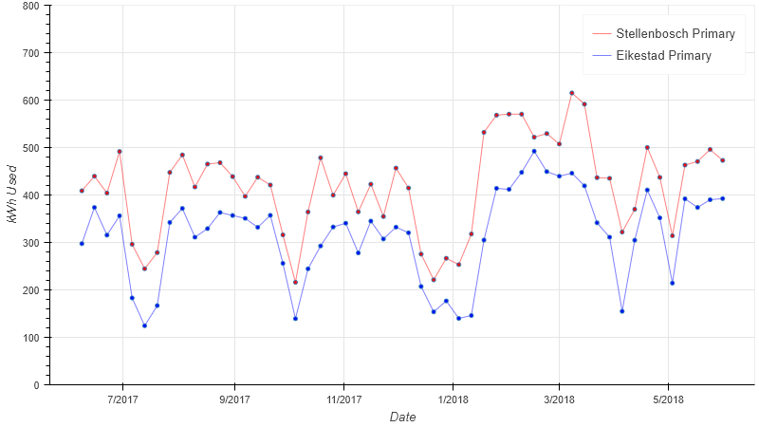
Simulation Setup
Approach:
4 Configurations:
      Baseline
      Smart Scheduling EWH
      Solar intervention
      Solar and Smart Scheduling EWH intervention
Simulate configurations using:
  Verified Solar and EWH models
  Using data obtained by sensors
      Average daily measured energy usage for both Schools (plotted for each week)

Slide 5
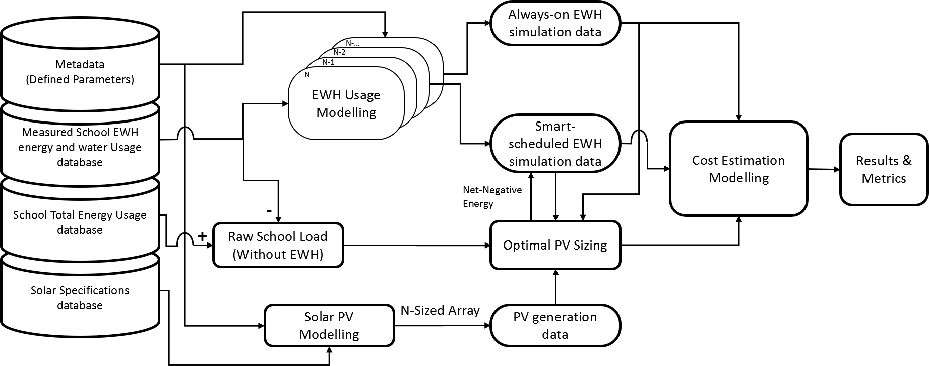
Simulation Setup
System Simulation Diagram:

Slide 6
System Modelling
Solar PV simulation:
Inputs
Calculations
Results
Measured school energy usage:
  Basic energy
  Peak demand
Weather data
Solar system simulation parameters
System Advisor Model libraries:
  Single diode solar model
  Empirically derived inverter model
Basic energy savings
Demand savings
Lost energy

Slide 7
System Modelling
EWH simulation:
Inputs
Calculations
Results
Measured school EWH usage:
  Electricity usage
  Hot water usage
EWH simulation parameters
Verified two-node EWH model
Simulation method:
  Thermostat control
  Smart schedule control
Basic energy savings
Demand savings
User comfort

Slide 8
System Modelling
EWH Smart-Scheduling algorithm:
Begin
Calculate heating priority for each EWH
Looped through entire priority list?
False
Is excess PV available?
False
True
True
Heat EWH with solar
Heat EWH with grid

Slide 9
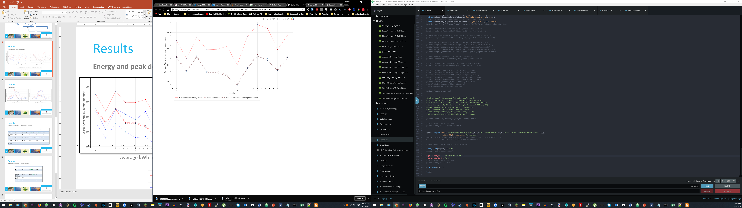
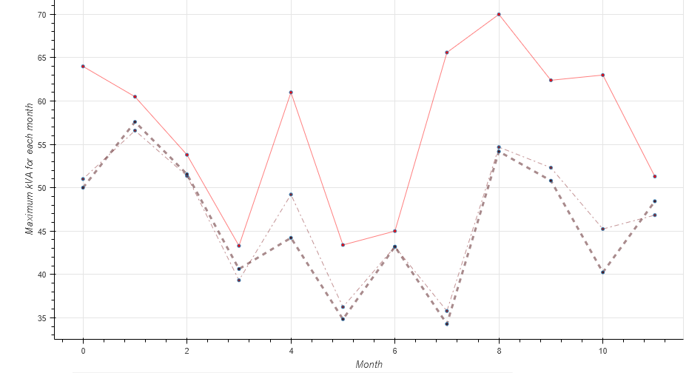
Results
Energy and peak demand savings:
      Average kWh used per day
      Maximum kVA per month

Slide 10
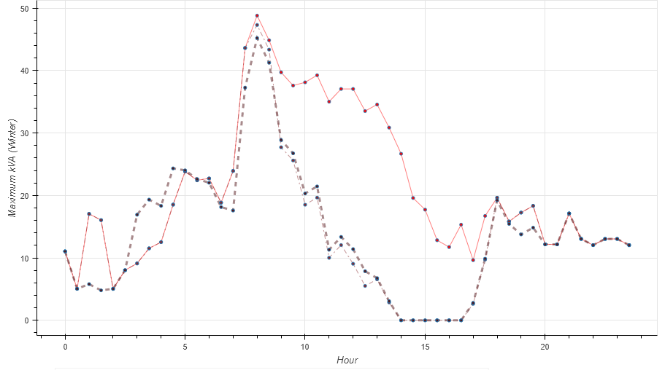

Results
Seasonality:
      Max kVA for a winter’s day
      Max kVA for a summer’s day

Slide 11
Results
Simulation results for Stellenbosch Primary:
Parameter | School Baseline | With smart-scheduling intervention | With solar intervention | With solar and smart-scheduling intervention | Unit
Total Energy Usage | 157.3 | 155.6 (1.08%) | 109.2 (30.7%) | 105.4 (32.7%) | MWh
Mean Daily Energy Usage | 430 | 426 | 299 | 289 | kWh
Daily peak demand [min,median,max] | [8,37,72] | [8,36,71] (2.70%) | [0,30,55] (19.1%) | [0,29,54] (21.2%) | kVA
Yearly CO₂ Emissions | 117 065 | 115 808 | 81 274 | 78 445 | kg
Percentage utility bill reduction | 0 | 1.4 | 23.6 | 25.8 | %

Slide 12
Results
Simulation results for Eikestad Primary:
Parameter | School Baseline | With solar intervention | Unit
Total Energy Usage | 114.8 | 71.8 (37.4%) | MWh
Mean Daily Energy Usage | 315 | 197 | kWh
Daily peak demand [min,median,max] | [6,31,62] | [0,25,55] (19.3%) | kVA
Yearly CO₂ Emissions | 85 436 | 50 458 | kg
Percentage utility bill reduction | 0 | 30.13 | %

Slide 13
Conclusion
Interventions resulted in reductions in utility bill and emissions.
The estimated payback period was favorable, making it viable for the schools investigated.
Optimal battery storage can possibly lead to improved results.

Slide 14
Thank you

