Slide 1


IRRADIANCE MODELING FOR BI-FACIAL PV MODULES USING THE RAY TRACING TECHNIQUE.
Renewable Energy Postgraduate Symposium 2018
J.A. Louw & Dr A.J. Rix
Notes:
Good afternoon.
My name is Jobert Louw and I will be discussing the topic:
IRRADIANCE MODELING FOR BI-FACIAL PV MODULES USING THE RAY TRACING TECHNIQUE.

Slide 2

Overview
1. Introduction
2. Bi-facial PV modules
  Rear side irradiance
  Electrical model
  Bi-facial PV module characterisation
3. Simulation and modelling of bi-facial PV modules
4. Ray tracing
  RADIANCE software
5. Proposed solution
  Program flow
6. Simulation results
7. Conclusions and future work
Notes:
The presentation will cover the following topics:
A short introduction into bi-facial PV technology.
More insight regarding the operation and modelling of bi-facial technology.
Existing simulation software and modelling techniques.
Ray Tracing software and the software tool named Radiance.
The proposed solution which entails a python interface for Radiance.
Simulation results of 3 different scenarios.
Conclusions and future work.

Slide 3
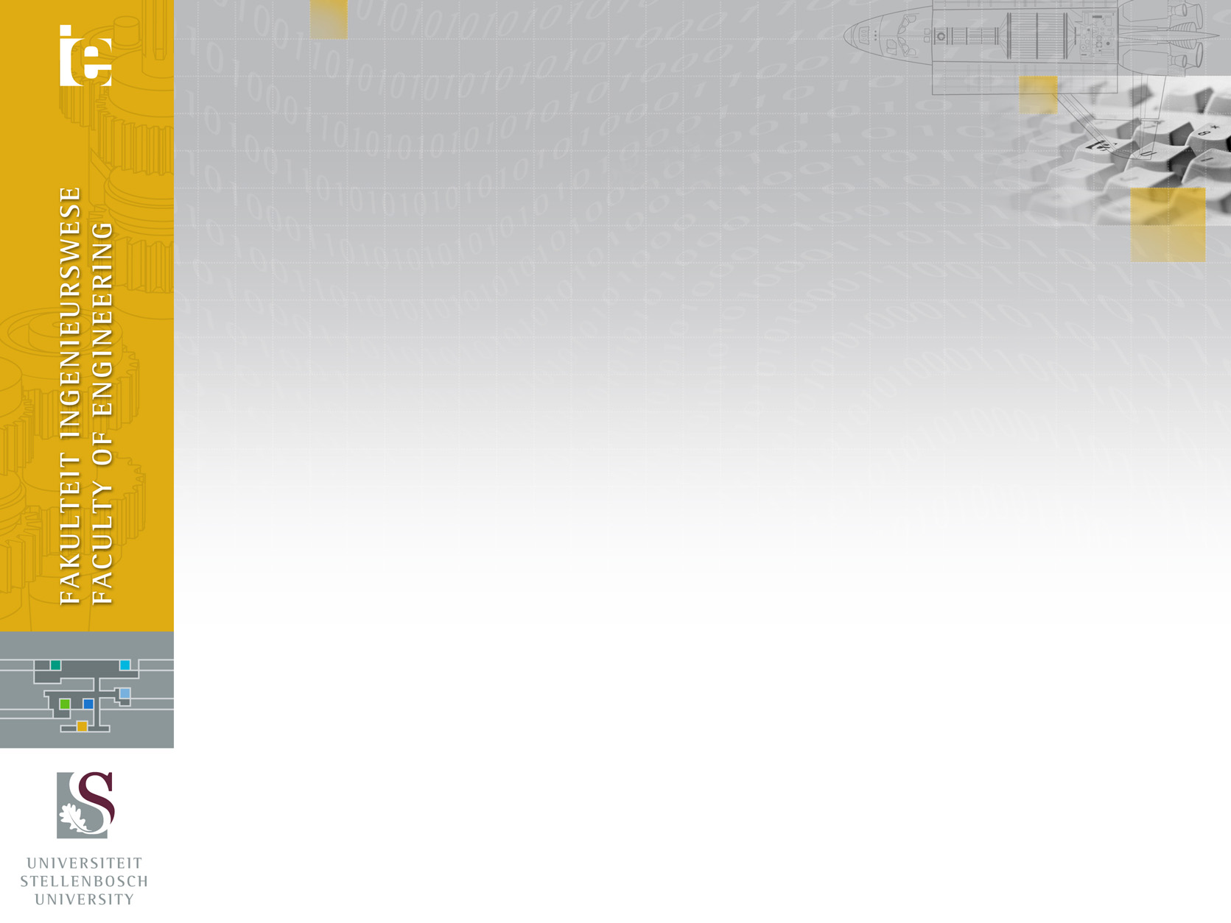






Introduction
Active rear side leads to potentially higher power outputs.
Cost difference: Mono-facial vs Bi-facial
Market for bi-facial PV
Characterization and simulation
Existing simulation software: inaccurate
Ray tracing can serve as the solution
Notes:
A bi-facial PV module is greatly dependent on the active rear side to potentially produce higher power outputs when compared to a mono-facial module.
Historically there has been a significant difference in cost between bi-facial and mono-facial modules.
Numerous advances in the manufacturing process of bi-facial cells have reduced costs of bi-facial modules which gives it the opportunity to enter the PV market.
Unfortunately PV plant investors and designers are still skeptical about the true benefits that bi-facial technology has to offer.
This is due to the inability to accurately characterize and model bi-facial modules.
Existing simulation software proves to be inaccurate
And therefore I am investigating the possibility of implementing Ray Tracing to solve this problem.

Slide 4

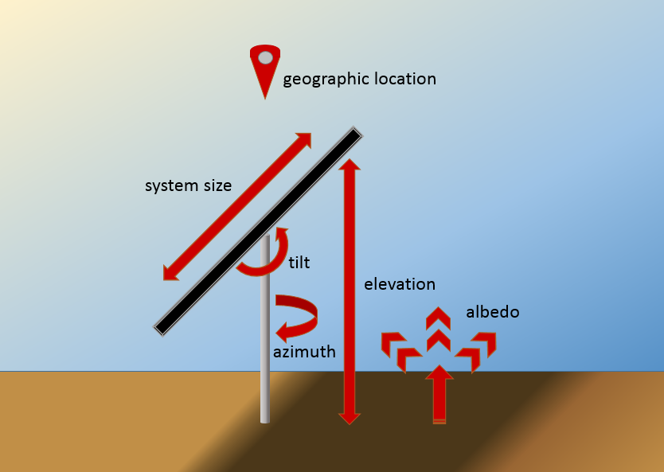


Bi-facial PV Modules
Rear side irradiance
  Mounting height
    - Increased irradiance
    between 0-1m
  Albedo
    - Ratio between reflected
    and received irradiance by
    ground surface
  Mounting structure
    - Self-shading severely
    decreases performance
Notes:
The rear side irradiance is a big contributor to the total power output of a bi-facial module.
The illustration on the right shows some of the factors that have a effect on maximizing the rear side irradiance.
A few important factors are the mounting height of the module, the ground surface albedo and the mounting structure of the module.
Research done by NREL, shows that an increase of module mounting height between 0-1 meters results in an increase of rear side irradiance.
By increasing the albedo value of the surrounding ground surface with snow for example, the rear side irradiance can also be maximized.
These two factors will have little to no effect if the module’s mounting structure is causing self-shading on the rear side.

Slide 5

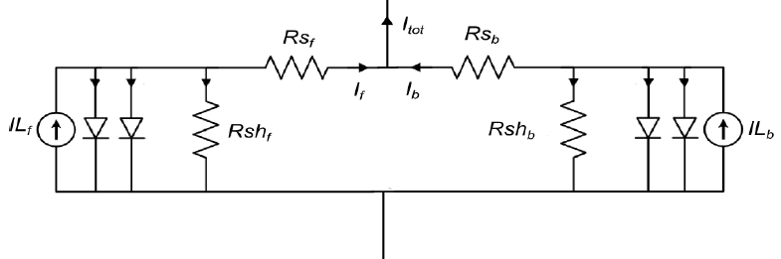
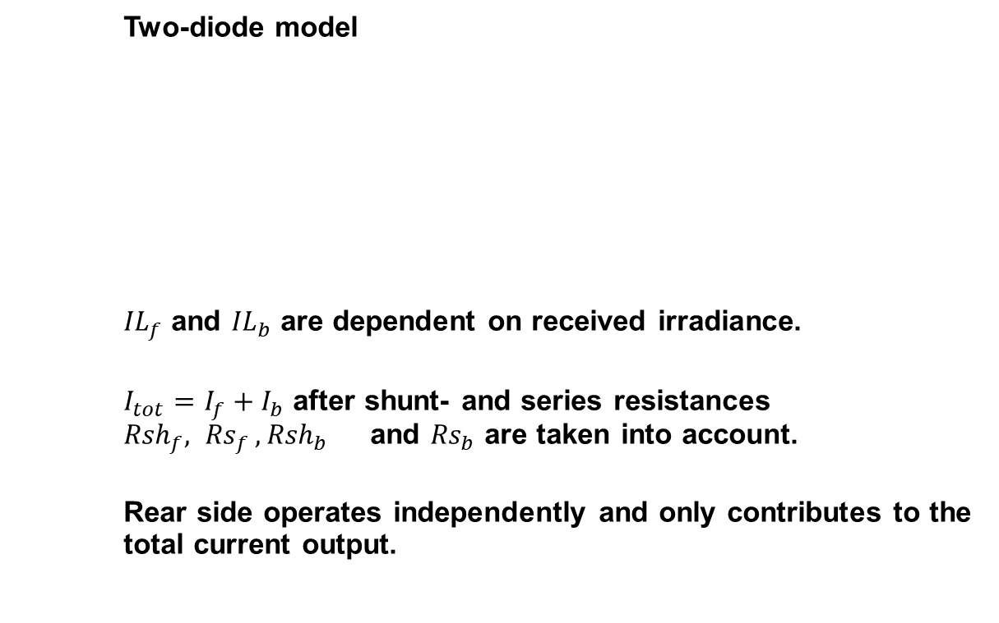
Bi-facial PV Modules
Electrical Model
Two-diode model
${IL}_{f}$ and ${IL}_{b}$ are dependent on received irradiance.
$I_{tot}=I_{f}+I_{b}$ after shunt- and series resistances ${Rsh}_{f}{, Rs}_{f},{Rsh}_{b}$ and ${Rs}_{b}$ are taken into account.
Rear side operates independently and only contributes to the total current output.
Notes:
Although we can maximize the rear side irradiance, it is important to know what effect this will have on the total power output by implementing a electrical model.
The model that I have investigated is the two-diode model.
This model is realized by placing two-two diode models is parallel, one representing the front side and the other representing the rear side of the module.
The current sources Ilf and Ilb are dependent on the amount of irradiance received by each side of the module.
Each side’s current output is added to result in the total current output of the module.
Although this model is simple, it remains difficult for bifacial module manufacturers to characterize modules extensively.

Slide 6


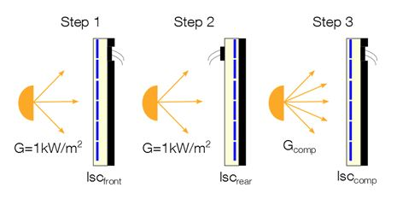
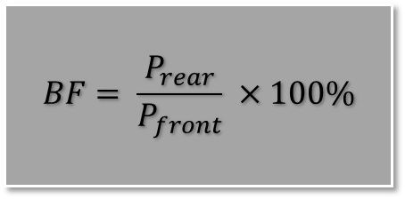
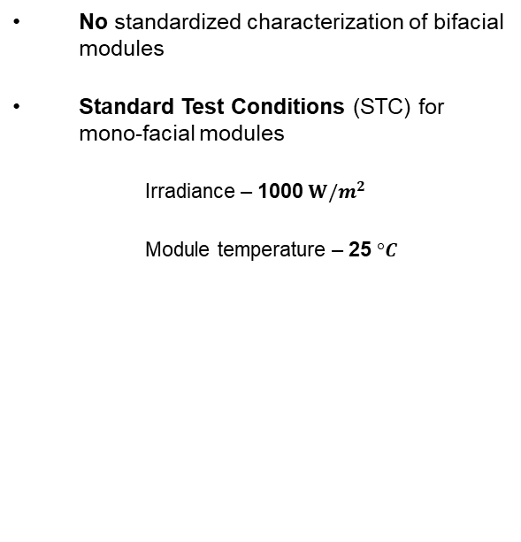
Bi-facial PV Modules
Characterization
Shortcoming:
Current implementation (NREL):
No standardized characterization of bifacial modules
Standard Test Conditions (STC) for mono-facial modules
  Irradiance – 1000 $W/m^{2}$
  Module temperature – 25 $°C$
Cover the rear side of the module.
Illuminate the front side and take power measurements.
Turn the module around with the front side now covered.
Illuminate the rear side and take power measurements.
Bi-faciality factor
$$BF= \frac{P_{rear}}{P_{front}} ×100\%$$
Notes:
Currently there are no standardized characterization tests for bi-facial modules.
Most bi-facial modules are only characterized by the bifaciality factor.
The bifaciality factor is the ratio that describes the rear side’s ability to produce power under the same illumination conditions as the front side.
The current methodology that NREL designed, is being implemented by most bi-facial modules manufacturers:
Standard Test Conditions are set to 1000 W/m2 illumination and module temperature of 25 degC.
Steps….
With these measurements the bifaciality factor can be calculated.

Slide 7
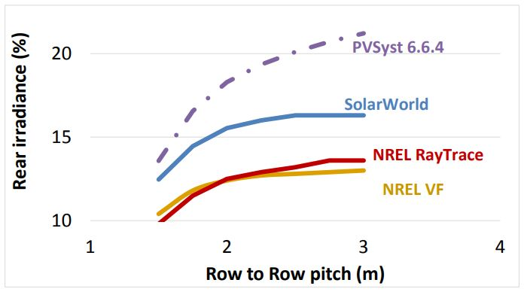
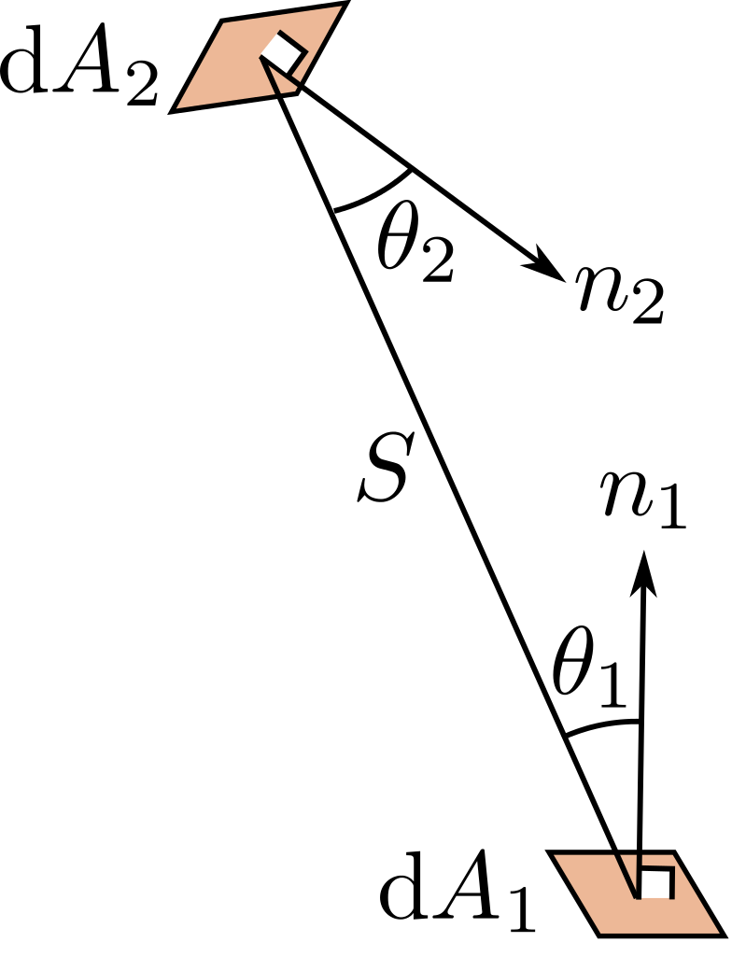
Simulation and Modelling
Shortage
PVSyst from v6.6.4.
SolarWorld
Irradiance modelling
View Factor
Neglect influences
Inaccuracy
10% variations
Notes:
As the bi-faciality factor is the only value given that characterizes the rear side, it becomes hard to model a bi-facial module.
Currently there is a shortage of commercially available software for simulating bi-facial PV modules.
PVSyst and SolarWorld are two software packages that have bi-facial simulation capabilities.
A study done by NREL shows the comparison between four simulation tools: PVSyst version 6.6.4., SolarWorld and NREL’s own implementation of a View Factor and Ray Tracing model.
From the graph on the right, it can be seen that there are variations of up to 10% between rear side irradiance values given by each simulation.
These variations are mainly due to different implementations of the View Factor model that neglects a number of factors that influences rear side irradiance.

Slide 8
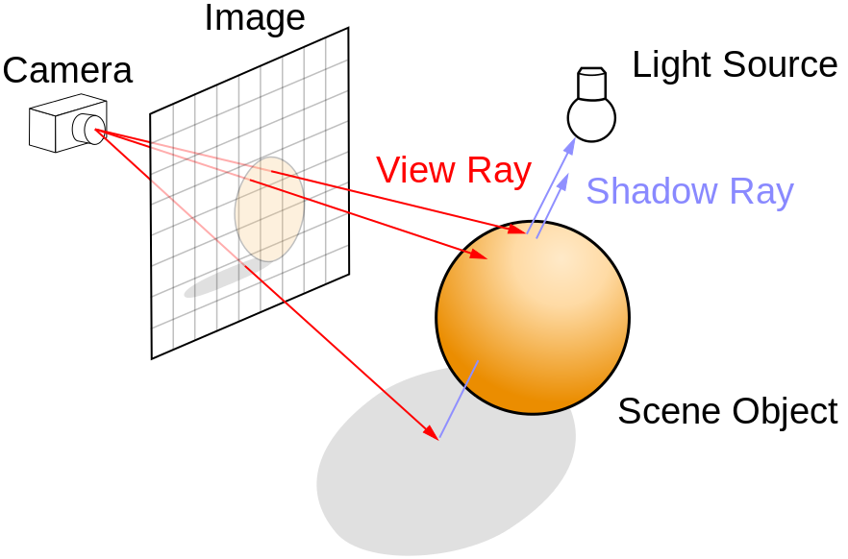
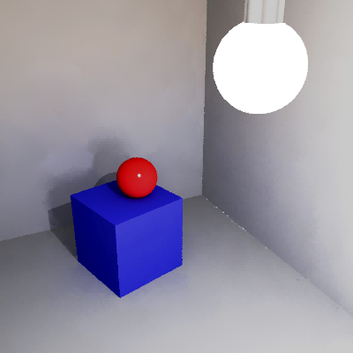
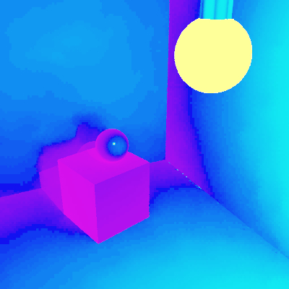
Ray Tracing
Radiance
UNIX based
Open-source toolkit
Architectural lighting analysis
CAD compatibility (.dwg -> .rad)
Own geometric functionality (.txt -> .rad)
Basic scene rendering
Irradiance mapping
Notes:
This is where Ray Tracing can serve as a solution.
This technique is realized by projecting a number of virtual rays into a predefined geometric scene.
Each ray interaction with a scene object is traced back to all light sources in the scene to result in a very realistic rendered image and illumination data.
My research aims to exploit the ray tracing capabilities of a software tool called Radiance.
Radiance is a Unix based, open source toolkit that was originally developed for architectural lighting analysis.
Geometric defined scenes can be imported from a variety of CAD programs as well as more robust text file descriptions.
The images below show a basic scene rendered with Radiance.
The left shows the detailed rendering of shadows where the right shows the interaction of light with different materials in the scene.

Slide 9






Proposed Solution
parameters
create scene
convert files
plot results
measuring points
irradiance
Azimuth
Zenith
Elevation
Date/time
Albedo
Geometric
n x m modules
.txt -> .rad -> .oct
Midpoint (x y z)
Normal vector
Normal to module surfaces
W/m^2
Notes:
The proposed solution is to develop a seamless python interface for Radiance that can simulate bi-facial plants and their various design parameters.
A user can input design parameters from which a geometric scene of a bifacial plant is created.
After converting the scene files, the mid points and normal vectors of each module are calculated in order to take irradiance measurements.
The results are then plotted in units of W/m2.

Slide 10
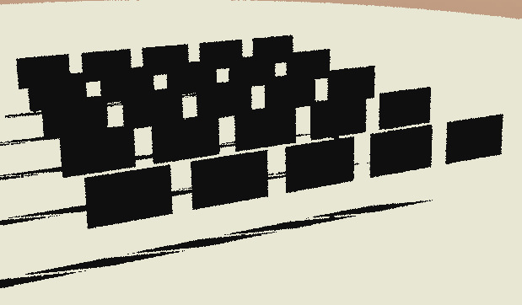
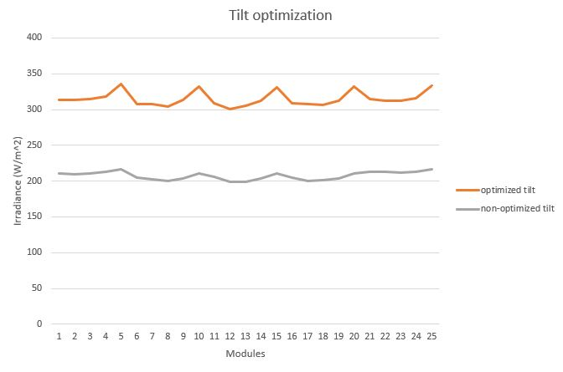
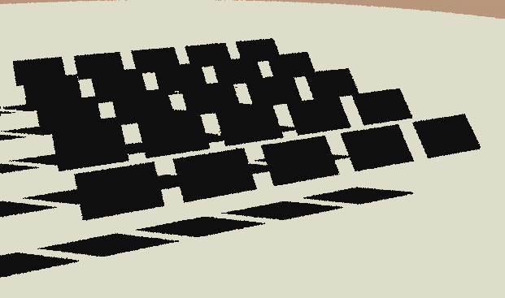
Simulation Results
Tilt optimization
Non-optimized
Module tilt angle = 90°
Optimized
Module tilt angle = 45°
Solar altitude = 30 °
Notes:
3 scenarios were simulated to test the reliability of the developed interface.
First a tilt optimization test was done.
The results for the simulation are shown on the right, which is the measured irradiance on the front of each module.
For this test the solar altitude angle was set to 30deg
At first the modules were set to a 90 angle relative to the ground.
The modules were then tilted to 45deg to face the sun more directly.
The results show a positive correlation and a increase in front irradiance that was expected.

Slide 11
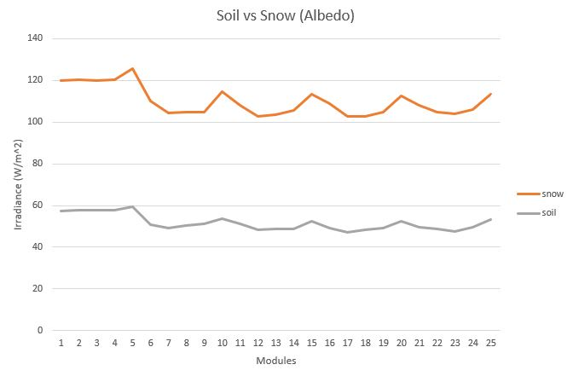

Simulation Results
Effect of albedo
Soil
Albedo = 0.45
Snow
Albedo = 0.85
Notes:
The second test was done to simulate the effect of ground surface albedo.
Again the results are shown on the right and are the measured rear side irradiance of each module.
For the first scenario the ground surface was set to soil with an albedo value of 0.45.
The ground surface was then set to snow with an albedo value of 0.85.
As you can see, the average rear side irradiance nearly doubled with an enhancement of ground surface.

Slide 12
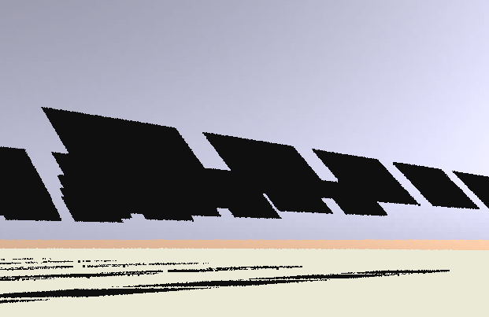
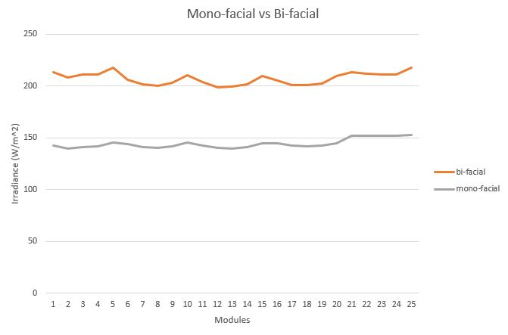
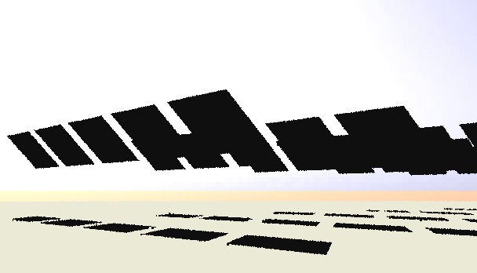
Simulation Results
Mono-facial vs Bi-facial
Mono-facial
Total irradiance = Front
Bi-facial
Total irradiance = Front + Rear
Notes:
Finally a comparison was made between mono-facial and bi-facial modules.
For the first test only the front side irradiance was taken into account for the total effective irradiance for each module.
For the bi-facial modules the front and rear side irradiances were added for the total effective irradiance of each module.
By taking the electrical model into account, it is clear that an increase in power output is expected for the bi-facial module test.

Slide 13
Conclusions
  Benefits
  Unpredictable
  Characterization
  Shortage
  Optimization
  10% variation
  View factor
Bi-facial PV technology
Simulation software
Simulation results
Ray tracing
  Interface for Radiance
  Various design parameters
  Results correlate
  Powerful tool
  Lighting analysis
  Rear side modelling
Notes:
From my research and results the following conclusions can be drawn:
Bi-facial PV offer many benefits but the unpredictability and inability to characterize the technology, makes it hard to fully enter the PV market.
Due to the shortage of bi-facial simulation software and the inaccuracy between existing products, it is desirable to investigate the possibility of Ray Tracing to serve as a viable solution.
Due to it’s high accuracy in lighting analysis, Ray Tracing and more specifically Radiance, can be a good candidate for modelling rear side irradiance of bi-facial modules.
So far a python interface for Radiance was successfully developed and the results of the simulations are satisfying when various design parameters are tested.

Slide 14
Future Work
Electrical model
Annual energy yield
Max/Min voltage and current ratings
Test various sky models
Optimization algorithms
Notes:
For future work I will be adding a electrical model in order to do annual energy yield calculations as well as finding the maximum and minimum power ratings of bi-facial plants.
I have already incorporated different sky models to further enhance the accuracy of irradiance values of simulations.
Lastly I will investigate the possibility of optimization algorithms to find the best setup for certain design parameters.

Slide 15
Thank you!
Questions?
IRRADIANCE MODELING FOR BI-FACIAL PV MODULES USING THE RAY TRACING TECHNIQUE.
J.A. Louw and Dr A.J. Rix

