Slide 1



Morphological and structural characterization of nano-sized carbon supported MoS₂ as Pt-free CE materials for DSSCs application.
Renewable Energy Postgraduates Symposium (REPS)
By
Asanda Bede
Supervisor: Prof. E. L. Meyer
Co-supervisor: Dr. R.T. Taziwa
Co-supervisor: Dr. D. Katwire
12 September 2018

Slide 2
Outline
Introduction
Methodology
  Metal sulfide synthesis
Results and discussions
  SEM
  HRTEM
  XRD
  Raman
  FTIR
  CV, CD and EIS
References
Acknowledgements
12 September 2018

Slide 3
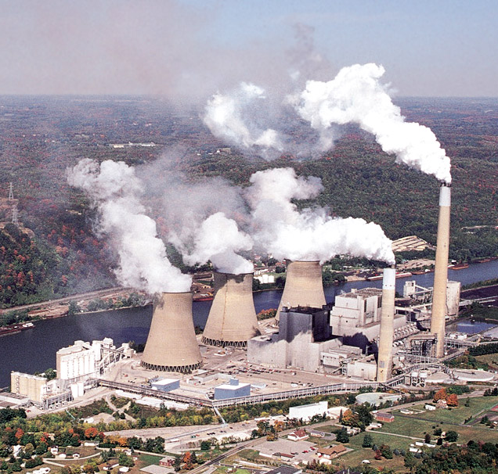
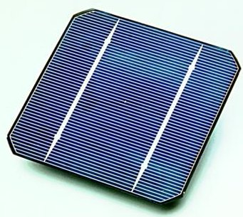
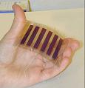
Introduction
High demand in energy due to an increasing population.
Coal fired power plants produce most of the electricity consumed in SA.
Silicon-based technology
-Widespread
-High Efficiency
-Expensive to manufacture
Dye-sensitized (“nano”)
-Newer,
- less proven
-Inexpensive to manufacture
-Flexible

Slide 4
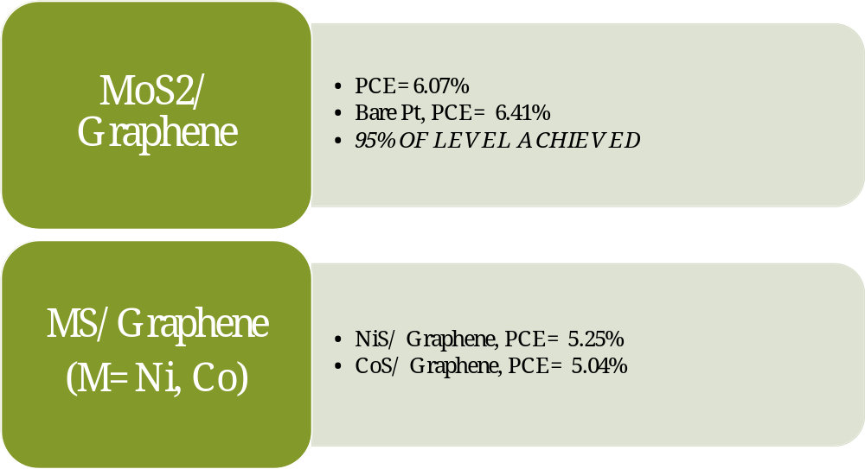

Introduction
Due to HIGH COST, HIGH DEMAND, LIMITED RESERVES.
Not appropriate for the redox species like Co³⁺/Co²⁺ and polysulfide electrolytes.
40% total cost of Manufacturing DSSC.
New alternative materials / Pt FREE Catalysts need to be explored.

Slide 5
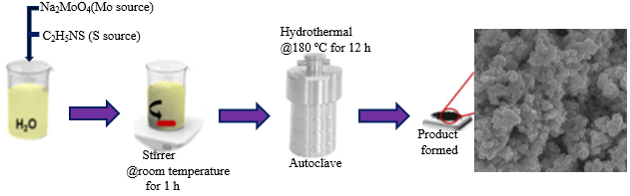
Experimental
MoS₂ samples (black precipitate), Multi-walled carbon nanotubes, and polyvinylidene fluoride (weigh ratio 8: 1: 1), were dissolved in N-methyl-2-pyrrolidinone.
Subsequently, the as-prepared slurry was paint brush on Ni foam at area of 1cm² . The coated CEs were dried at 70⁰C for overnight in an oven.
MoS₂ (mg) | MWCNTS (mg) | PVF (mg) | Mole Ratio
240 | 30 | 30 | 8:1:1
210 | 60 | 30 | 7:2:1
180 | 90 | 30 | 6:3:1
150 | 120 | 30 | 5:4:1
120 | 150 | 130 | 4:5:1
90 | 180 | 30 | 3:6:1
60 | 210 | 30 | 2:7:1
30 | 240 | 30 | 8:1:1
12 September 2018

Slide 6
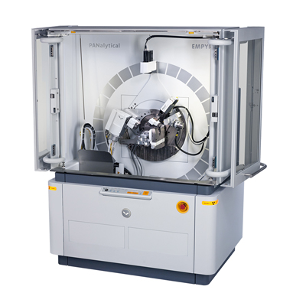
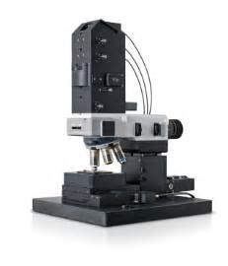
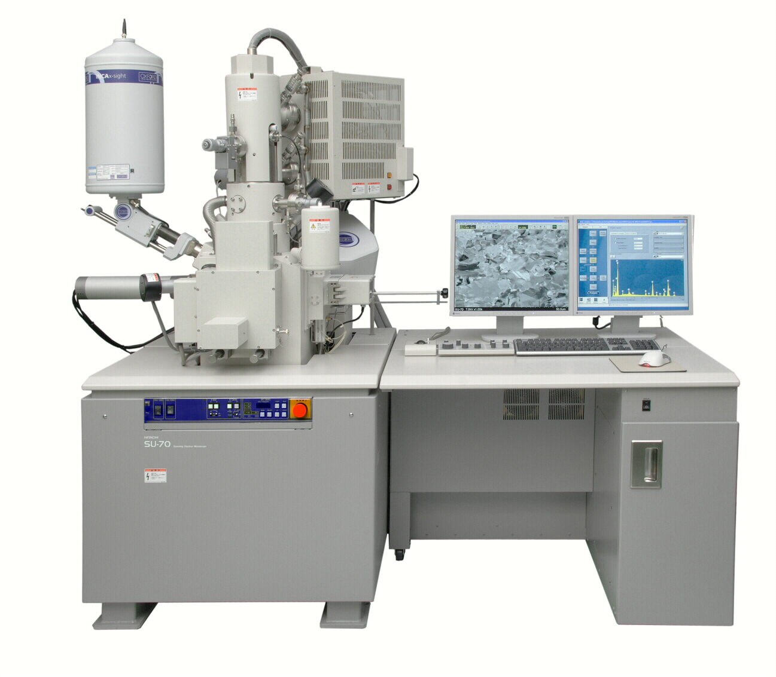
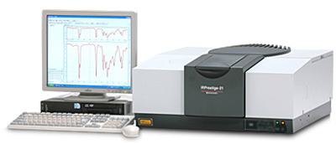
Experimental
SEM.
Raman Spectroscopy.
XRD.
FTIR

Slide 7
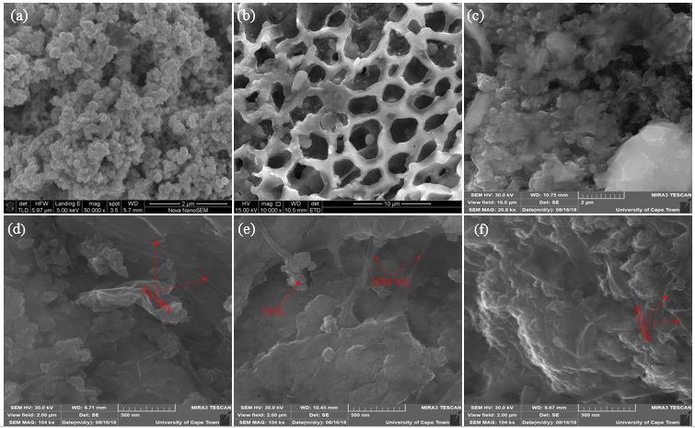
Results: SEM
SEM reveals Spherical MoS₂ NPs produced via hydrothermal method.
Also, reveals the distribution of MWCNTs on MoS₂

Slide 8
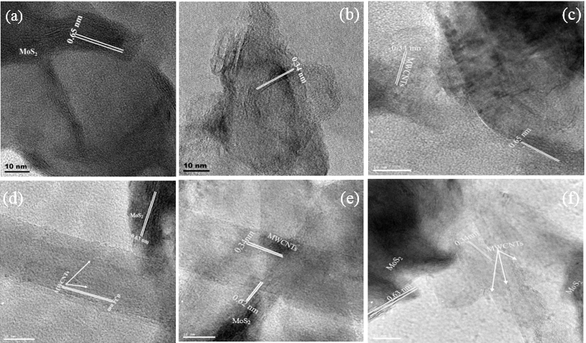
Results: HRTEM
HRTEM were employed to elucidate the structures of MoS₂ and MoS₂/MWCNTs

Slide 9
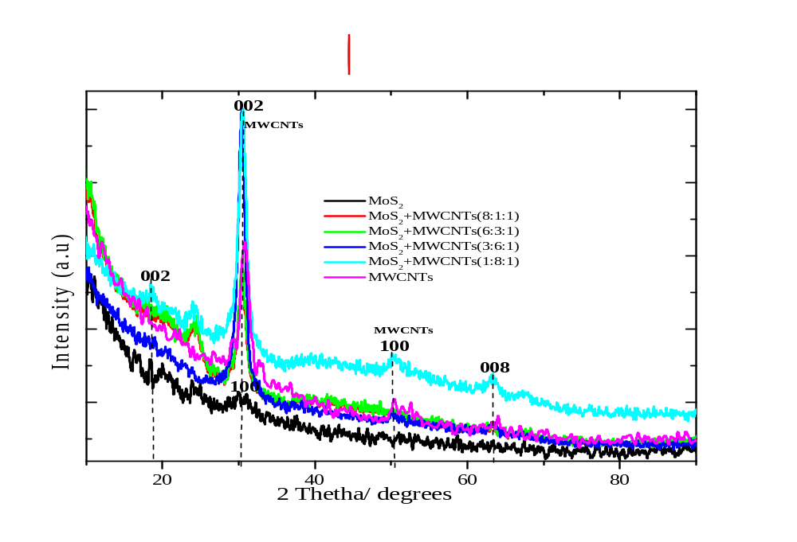
Results: XRD
(002) peak of MoS₂ have shifted from 15. 4⁰ to higher degree at 18.3⁰, denoting an outstanding interlayer expansion.
Major detectable peaks could be indexed to 1T-MoS2.

Slide 10
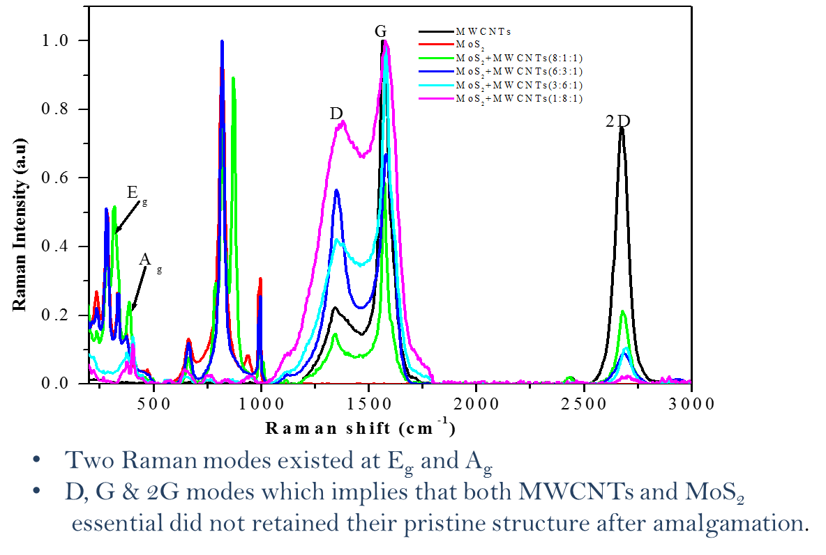
Results: Raman
Two Raman modes detected E_{g} and A_{g.}
D, G and 2D’ modes were also detected.

Slide 11
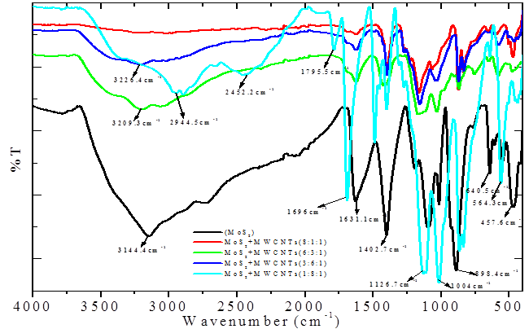
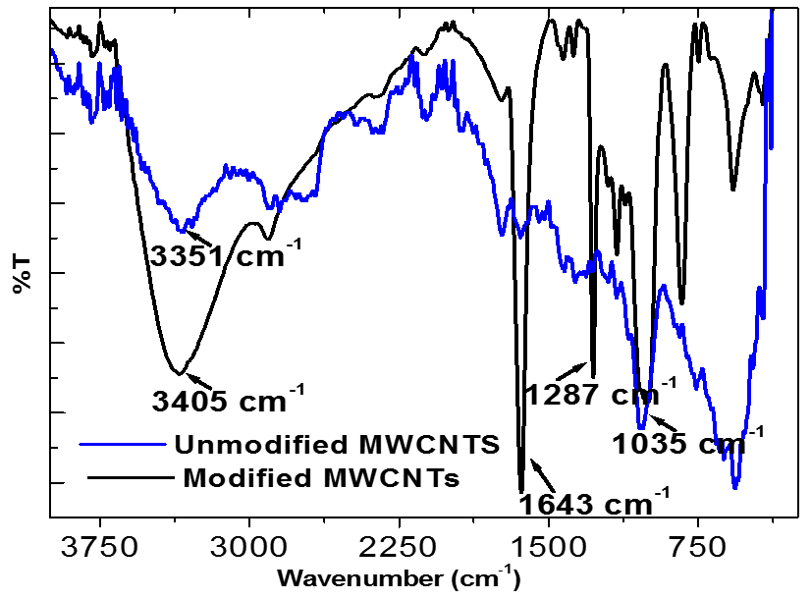
Results: FTIR
Intense absorption bands at 457 cm⁻¹, 1126 cm⁻¹, 1409cm⁻¹, 1696 cm⁻¹

Slide 12
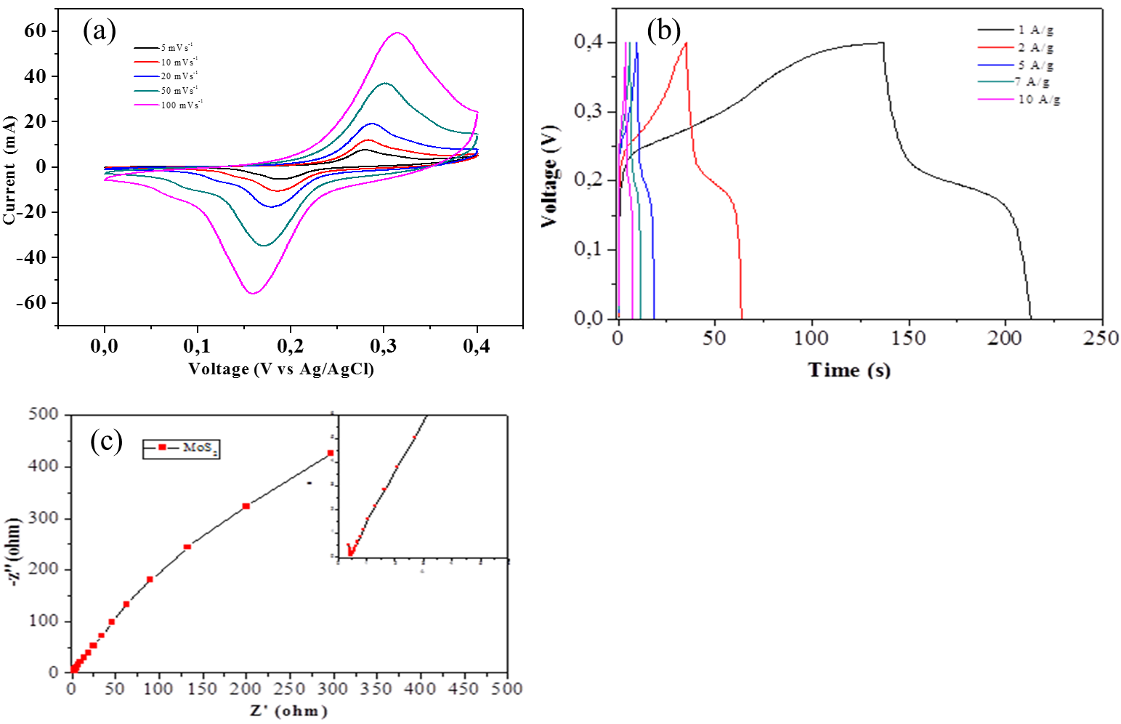
Results: Electrochemistry
Figure (a) reveals CV curve for MoS2 electrode at scan rates of 5, 10, 20, 50 and 100 mVs⁻¹.
The shape of these CV curves show no obvious change with increase in scan rate from 5 mVs⁻¹ to 100 mVs⁻¹

Slide 13

Conclusion
SEM ANALYSIS
Morphological analysis of MoS₂ and
MoS₂/MWCNTs were successfully
evaluated using SEM

Slide 14

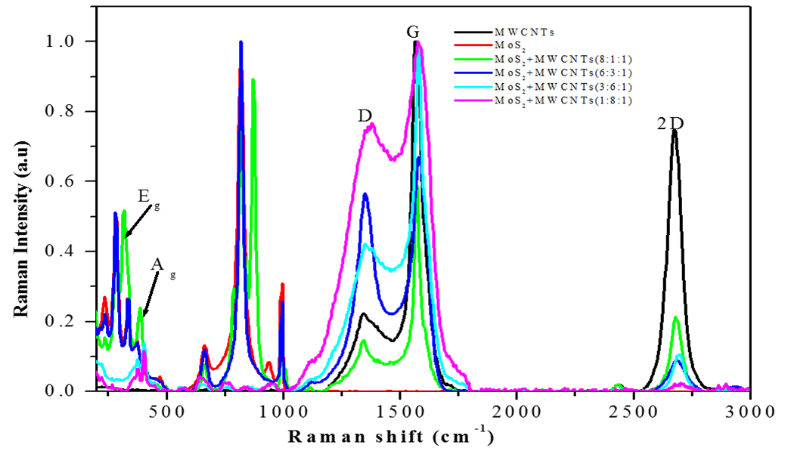
Conclusion
XRD AND RAMAN ANALYSIS
Structural analysis of MoS₂ and
MoS₂/MWCNTs were successfully
evaluated using XRD and Raman.

Slide 15
Conclusion
FTIR ANALYSIS
FTIR confirmed that S is
bonded to Mo.

Slide 16
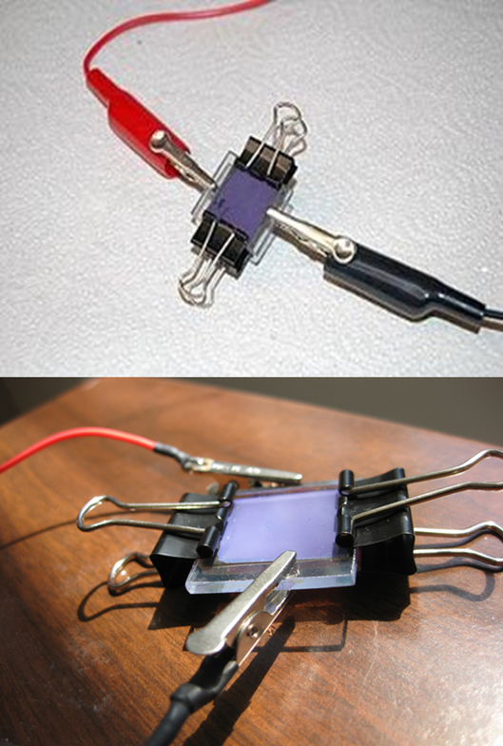
Recommendations
Perform Electrochemical characterization of
MoS₂/MWCNTs CE.
As well as elemental analysis.
Evaluate the DSSC employing MoS₂ and
MoS₂ /MWCNTs.
Investigate the effect of doping on the
performance of the DSSC.

Slide 17
References
Won J.L., Easwaramoorthi R., Dong Y.L., Jae S.S., “Efficient dye-sensitized solar cells with catalytic multiwall carbon nanotube counter electrodes,” ACS applied materials & interfaces 2009, 6, 1145–1149.
“Dye Solar Cells for Real–The assembly guide for Making Your Own Cells”, Solaronix.
O’Regan B, Gratzel M. A low-cost, high-efficiency solar cell based on dye-sensitized colloidal TiO2 films. Nature 1991; 353, 37–40.
Yu H., Zhang S.Q., Zhao H.J., Will G., Liu P.R., An Efficient and Low-Cost TiO2 Compact Layer for Performance Improvement of Dye-Sensitized Solar Cells, Electrochim. 2009, 54, 1319.
Park K.H., Dhayal M., High Efficiency Solar Cell Based on Dye Sensitized Plasma Treated Nano-Structured TiO2 Films, Electrochem. Commun.2009, 11, 75–79.
Fang X.M., Ma T.L., Guan G.Q., Akiyama M., Kida T., Abe E., Effect of The Thickness of The Pt Film Coated on A Counter Electrode on The Performance of A Dye-Sensitized Solar Cell, J. Electroanal. Chem. 2004, 570, 257–263.
Fang X.M., Ma T.L., Guan G.Q., Akiyama M., Abe E., Performances Characteristics of Dye-Sensitized Solar Cells Based on Counter Electrodes with Pt Films of Different Thickness, J. Photochem. Photobiol.2004, 164, 179–182.
12 September 2018

Slide 18
Acknowledgements
My supervisors.
Fort Hare Institute of Technology (FHIT).
RENEWABLE AND SUSTAINABLE ENERGY (NRF).
12 September 2018

Slide 19
THANK YOU ALL
12 September 2018

