Slide 1


9th RENEWABLE ENERGY POSTGRADUATE SYMPOSIUM
13 – 14 September 2018,
Faculty of Engineering, Stellenbosch University
Impact of Voltage Sags on a Transformer-less Wind Energy System
By
Akinola A. Ajayi-Obe; Mohamed A. Khan
Advanced Machines and Energy Systems (AMES) Research Group
14th September 2018

Slide 2
9th RENEWABLE ENERGY POSTGRADUATE SYMPOSIUM
13 – 14 September 2018,
Faculty of Engineering, Stellenbosch University
Presentation Outline
Purpose of a Transformer in a Conventional Wind Power Plant
Why Transformer-less?
Impact of Voltage Sags on a Conventional Wind Power Plants
Impact of Voltage Sags on a Transformer-less Wind Energy Conversion Systems
Conclusions

Slide 3
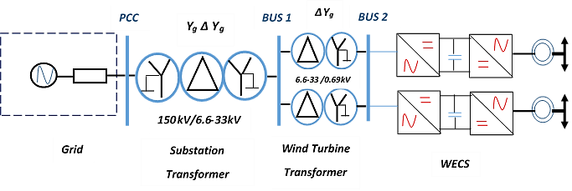
Purpose of a Transformer in a Conventional Wind Power Plant
9th RENEWABLE ENERGY POSTGRADUATE SYMPOSIUM
13 – 14 September 2018,
Faculty of Engineering, Stellenbosch University
  Voltage Step-up
Transmission/Distribution Power Network
Substation Unit:
6.6 kV-33 kV to 150 kV
Collection Point: 6.6 kV-33 kV
Wind Energy Conversion Systems (WECS) or Wind Turbines rated at 690 V.
Fig. 1: A Conventional Wind Power Plant

Slide 4
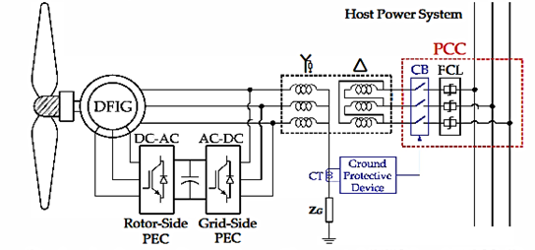
Purpose of a Transformer in a Conventional Wind Power Plant
9th RENEWABLE ENERGY POSTGRADUATE SYMPOSIUM
13 – 14 September 2018,
Faculty of Engineering, Stellenbosch University
  B. Grounding
The primary wye winding connection of this transformer provides the low impedance path between the wind energy conversion system (WECS) and the wind power plant ground.
Allows the transmission of excess current to the ground during faulty conditions.
Fig. 2: A grid-connected DFIG-based WECS with its grounded-wye/delta transformer winding connection and protective device.

Slide 5
Purpose of a Transformer in a Conventional Wind Power Plant
9th RENEWABLE ENERGY POSTGRADUATE SYMPOSIUM
13 – 14 September 2018,
Faculty of Engineering, Stellenbosch University
  C. Voltage Sag Transformation
Original Voltage
Sags
Type A
Type B
Type C
Type E
Transformed Voltage
Sags
Type A
Type C
Type D
Type F
Type A
Type D
Type C
Type G
Transformed Voltage
Sags
PCC
Y_{g} ∆Y_{g}
BUS 1
∆Y_{g}
BUS 2
V_{s}
Z_{s}
33 kV /0.69 kV
150kV/33 kV
Fault
Z_{f}
Substation Transformer
Wind Turbine
Transformer
Grid
WECS
Fig. 3: A Conventional Wind Power Plant model with a short circuit fault at PCC.

Slide 6
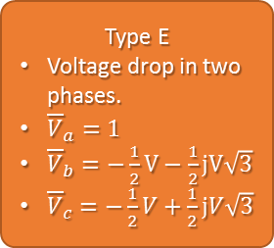
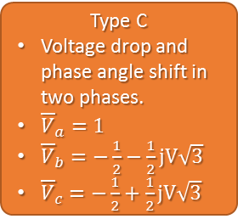
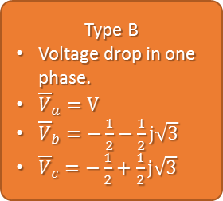
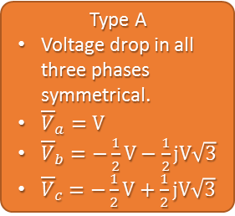
Purpose of a Transformer in a Conventional Wind Power Plant
9th RENEWABLE ENERGY POSTGRADUATE SYMPOSIUM
13 – 14 September 2018,
Faculty of Engineering, Stellenbosch University
  C. Voltage Sag Transformation
Type A
Type A
Voltage drop in all three phases symmetrical.
${\overline{V}}_{a}=V$
${\overline{V}}_{b}=−\frac{1}{2}V−\frac{1}{2}jV\sqrt{3}$
${\overline{V}}_{c}=−\frac{1}{2}V+\frac{1}{2}jV\sqrt{3}$
Type B
Type B
Voltage drop in one phase.
${\overline{V}}_{a}=V$
${\overline{V}}_{b}=−\frac{1}{2}−\frac{1}{2}j\sqrt{3}$
${\overline{V}}_{c}=−\frac{1}{2}+\frac{1}{2}j\sqrt{3}$
Type C
Type C
Voltage drop and phase angle shift in two phases.
${\overline{V}}_{a}=1$
${\overline{V}}_{b}=−\frac{1}{2}−\frac{1}{2}jV\sqrt{3}$
${\overline{V}}_{c}=−\frac{1}{2}+\frac{1}{2}jV\sqrt{3}$
V_{b}
V_{b}
V_{b}
V_{a}
V_{a}
V_{a}
V_{c}
V_{c}
V_{c}
Type E
Type E
Voltage drop in two phases.
${\overline{V}}_{a}=1$
${\overline{V}}_{b}=−\frac{1}{2}V−\frac{1}{2}jV\sqrt{3}$
${\overline{V}}_{c}=−\frac{1}{2}V+\frac{1}{2}jV\sqrt{3}$
V_{b}
V_{a}
V_{c}

Slide 7
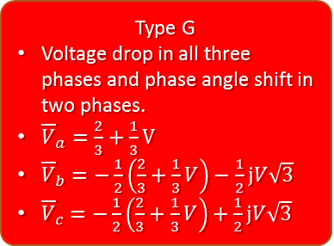
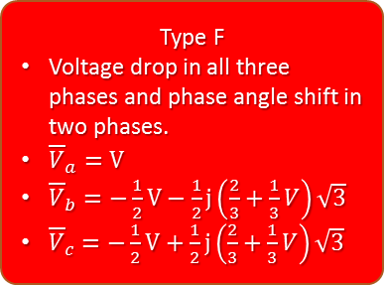
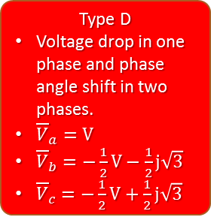
Purpose of a Transformer in a Conventional Wind Power Plant
9th RENEWABLE ENERGY POSTGRADUATE SYMPOSIUM
13 – 14 September 2018,
Faculty of Engineering, Stellenbosch University
  C. Voltage Sag Transformation
Type D
Type D
Voltage drop in one phase and phase angle shift in two phases.
${\overline{V}}_{a}=V$
${\overline{V}}_{b}=−\frac{1}{2}V−\frac{1}{2}j\sqrt{3}$
${\overline{V}}_{c}=−\frac{1}{2}V+\frac{1}{2}j\sqrt{3}$
Type F
Type F
Voltage drop in all three phases and phase angle shift in two phases.
${\overline{V}}_{a}=V$
${\overline{V}}_{b}=−\frac{1}{2}V−\frac{1}{2}j\left(\frac{2}{3}+\frac{1}{3}V\right)\sqrt{3}$
${\overline{V}}_{c}=−\frac{1}{2}V+\frac{1}{2}j\left(\frac{2}{3}+\frac{1}{3}V\right)\sqrt{3}$
V_{b}
V_{b}
V_{a}
V_{a}
V_{c}
V_{c}
Type G
Type G
Voltage drop in all three phases and phase angle shift in two phases.
${\overline{V}}_{a}=\frac{2}{3}+\frac{1}{3}V$
${\overline{V}}_{b}=−\frac{1}{2}\left(\frac{2}{3}+\frac{1}{3}V\right)−\frac{1}{2}jV\sqrt{3}$
${\overline{V}}_{c}=−\frac{1}{2}\left(\frac{2}{3}+\frac{1}{3}V\right)+\frac{1}{2}jV\sqrt{3}$
V_{b}
V_{a}
V_{c}

Slide 8
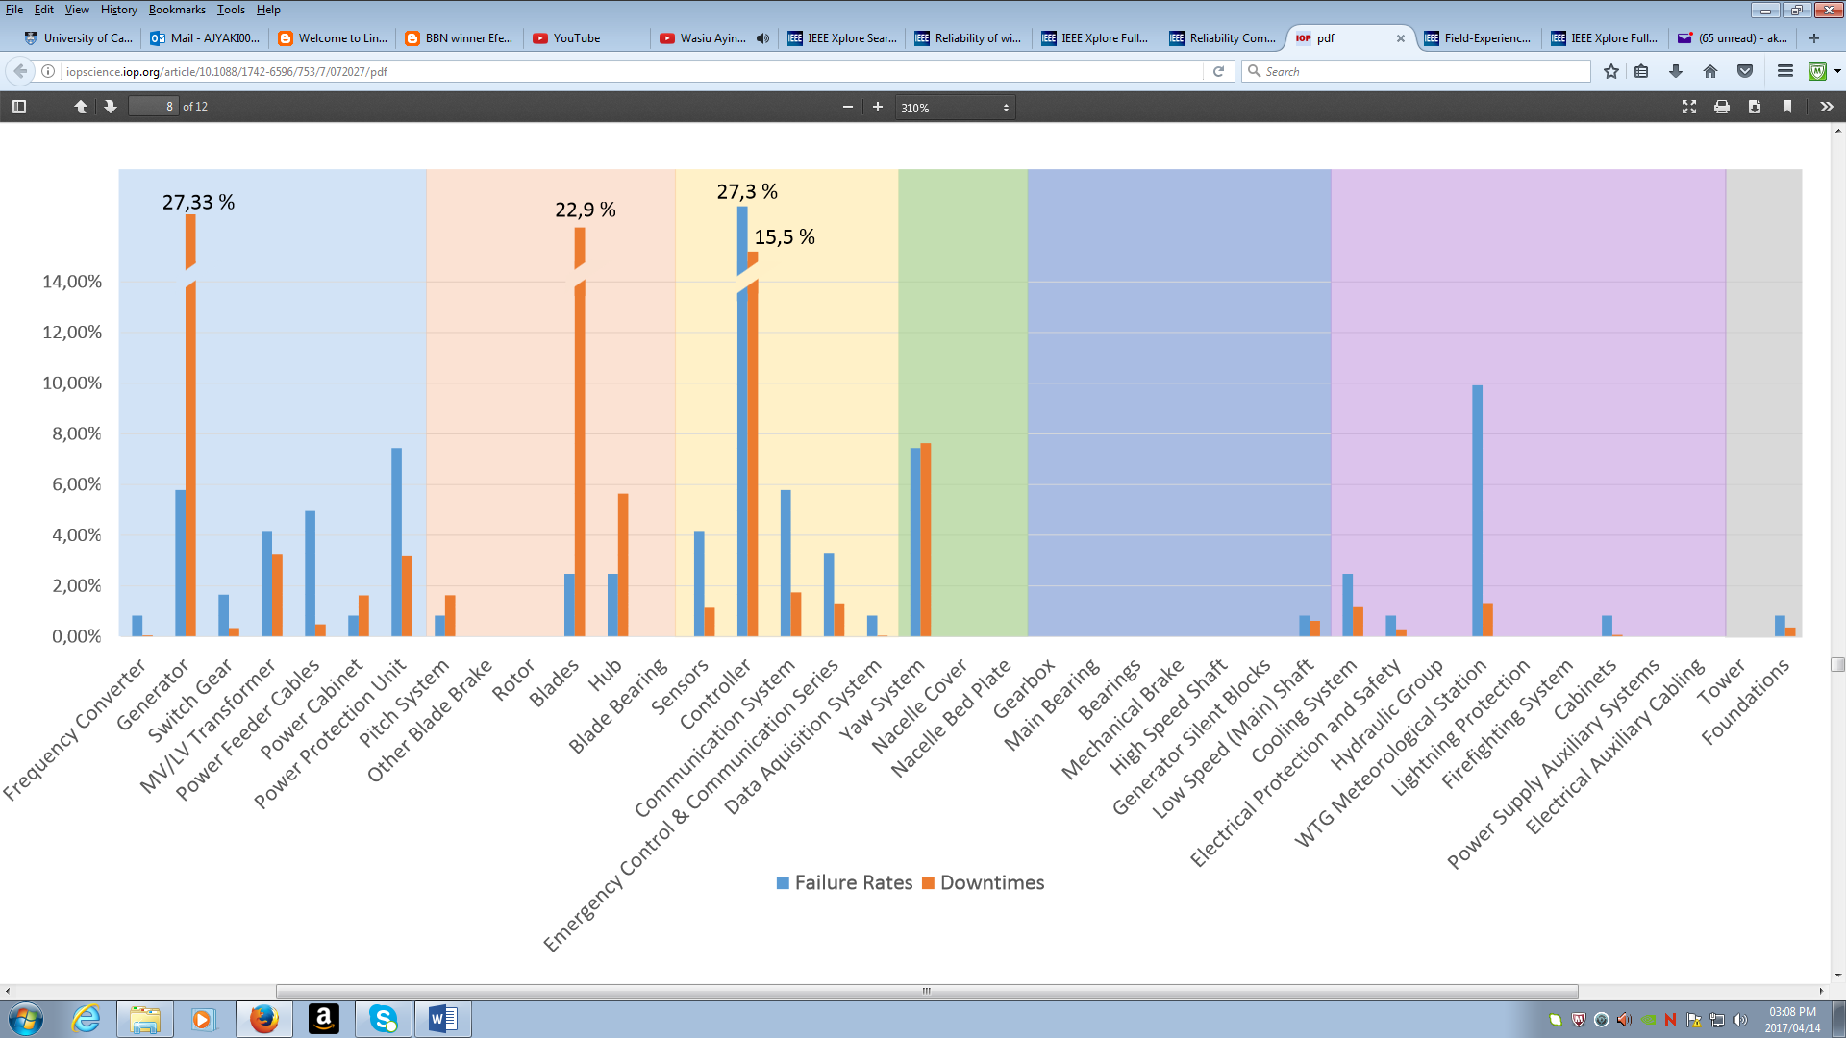
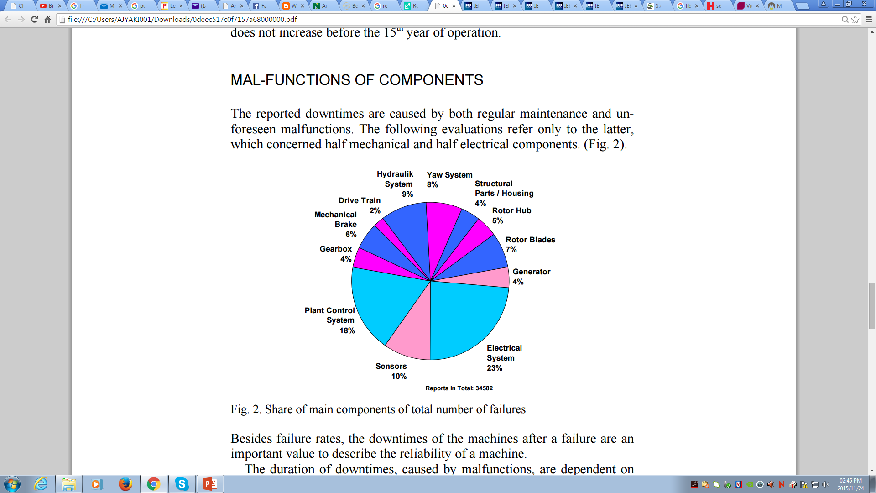
9th RENEWABLE ENERGY POSTGRADUATE SYMPOSIUM
13 – 14 September 2018,
Faculty of Engineering, Stellenbosch University
Why Transformer-less?
Study A:
1500 Wind Turbines operated for 15 years
Study B:
3700 Wind Turbines operated for 5 years
Study C:
6000 Wind Turbines operated for 11 years
Failure Rate
Downtime Rate
Fig. 4: Percentage Distribution of the Number of Failures for Onshore Swedish Wind Power Plants
Fig. 5: Breakdown of the Failure Rates and Downtimes of Electrical Subsystem Components of Direct Drive WECS

Slide 9
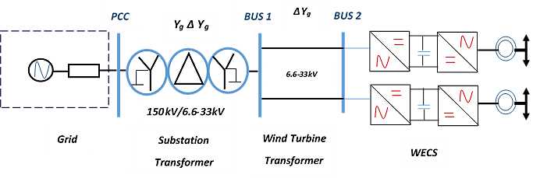
9th RENEWABLE ENERGY POSTGRADUATE SYMPOSIUM
13 – 14 September 2018,
Faculty of Engineering, Stellenbosch University
Why Transformer-less?
Fig. 6: A Wind Power Plant with Transformer-less Wind Energy Conversion System (WECS).

Slide 10
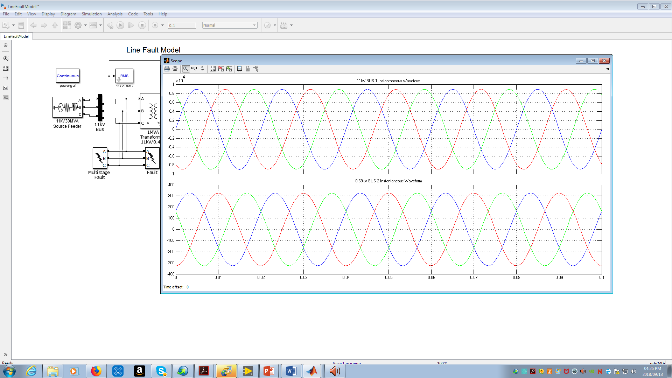
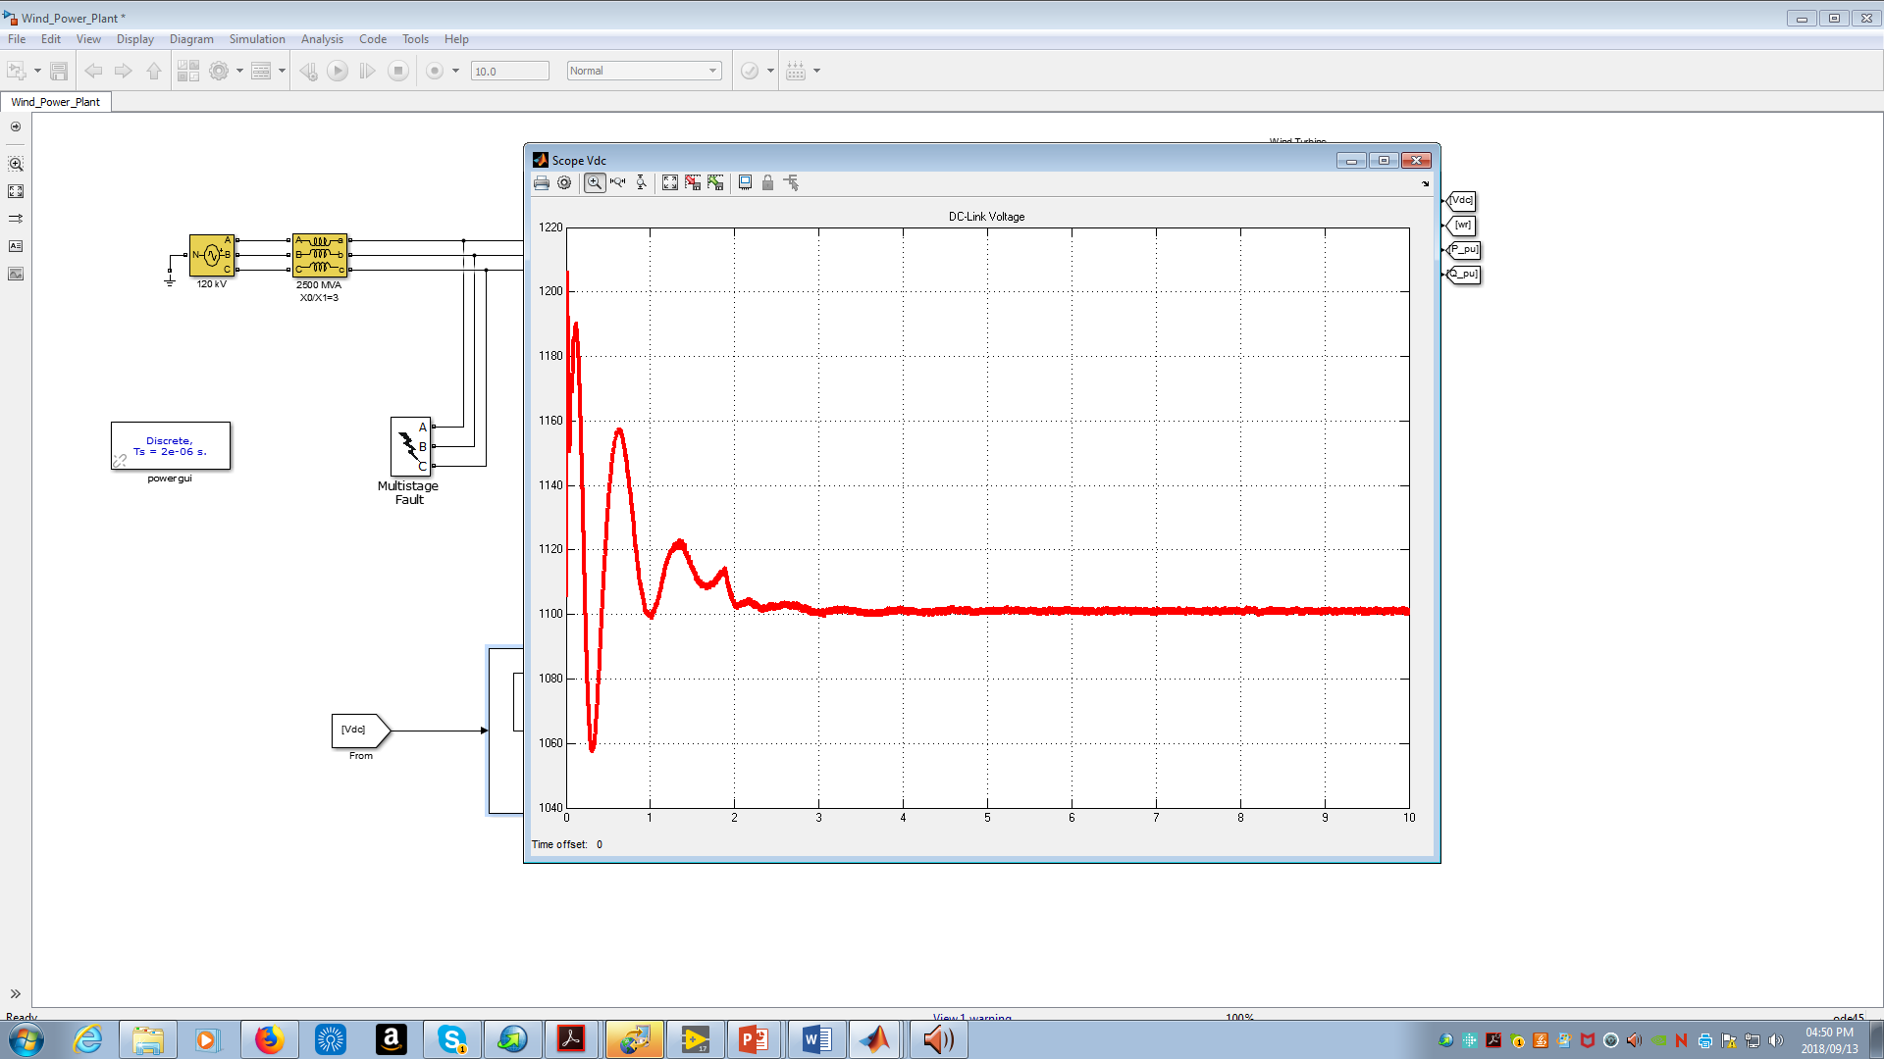
9th RENEWABLE ENERGY POSTGRADUATE SYMPOSIUM
13 – 14 September 2018,
Faculty of Engineering, Stellenbosch University
Impact of Voltage Sags on a Conventional Wind Power Plants.
Based on a MATLAB/Simulink Model of a Wind Power Plant with five Permanent Magnet Synchronous Generator (PMSG) using the following parameters:
Parameter | Value
Nominal Power Rating of PMSG | 2 MW
Terminal Voltage Rating of PMSG | 690 V
Fundamental Frequency | 60 Hz
Power Rating of Transformer | 2.5 MVA
DC-Link Voltage | 1100 V
DC-Link Voltage Controller Proportional Gain (Kp) | 1.1
DC-Link Voltage Controller Integral Gain (Ki) | 27.5
(a)
(b)
Fig. 7: (a) Wind Turbine Output Voltage; (b) DC-Link Voltage Transient.

Slide 11
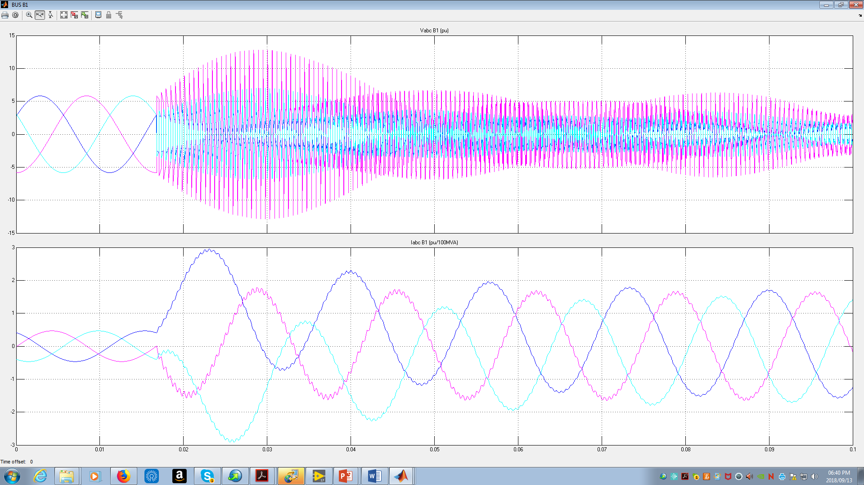
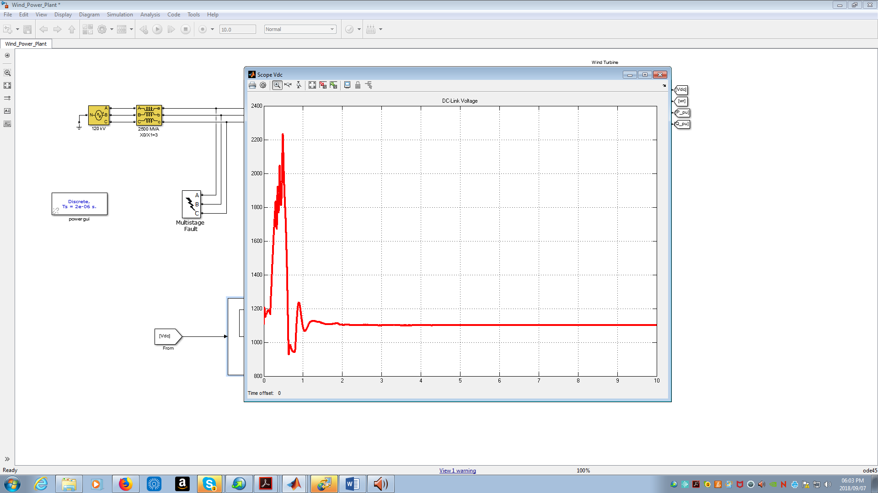
9th RENEWABLE ENERGY POSTGRADUATE SYMPOSIUM
13 – 14 September 2018,
Faculty of Engineering, Stellenbosch University
Impact of Voltage Sags on a Conventional Wind Power Plants.
  Asymmetrical Sag
Type A
Consist of positive sequence component.
Overshoot of dc-link voltage is directly proportional to the amplitude of positive sequence in the grid voltage
Largest overshoot in the dc-link voltage in the type A sag.
83% transient
Transient overshoot in the dc-link voltage
increase by 83% and it lasts for about 1 minute.

Slide 12
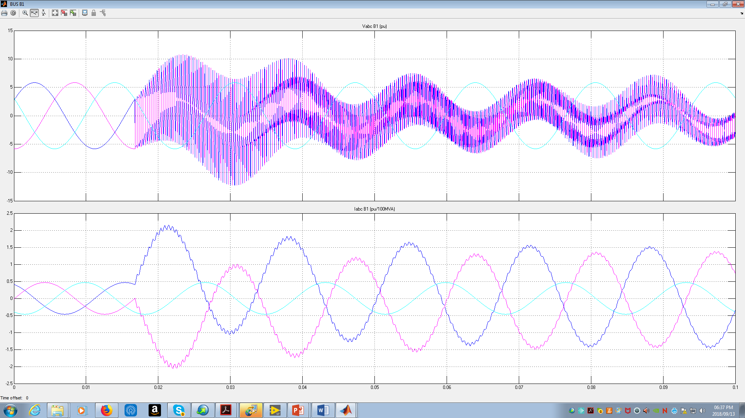
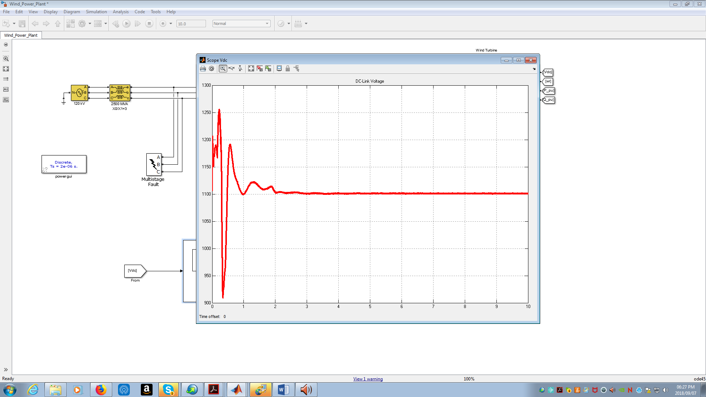
9th RENEWABLE ENERGY POSTGRADUATE SYMPOSIUM
13 – 14 September 2018,
Faculty of Engineering, Stellenbosch University
Impact of Voltage Sags on a Conventional Wind Power Plants.
  Symmetrical Sag
Type C
Consist of positive sequence and negative sequence components.
Overshoot of dc-link voltage is between 10%-30%.
Largest overshoot in the fault current is observed.
Transient overshoot in the dc-link voltage increase by 13.6% and it lasts for about 2 minutes.
13.6% transient

Slide 13
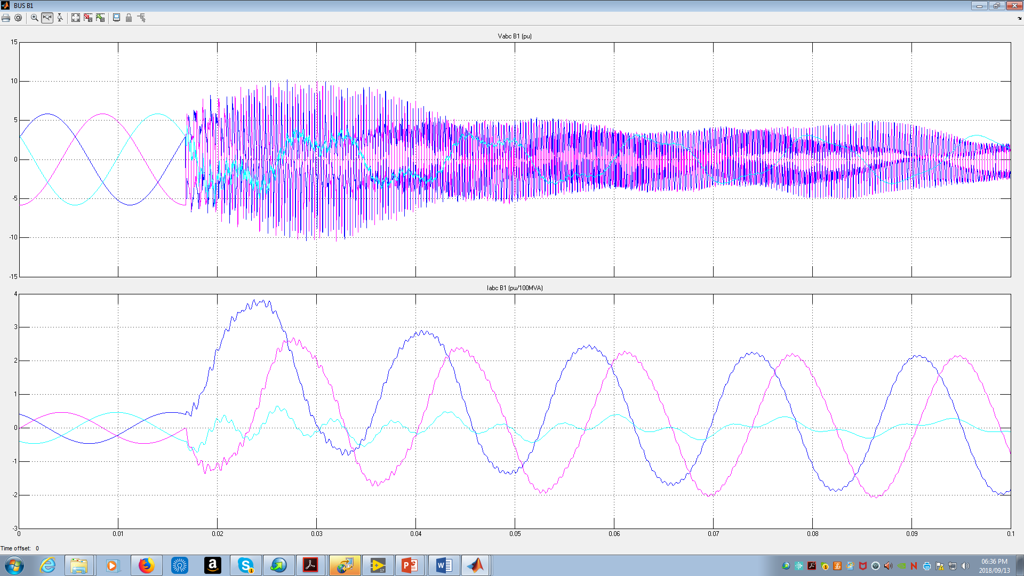
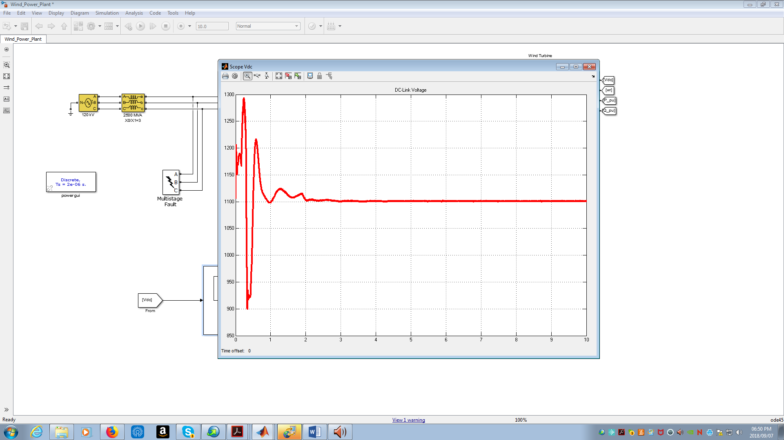
9th RENEWABLE ENERGY POSTGRADUATE SYMPOSIUM
13 – 14 September 2018,
Faculty of Engineering, Stellenbosch University
Impact of Voltage Sags on a Conventional Wind Power Plants.
  Symmetrical Sag
Type G
Consist of positive sequence, negative sequence, and zero sequence components.
Overshoot of dc-link voltage is between 10%-30%.
Transient overshoot in the dc-link voltage increase by 18.2% and it lasts for about 2 minutes.
18.2% transient

Slide 14
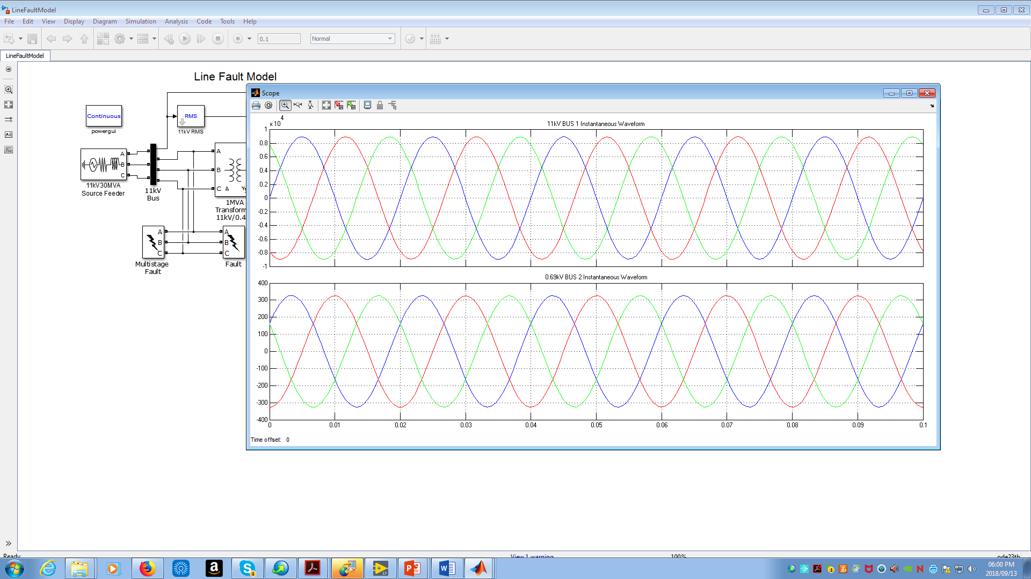
9th RENEWABLE ENERGY POSTGRADUATE SYMPOSIUM
13 – 14 September 2018,
Faculty of Engineering, Stellenbosch University
Impact of Voltage Sags on a Transformer-less Wind Energy Conversion Systems.
Based on a MATLAB/Simulink Model of a Wind Power Plant with five Permanent Magnet Synchronous Generator (PMSG) using the following parameters:
Parameter | Value
Nominal Power Rating of PMSG | 2 MW
Terminal Voltage Rating of PMSG | 11000 V
Fundamental Frequency | 60 Hz
DC-Link Voltage | 17000 V
DC-Link Voltage Controller Proportional Gain (Kp) | 1.1
DC-Link Voltage Controller Integral Gain (Ki) | 27.5
Fig. 8: Wind Turbine Output Voltage

Slide 15
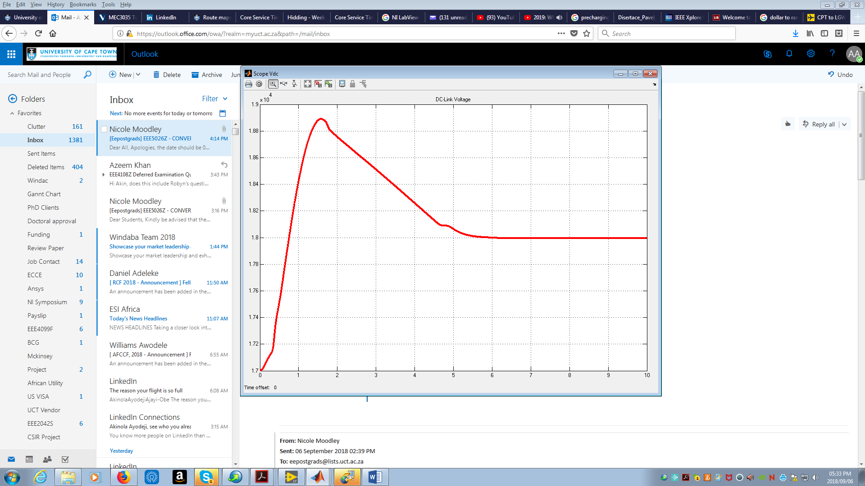
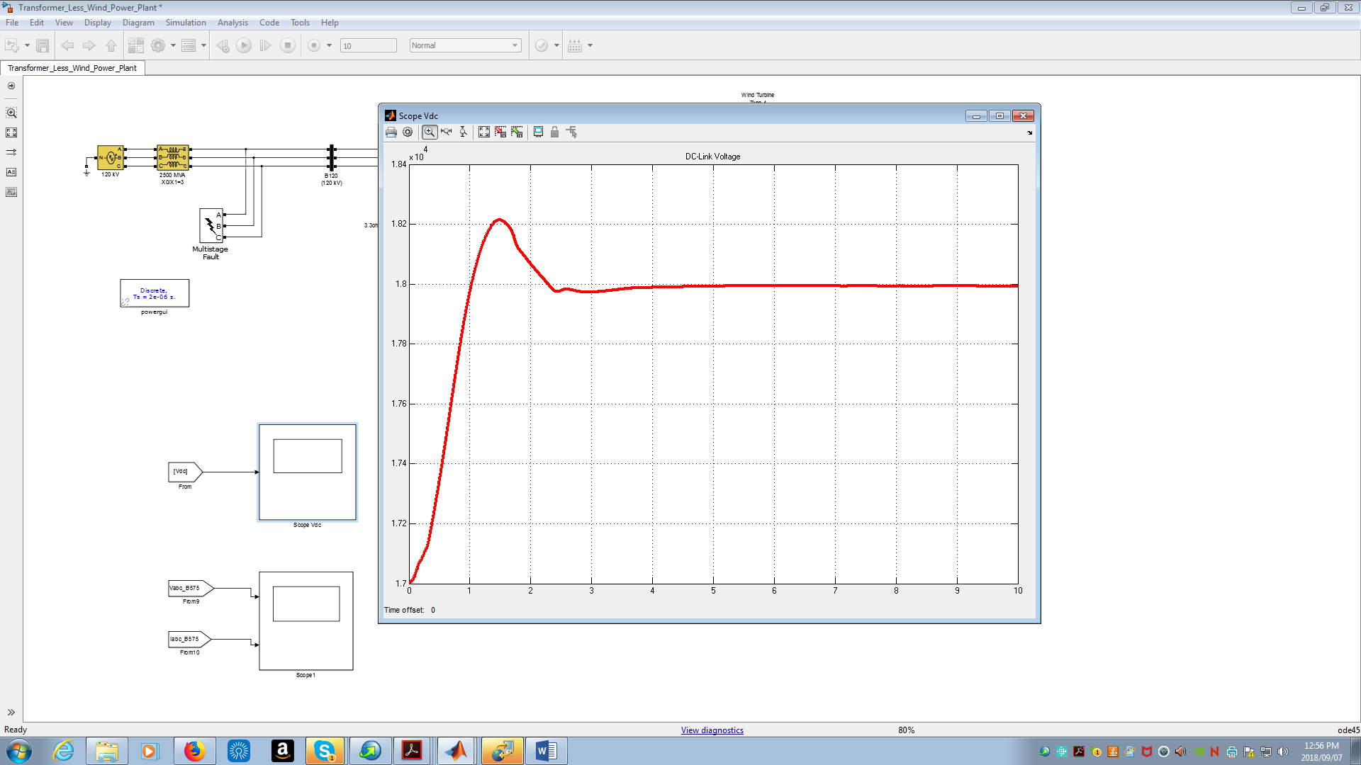
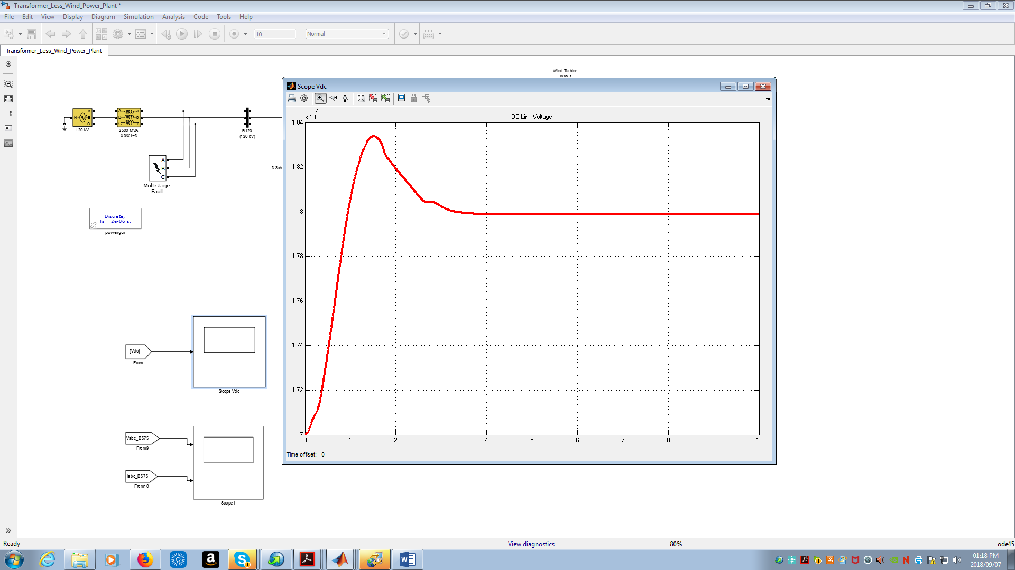
9th RENEWABLE ENERGY POSTGRADUATE SYMPOSIUM
13 – 14 September 2018,
Faculty of Engineering, Stellenbosch University
Impact of Voltage Sags on a Transformer-less Wind Energy Conversion Systems.
Type A
Type C
11.2% transient
7.06% transient
Transient overshoot in the dc-link voltage increase by 11.2% and it lasts for more than 10 minutes.
Transient overshoot in the dc-link voltage increase by 7.06% and it lasts for more than 10 minutes.
Type F
7.65% transient
Transient overshoot in the dc-link voltage increase by 7.65% and it lasts for more than 10 minutes.

Slide 16
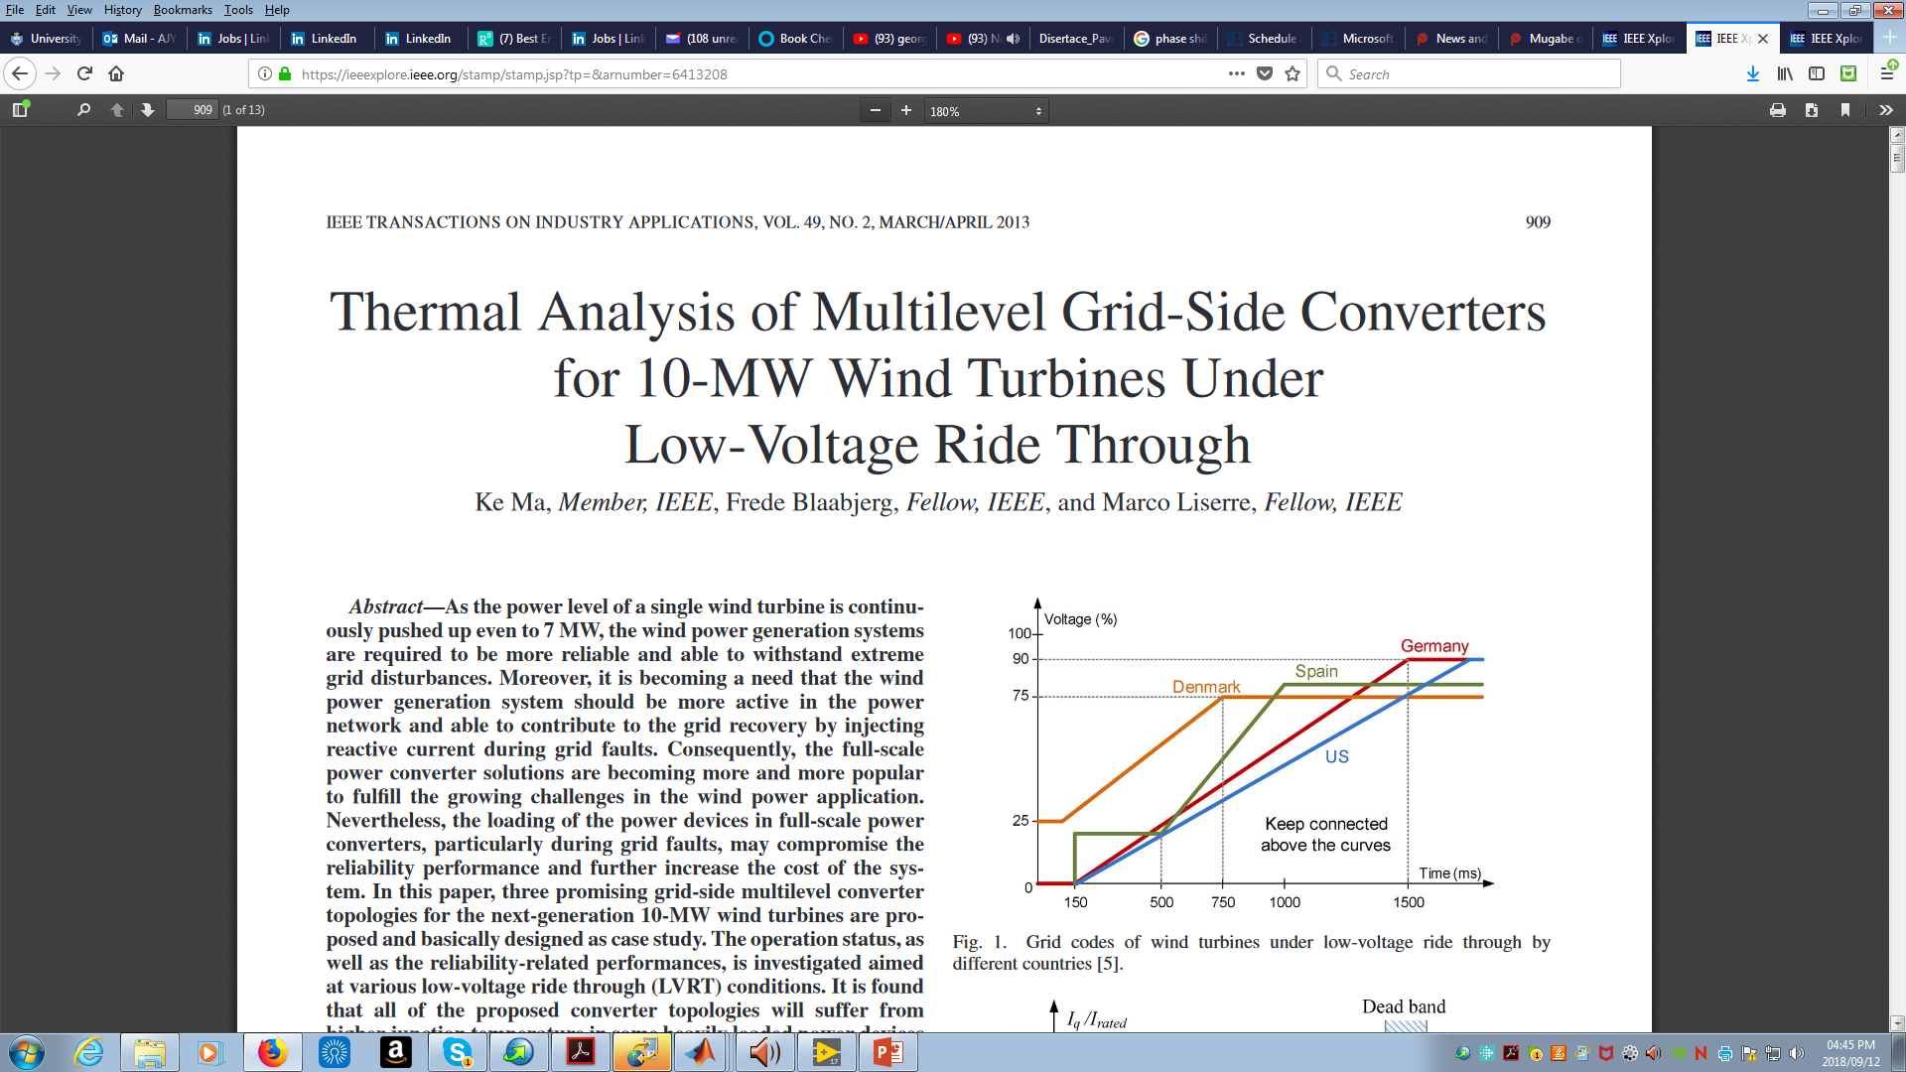
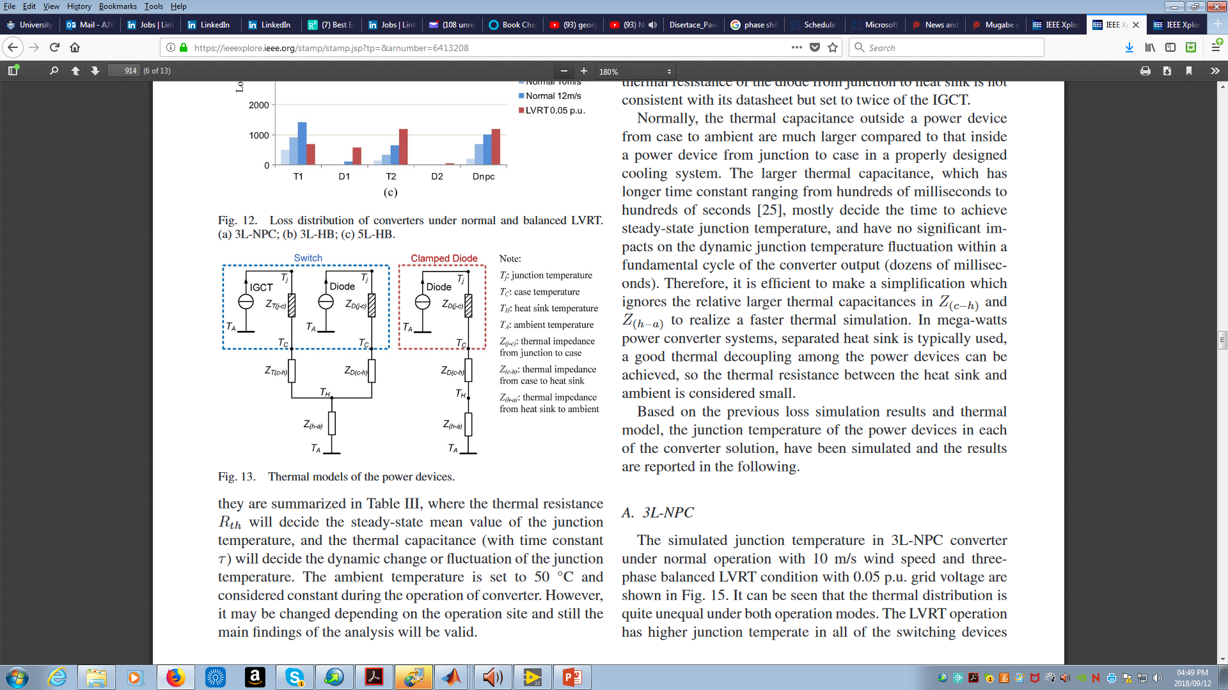
9th RENEWABLE ENERGY POSTGRADUATE SYMPOSIUM
13 – 14 September 2018,
Faculty of Engineering, Stellenbosch University
Impact of Voltage Sags on a Transformer-less Wind Energy Conversion Systems.
Major Impact of Voltage Sags on
Wind Energy Conversion System.
Grid Code under Fault Ride-Through
Fault Ride-Through Requirement
Thermal Loading of semiconductor devices
Dynamics of the Voltage and Current Controllers
Combined control algorithm (using both PI control and Predictive control)

Slide 17
9th RENEWABLE ENERGY POSTGRADUATE SYMPOSIUM
13 – 14 September 2018,
Faculty of Engineering, Stellenbosch University
Conclusions
A transformer-less WECS will be operated at the medium voltage range between 6.6 kV to 33 kV, and high power
megawatt range (1MW to 10MW).
Therefore, the PMSG will be more suitable for the transformer-less WECS and will require a full-scale converter.
A multilevel converter topology will be required at the grid-side converter of the WECS.
The current controller of the grid-side converter must provide fast response to the severe grid faults.

Slide 18
9th RENEWABLE ENERGY POSTGRADUATE SYMPOSIUM
13 – 14 September 2018,
Faculty of Engineering, Stellenbosch University
Thank you very much !!!!!!

