Slide 2
Integration of solar process heat at a South African microbrewery: a feasibility study
Pieter De Wet Taljaard ª, Thomas Harms ª, and Ben Sebitosi ^{b}
ª Solar Thermal Energy Research Group (STERG),
Stellenbosch University
^{b} Department of mechanical and mechatronic engineering,
Stellenbosch University

Slide 3
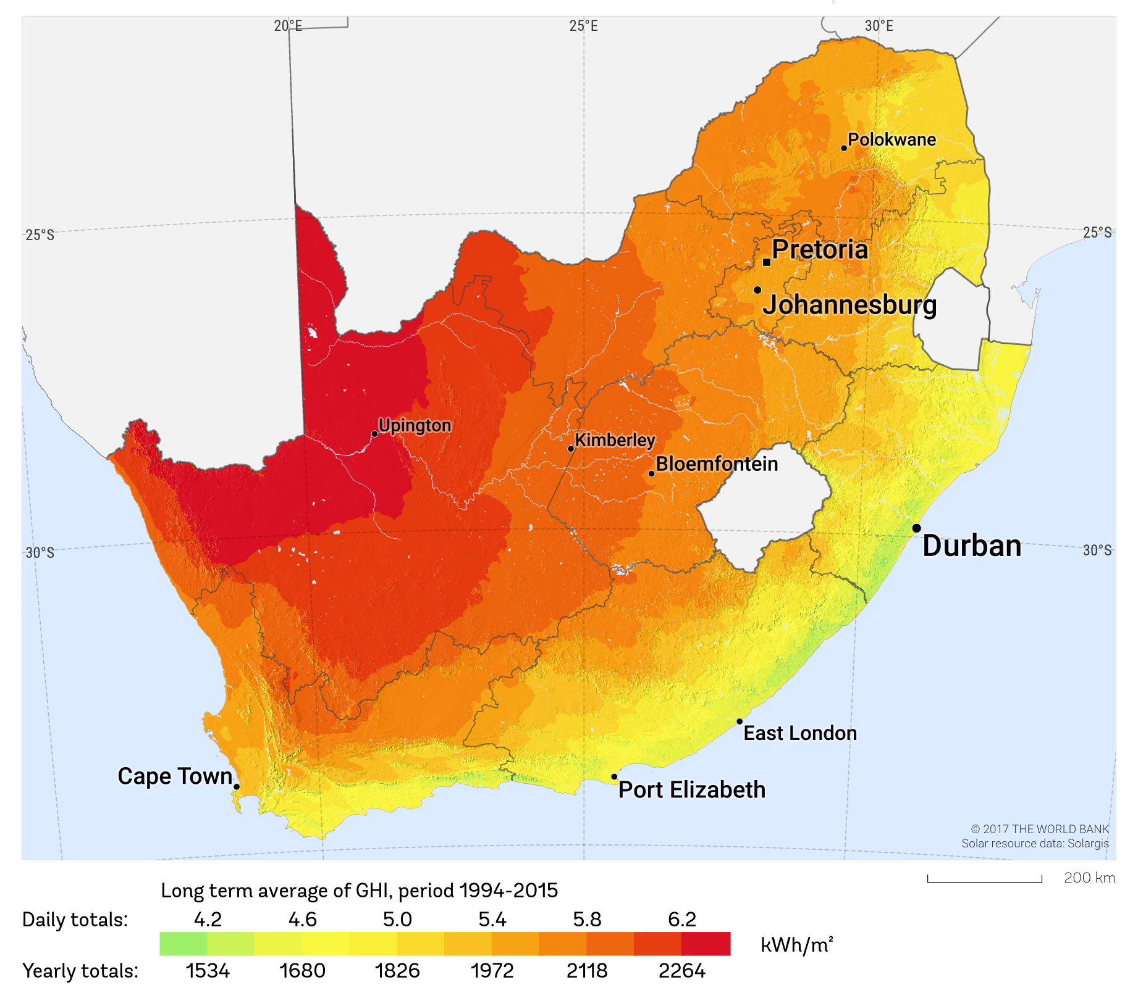
Background
SA Solar Resource in Industrial Areas
Gauteng
2000 kWh/m²
Greater Cape Town
1800 kWh/m²
Greater Durban
1600 kWh/m²

Slide 4
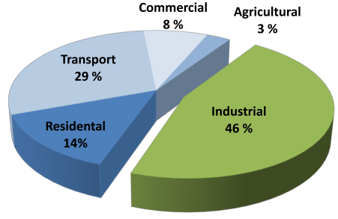
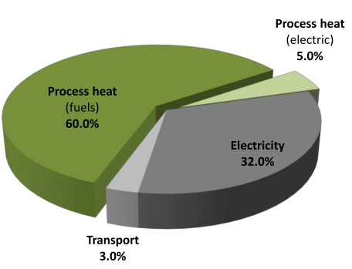
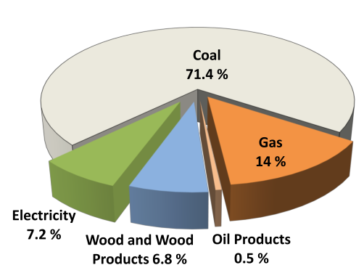
Background
Sectoral Energy Demand
Industrial Heat demand
Industrial Energy Usage
Fuel Source
Hess 2015, (Adapted from SATIM 2014)

Slide 5
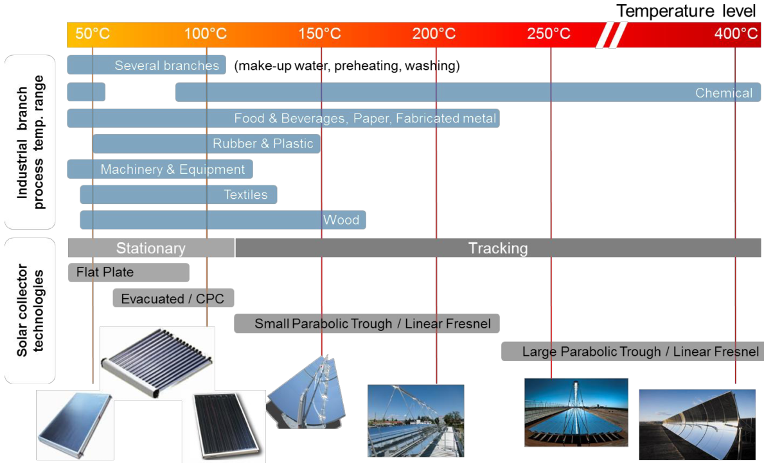
Background
Technology
Temperature
Supplied
Stationary vs
Tracking

Slide 6
Background
Target industries
Low temperature heat requirement
Constant heat demand
High cost fuel source
Food and beverage, Textile and agri-processing

Slide 7

Background
Berg River Brewery
Microbrewery in Paarl, WC
Established in 2016
Food and Beverage Industry
Low to medium Temperature requirement

Slide 8
Motivation
SPH at BRB
Unbiased assessment of SPH
SPH for small industrial applications

Slide 9
Thermal Demand
Per Brew
Process | Start Temp. [°C] | End Temp. [°C] | Medium | Specific heat [kWh/m3K] | Volume [L] | Heat Requirement [kWhth] | Percentage of Heat Requirement
Mashing | 18 | 75 | water | 1.16 | 300 | 19.8 | 23%
Wort filter | 18 | 75 | water | 1.16 | 350 | 23.1 | 26%
Boiler/Kettle | 75 | 100 | sweet wort | 1 | 600 | 15.0 | 17%
Boiling/Hot hold | 100 | 100 | wort & hops | 1.25 | 600 | 30.0 | 34%

Slide 10
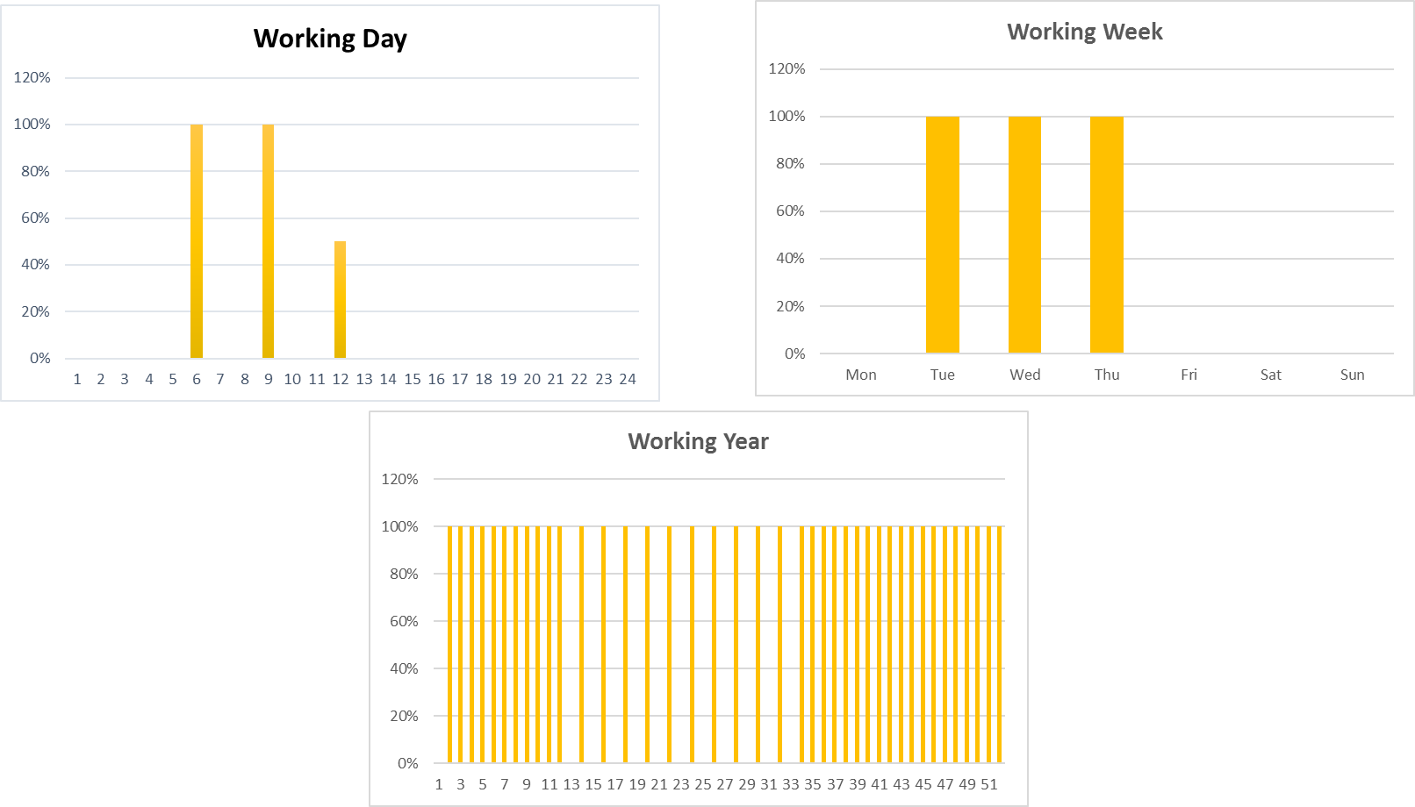
Thermal Demand
Load Profile
3 Brews per day
3 Brewing days per
Brewing week
Seasonal production variation
Summer vs Winter

Slide 11
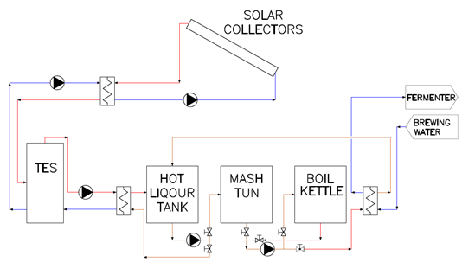
System Design
Concept
External heat
exchangers
Heat recovery
Preheating strategy
Backup System

Slide 12
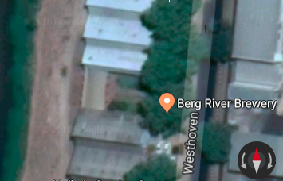
System Design
Collector location
North: 180 m² - 23°
South: 250 m² - 21°

Slide 13
System Design
Collector location
North: 180 m² - 23°
South: 250 m² - 21°
Asbestos Roof!!!

Slide 14
System Design
Specifics
Collector Aperture Area: 18.42 m²
Storage Volume: 1500 L
VSD drives on Solar and tank loops
Stainless steel food grade components

Slide 15
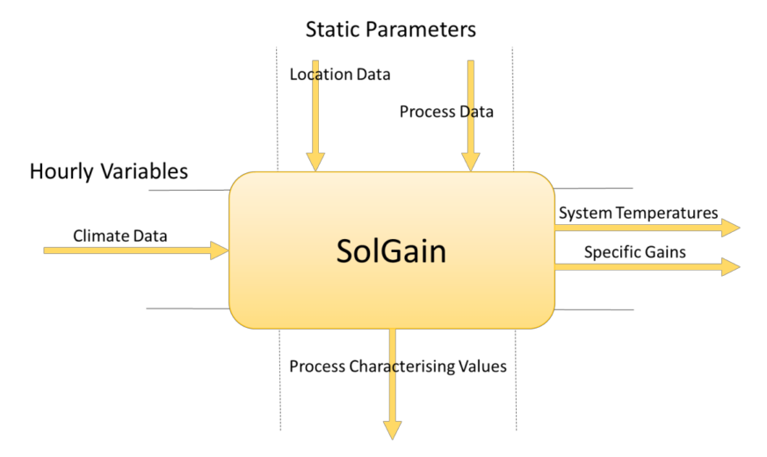
System Performance Modelling
Input
Solar resource
Process characteristics
Heat demand type
SolGain demand profile

Slide 16
System Performance Modelling
Results
Annual Thermal Demand
27 170 kWh_{th}
Supplied by SPH
19 020 kWh_{th}
Solar Fraction - 70%
System Efficiency – 27%

Slide 17
Business Case – To Buy or not to Buy
Capex
System Cost
R 20 800/m²
Minimum
R 16 000/m²
Maximum
R31 600/m²

Slide 18
Business Case – To Buy or not to Buy
LCOH
Period | LCOH - R/kWh_{th}
10 years | R 3.43
20 Years | R 2.62
Discount Rate: 4.8%
Degradation: 0.5%
O&M Cost: R 15 000/annum

Slide 19
Business Case – To Buy or not to Buy
LCOH
Period | LCOH - R/kWh_{th}
10 years | R 3.43
20 Years | R 2.62
Electricity Cost : R1.775 R/kWh
Discount Rate: 4.8%
Degradation: 0.5%
O&M Cost: R 15 000/annum

Slide 20
Business Case – To Buy or not to Buy
Payback Period
Berg River Brewery – 12.4 Years
CBC system – 9.3 Years

Slide 21
Business Case – To Buy or not to Buy
Conclusion
Low system utilisation
Low Electricity cost
High system cost

Slide 22
Business Case – To Buy or not to Buy
Conclusion
Low system utilisation
Low Electricity cost
High system cost
Investigate suitability of alternative technologies
Not Economically Feasible

Slide 23
Thank You
Berg River Brewery
NRF
STERG
STERG@sun.ac.za
+27 (0)21 808 4016

