Slide 1


Estimation of global solar radiation from SAURAN stations in South Africa using air temperature based Hargreaves-Samani & Clemence models
By Shabangu charlotte
Supervisor :Dr N.E. maluta
Co-supervisor :MRs T. S. mulaudzi

Slide 2
Renewable Energy Postgraduate symposium conference
2018

Slide 3
LAYOUT OF THE PRESENTATION
Introduction
Study area
Methodology
Results and discussion
Conclusion
Page 1

Slide 4
Introduction
In 2020 renewable energy is expected to supply 15% of electricity in South Africa [4-6].
knowledge of solar radiation data is important for designs and installation of solar designs [4-6].
Global solar radiation is the total amount of solar energy received from the surface.
Availability of quality measuring equipment (pyrheliometer and pyranometer) in South Africa[6].
Several empirical methods have been developed for estimating global solar radiation.
11 SAURAN station sites in South Afrika .
Reliability of temperature data from KZH SAURAN station.
This study focuses on estimating global solar radiation using the air temperature data from one of the South African Universities Radiometric Network (SAURAN) stations around South Africa.
Hargreaves-Samani & Clemence models use air temperature data only, Hence they were selected.
Page 2
Notes:
I

Slide 5
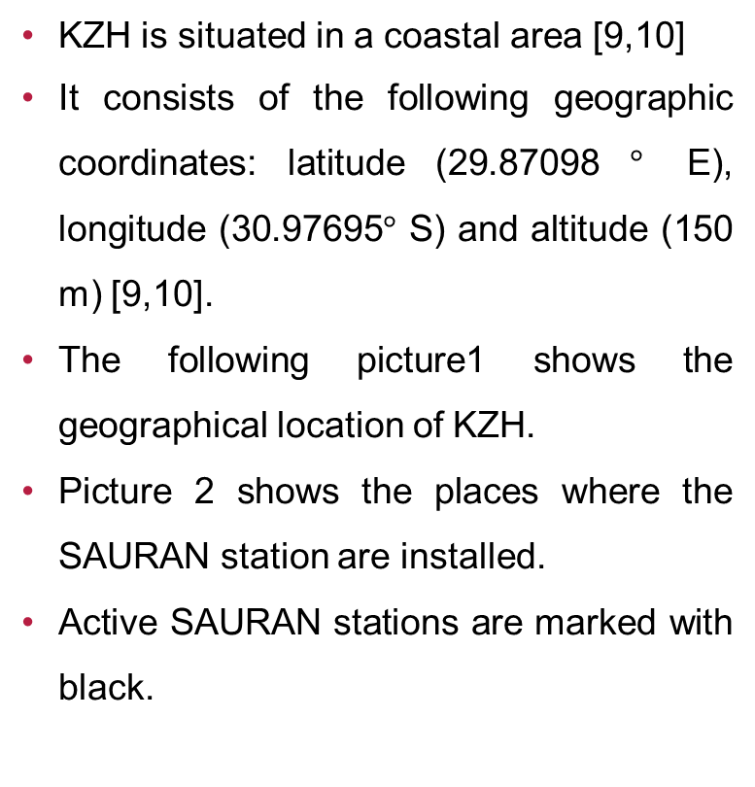
Study Area
There are 11 SAURAN stations installed in South Africa [9,10].
The station under study is University of Kwazulu – Natal Howard college (KZH), situated in Durban at Kwazulu- Natal Province, South Africa
KZH is situated in a coastal area [9,10]
It consists of the following geographic coordinates: latitude (29.87098 $°$ E), longitude (30.97695$°$ S) and altitude (150 m) [9,10].
The following picture1 shows the geographical location of KZH.
Picture 2 shows the places where the SAURAN station are installed.
Active SAURAN stations are marked with black.
Page 3

Slide 6
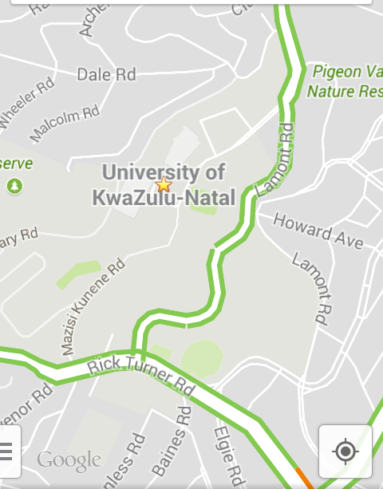
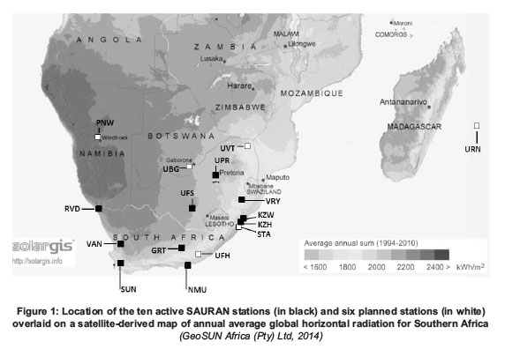
Picture 1
Picture2
Page 4

Slide 7
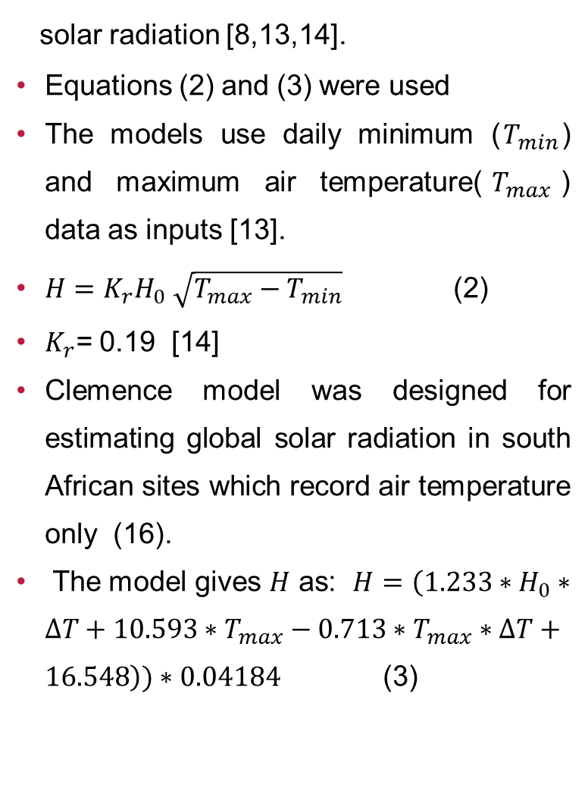
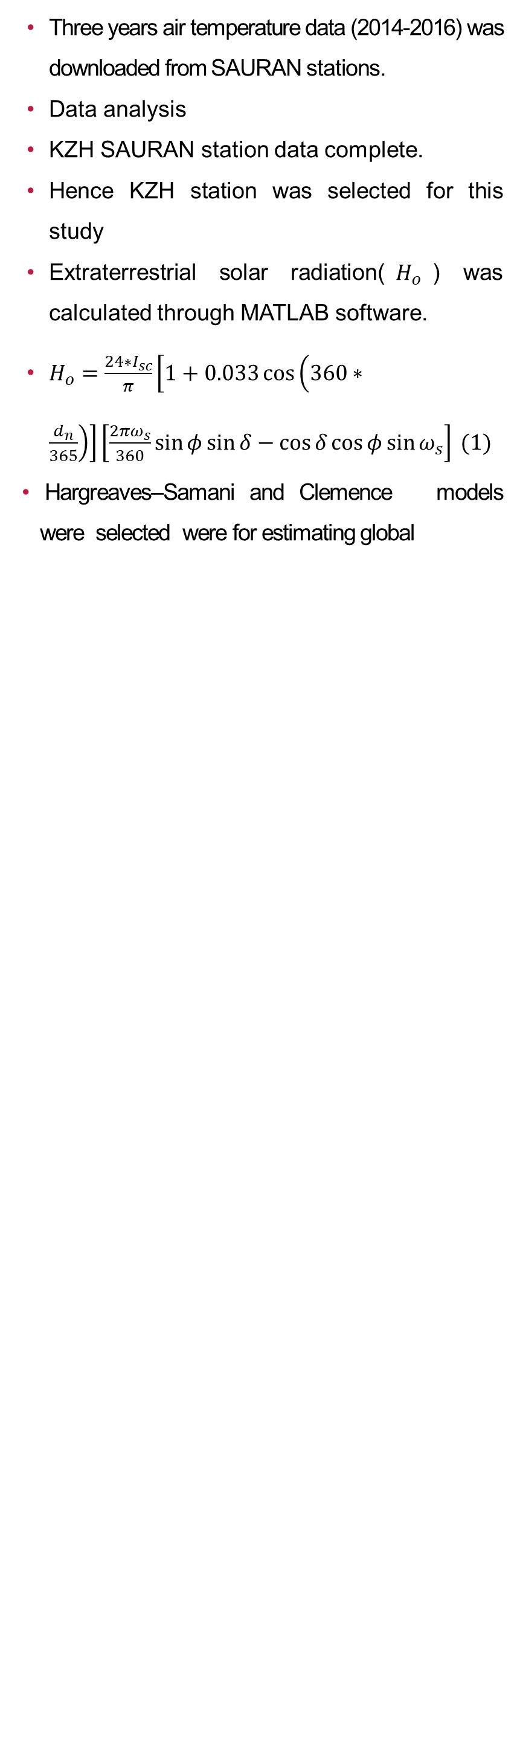
Methodology
Three years air temperature data (2014-2016) was downloaded from SAURAN stations.
Data analysis
KZH SAURAN station data complete.
Hence KZH station was selected for this study
Extraterrestrial solar radiation($H_{o}$) was calculated through MATLAB software.
$H_{o}=\frac{24∗I_{sc}}{π}\left[1+0.033\cos\left(360∗\frac{d_{n}}{365}\right)\right]\left[\frac{2πω_{s}}{360}\sin{φ\sin{δ−\cos{δ\cos{φ\sin{ω_{s}}}}}}\right] (1)$
Hargreaves–Samani and Clemence models were selected were for estimating global
solar radiation [8,13,14].
Equations (2) and (3) were used
The models use daily minimum ($T_{min}$) and maximum air temperature($T_{max}$) data as inputs [13].
$H=K_{r}H_{0} \sqrt{T_{max}−T_{min}}$ (2)
$K_{r}$= 0.19 [14]
Clemence model was designed for estimating global solar radiation in south African sites which record air temperature only (16).
The model gives $H$ as: $H=\left(1.233∗H_{0}∗∆T+10.593∗T_{max}−0.713∗T_{max}∗∆T+16.548\right))∗0.04184$ (3)
Page 5

Slide 8
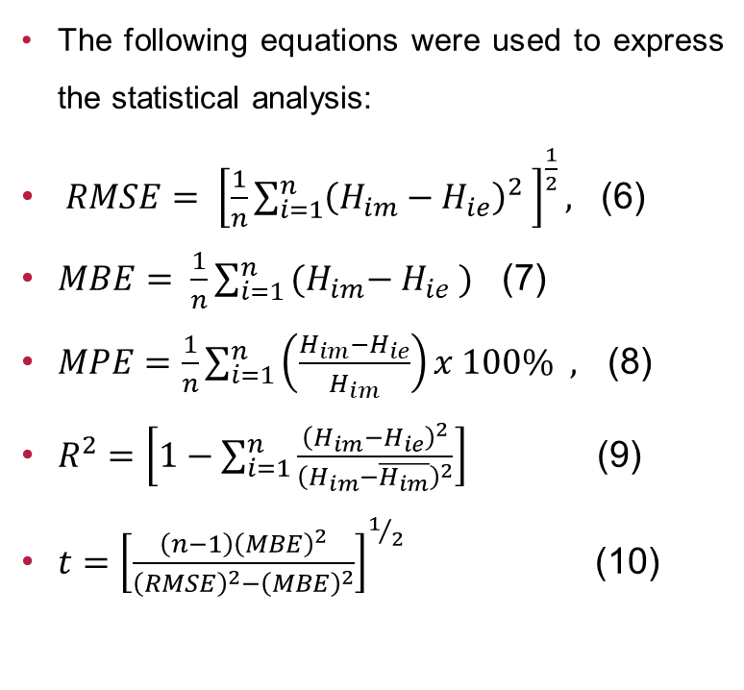
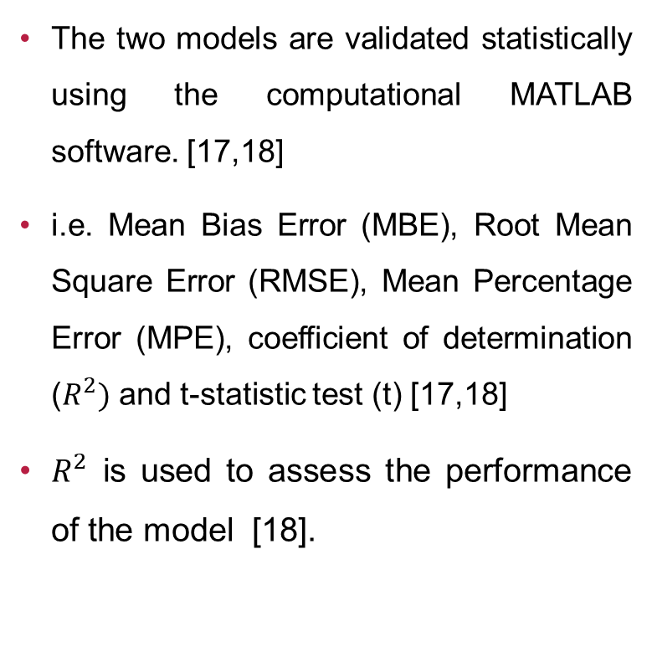
Methodology continues
The two models are validated statistically using the computational MATLAB software. [17,18]
i.e. Mean Bias Error (MBE), Root Mean Square Error (RMSE), Mean Percentage Error (MPE), coefficient of determination ($R^{2})$ and t-statistic test (t) [17,18]
$R^{2}$ is used to assess the performance of the model [18].
The following equations were used to express the statistical analysis:
$RMSE= {\left[\frac{1}{n}\sum_{i=1}^{n}{{\left(H_{im}−H_{ie}\right)}^{2} }\right]}^{\frac{1}{2}},$ (6)
$MBE= \frac{1}{n}\sum_{i=1 }^{n}{{(H}_{im}− H_{ie}} )$ (7)
$MPE=\frac{1}{n}\sum_{i=1}^{n}{\left(\frac{H_{im}−H_{ie}}{H_{im}}\right)x 100\% , }$ (8)
$R^{2}=\left[1−\sum_{i=1}^{n}{\frac{{\left(H_{im}−H_{ie}\right)}^{2}}{{\left(H_{im}−\overline{H_{im}}\right)}^{2}}}\right]$ (9)
$t={\left[\frac{\left(n−1\right){\left(MBE\right)}^{2}}{{\left(RMSE\right)}^{2}−{\left(MBE\right)}^{2}}\right]}^{1/2}$ (10)
Page 6

Slide 9
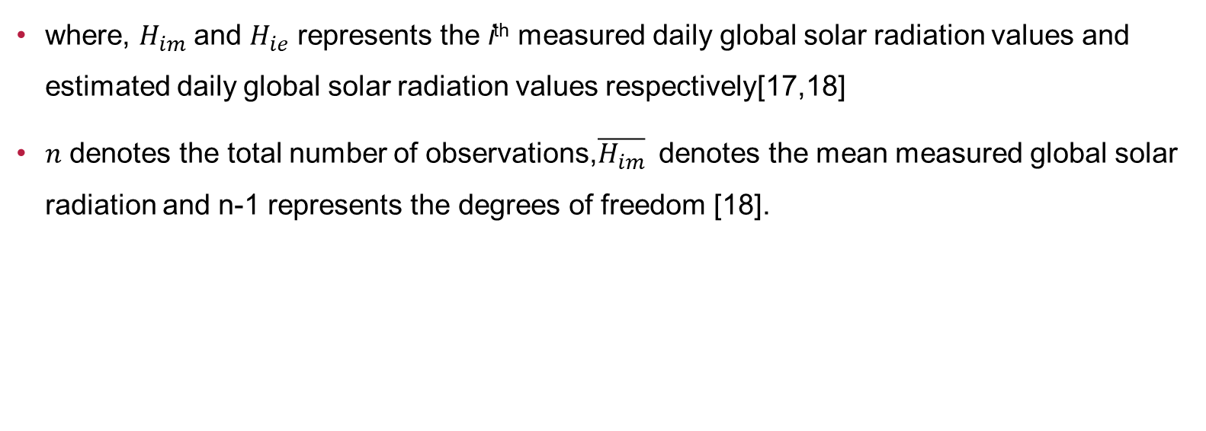
Methodology continues
where, $H_{im}$ and $H_{ie}$ represents the i^{th} measured daily global solar radiation values and estimated daily global solar radiation values respectively[17,18]
$n$ denotes the total number of observations,$\overline{H_{im}}$ denotes the mean measured global solar radiation and n-1 represents the degrees of freedom [18].
Page 7

Slide 10
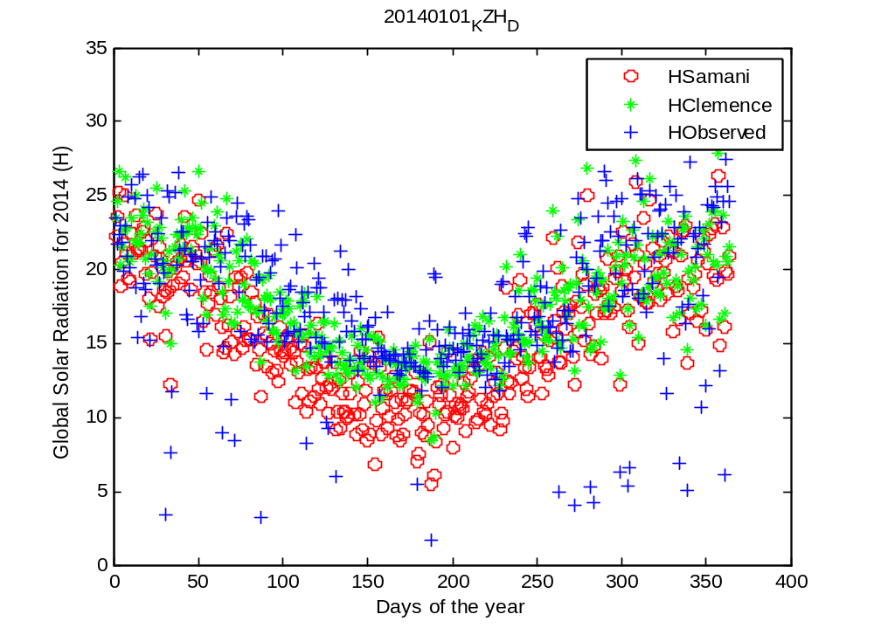
Results and discussion
The estimated global solar radiation data are then compared with the observed global solar radiation .
MATLAB software was used to plot scattered plots
Three scattered plots for the years 2014 -2016 are presented below as figures 1-3 .
Figure 1:Comparison between estimated and measured global solar radiation for KZH station in 2014
Page 8

Slide 11
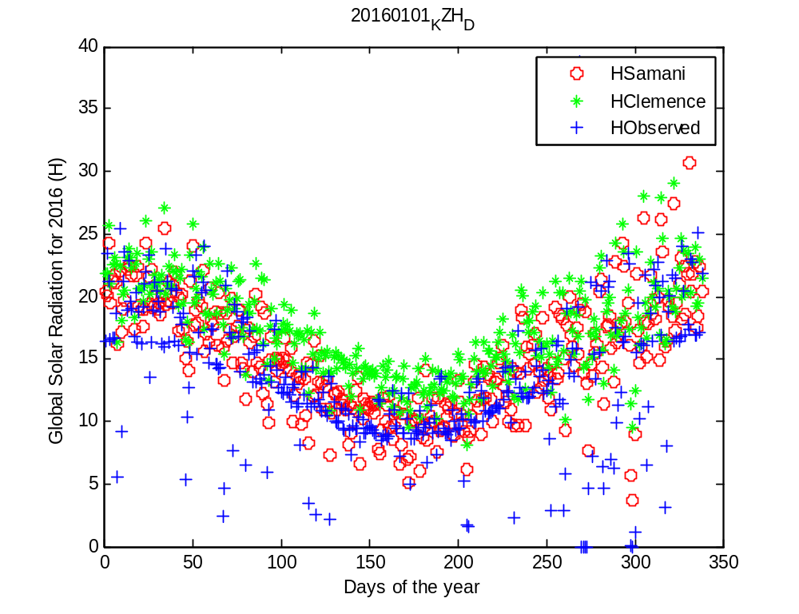
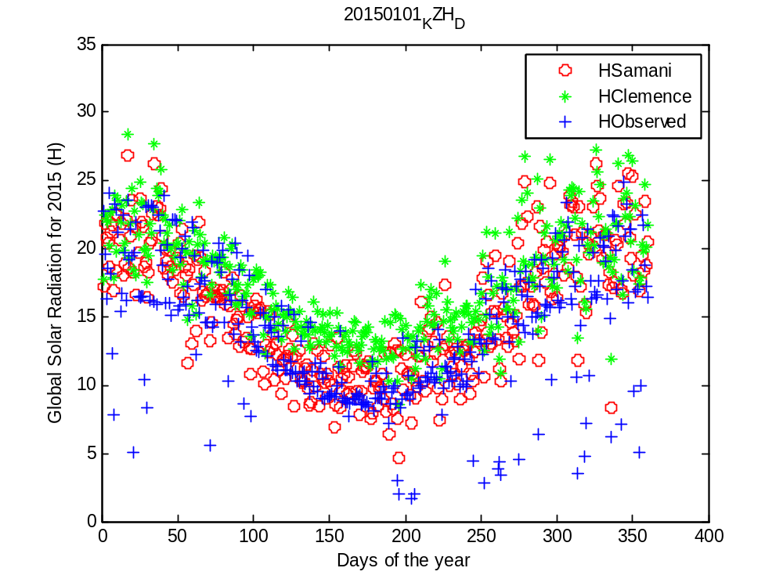
Results and discussion continues………………….
Figure 3 :Comparison between estimated and measured global solar radiation for KZH in 2016
Figure 2:Comparison between estimated and measured global solar radiation for KZH in 2015
Page 9

Slide 12
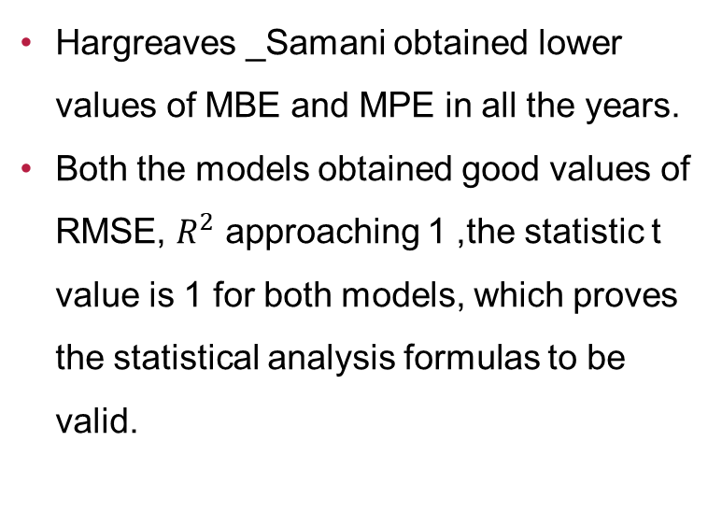
Results and discussion continues
Figure 1:estimated global solar radiation corelates well with measured global solar radiation for both models
Figure 2 :there is a slight overestimation by Clemence model in April 2015
Figure 3:Overestimation by Clemence model from April to may in 2016.
Table 1:Both models obtained lowest values of MBE ranging between 0.013 to 0.0088.
Clemence model obtained the MPE value of 1.0801 for 2015 ,showing overestimation.
Hargreaves _Samani obtained lower values of MBE and MPE in all the years.
Both the models obtained good values of RMSE, $R^{2}$ approaching 1 ,the statistic t value is 1 for both models, which proves the statistical analysis formulas to be valid.
Page 10

Slide 13
Table 1: Statistical validations of the models for estimating monthly mean daily global solar radiation in KZH stations.
Year | MBE (MJ/m² ) |  | MPE % |  | RMSE (MJ/m² ) |  | R² |  | t-Value
 | Samani | Clemence | Samani | Clemence | Samani | Clemence | Samani | Clemence | Samani | Clemence
2014 | 0.0013 | 0.0036 | 0.1285 | 0.3619 | 0.0246 | 0.0691 | 0.9995 | 0.9962 | 1.000 | 1.000
2015 | 0.0078 | 0.0108 | 0.7788 | 1.0801 | 0.1418 | 0.2063 | 0.9802 | 0.9657 | 1.000 | 1.000
2016 | 0.0057 | 0.0088 | 0.5667 | 0.8822 | 0.1083 | 0.1685 | 0.9898 | 0.9778 | 1.000 | 1.000
Page 11

Slide 14
Conclusion
Hargreaves- Samani model was observed to be having lower values of MBE and MPE for 2014 to 2016.
Both models have good values of R² approaching 1 and t -statistic value of 1.
Hargreaves -Samani & Clemence models have been proven to have a good performance based on the values of R² approaching 1 for KZH.
It can therefore be concluded that Hargreaves -Samani & Clemence models are suitable for estimating monthly mean global solar radiation in University of kwazulu natal Howard college.
Page 12

Slide 15
Future work
It is in our interest to estimate global solar radiation from other SAURAN stations temperature data in south Africa.
It would be great to work with sunshine hour models like Angstrom-Prescott model, which will be compared with air temperature models for estimating global solar radiation in particular area.
page13

Slide 16
References
National resource account, energy accounts for South Africa 1995- 2001, statistics South Africa, pp.8-14, Pretoria, South Africa, 2005.
REIPPPP focus on Free State, Limpopo ,North West ,Kwazulu -Natal, Mpumalanga, and Gauteng provinces, provincial report vol (4),pg.1-22,2017..
Odell S.J. Comparative assessment of coal – fired and nuclear power plants, pp.1-32, 2011.
Korachagaon I, Bapat V.N. Development of a site-independent mathematical model for the estimation of global solar radiation on earth’s surface around the globe, International Journal of Energy and Environment, vol .3(2), pp.295-304,2012.
Page 14

Slide 17
References continues…
Myers D.R. Practical modeling for renewable energy applications, solar radiation.pp.1- 23,2013.
Du Plessis M. Cheaper electricity with renewables, pp. 7,1986
Musango J.K,Amigun B,Brent A.C.Sustainable electricity generation technologies in South Africa:initiatives,Challenges and Policy Implications ,Energy and Environment Research,Vol.1(1),pp.124-138,2011.
Mackellar N, New M, Jack C. Observed and modelled trends in rainfall and temperature for South Africa :1960-2010, South African Journal of Science,vol.110(7),pp.1-13,2014.
Broughton K. SAURAN station details: Sun Stellenbosch university, Stellenbosch, Western Cape province,2015.
Page 15

Slide 18
Reference continues……….
Brooks M. J, du Clou S,Van Nie Kirk W.L,Gauché P,Leonard C,Mouzouris M .J, Meyer R, Van der Westhuizen N ,Van Dyk E.E,Vorster F.J .SAURAN: A new source for solar radiometric in Southern Africa, Journal of Energy in South Africa, vol.26(1), pp. 2413- 3051, 2015.
Kaempffer C, Germishuyse T. Climate data at the Agricultural Research Council, ARC, ISCW, pp.66-68,2009.
Government communication and information system, South Africa year book, the land and its people, pp.1-21,2001.
Besharat F, Dehghan A.A, Faghih A.R. Empirical model for estimating global solar radiation: A review and case study, Renewable and Sustainable Energy Reviews, vol.21, pp.798-821, 2013.
Okonkwo G. N, Nwokonye A. O. Estimating global solar radiation from temperature data in Minna location, European Scientific Journal, vol.10(15), pp.254-264,2014.
Page 16

Slide 19
Reference continues
Almorox J. Estimating global solar radiation from common meteorological data in Aranjuez,SpainTurkish Journal of Physics, vol.35(1). pp.53-64,2011.
Clemence, B.S.E. An attempt at estimating solar radiation at South African sites which measure air temperature only, South African Journal of Plant and Soil, vol.9(1), pp. 40-42, 2013.
Adeala A. A, Huan Z ,Enweremadu C.C .Evaluation of global solar radiation using multiple weather parameters as predictors for South African provinces, Thermal Science, vol.19 (2), pp. S495-S509,2015.
Akpootu D.O, Sanusi Y.A. A new temperature-based model for estimating global solar radiation in Port- Harcourt south Nigeria, International Journal of Engineering and Science, vol. 4(1), pp. 63-73, 2015.
Page 17

Slide 20
Acknowledgement
GEOSUN………
University of Venda
Supervisors :N.E Maluta and Mrs. T.S Mulaudzi
Sponsors : Center for renewable and Sustainable Energy studies
Page 18

Slide 21
THANKS FOR LISTENING

