Slide 1
Biofuels for Transportation
Prof Johann Görgens
Process Engineering

Slide 2
Why Biofuels?
Besides electricity, transport is the biggest CO₂ emitter in South Africa
  Due to coal-to-liquids and gas-to-liquids
  40% efficiency = 60% CO₂ production
Liquid biofuels have a good energy density
  Energy stored per kilogram biofuel is an order of magnitude greater than electric batteries
Cheapest option for gaseous fuels is biogas which can be used in petrol or diesel vehicles
  Significant range limits compared to liquid fuels

Slide 3
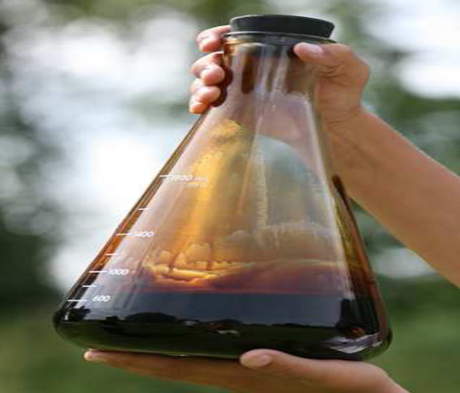
Types of Liquid Biofuels
The most well known:-
  Biodiesel by transesterification
  Bioethanol – to blend with petrol
  Synthetic fuels – from biobased resource
Less well known:-
  Upgraded pyrolysis oil
  Aviation biofuels

Slide 4
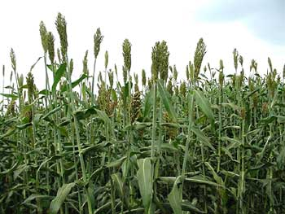
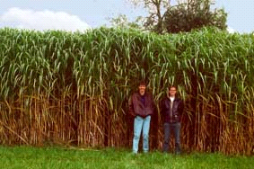
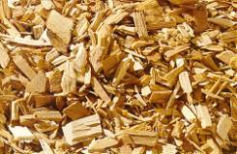
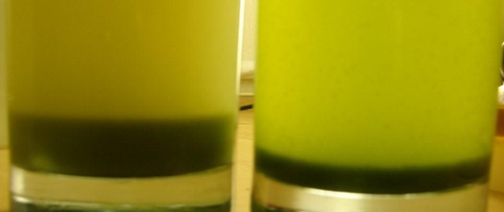
Types of feedstock
First Generation (1G)
  Edible oils (soybean and canola oil) used for biodiesel
  Bioethanol produced from sugar cane or starch crops (grain sorghum and triticale)
Second Generation (2G)
  Waste oils and animal fats used for biodiesel production
  Lignocellulosic biomass (energy crops, agricultural and forestry residues, industrial waste)
  used to produce a variety of products including ethanol, synthetic fuel and upgraded pyrolysis oils
Third Generation (3G)
  Algae can be used to produce fuels and high value pharmaceuticals

Slide 5
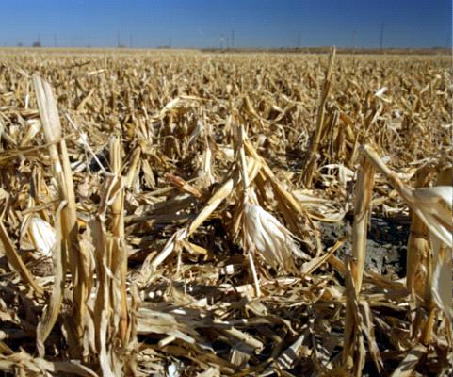
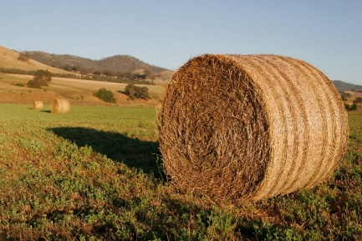
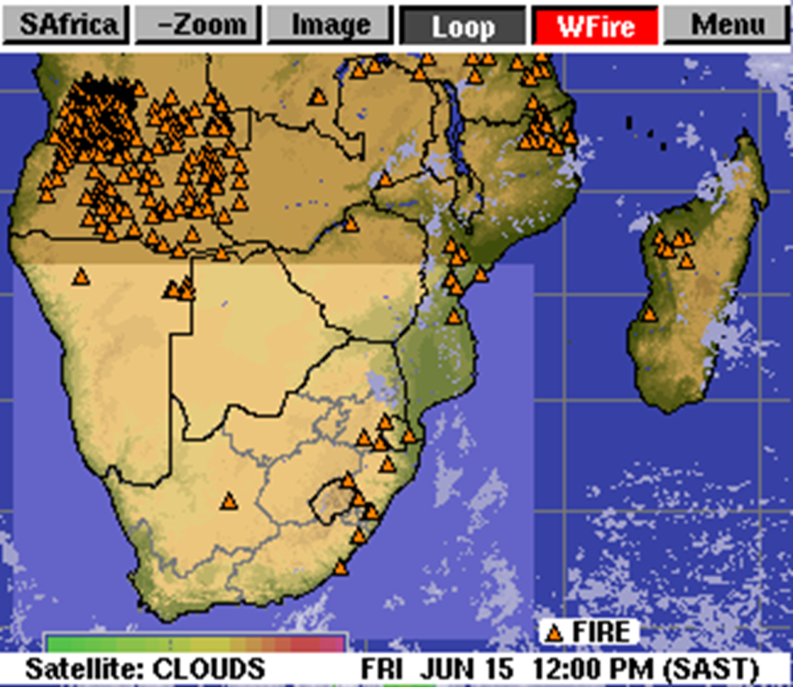
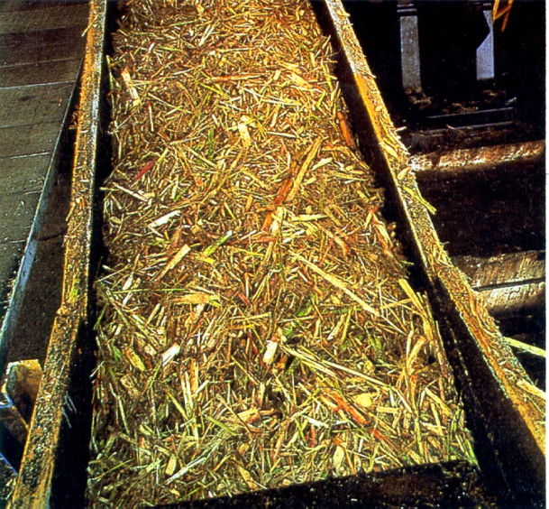
Residues
Maize stover
Straw
Bagasse

Slide 6
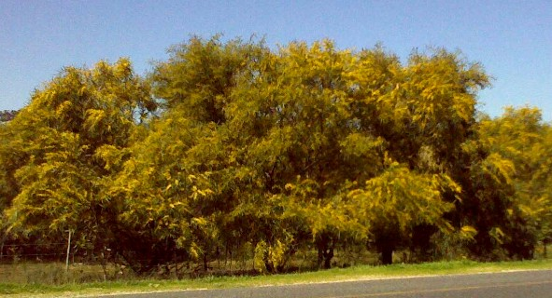
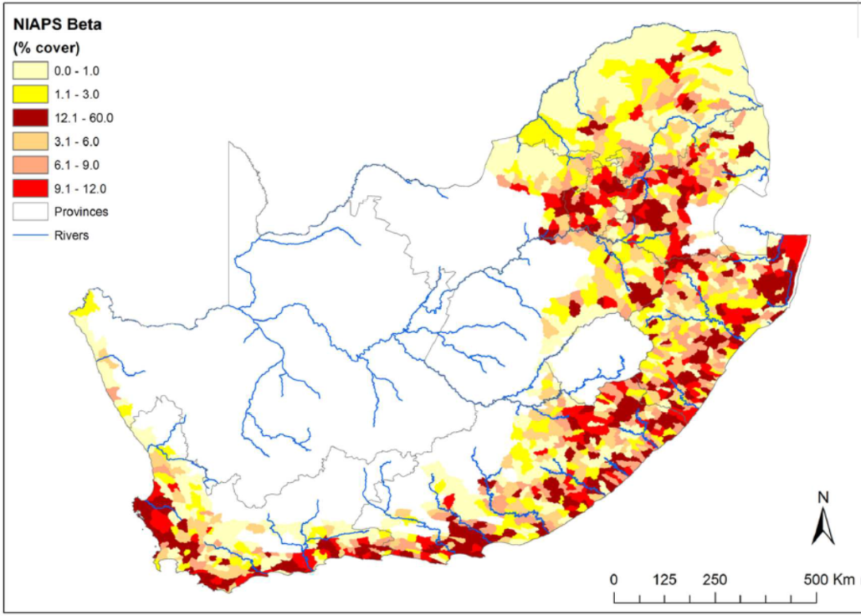
Invasive Alien Plants

Slide 7
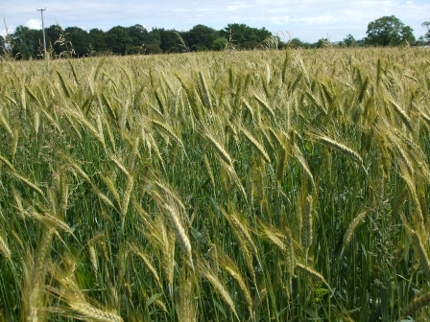
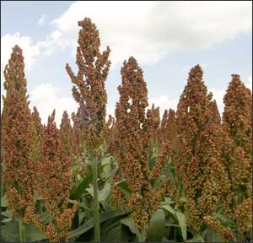
Energy Crops
Woodchips
Miscanthus
Triticale
Grain sorghum

Slide 8
Conversion Technologies
Electricity
  Combustion of primary or intermediary bio-energy feedstocks: Bioler, turbine, engine
  Feedstocks: Biomass, biogas, gasification product gas, torrefied/pyrolysed biomass, bio-oils
Liquid biofuels
  Fermentation to ethanol/butanol
  Pyrolysis to liquid followed by upgrading
  Gasification to syngas followed by synthesis
Heat: Depends on market value

Slide 9
Challenges with Manufacturing
More expensive to process due to feedstocks having:
  Low energy density
  High oxygen content
Financial incentives usually subsidies required
The need to avoid competition with food – by using or displacing edible feedstocks
Process energy is often required and this may be sourced from fossil fuels – carbon balance

Slide 10
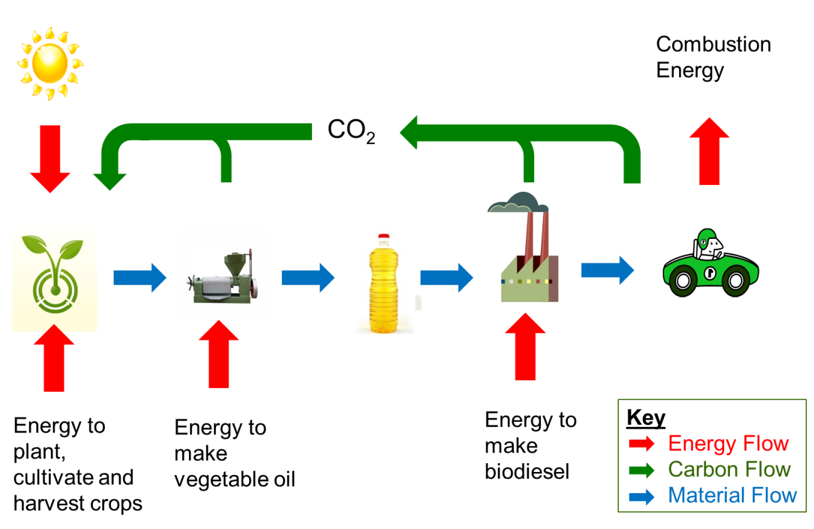
The carbon cycle - biodiesel

Slide 11
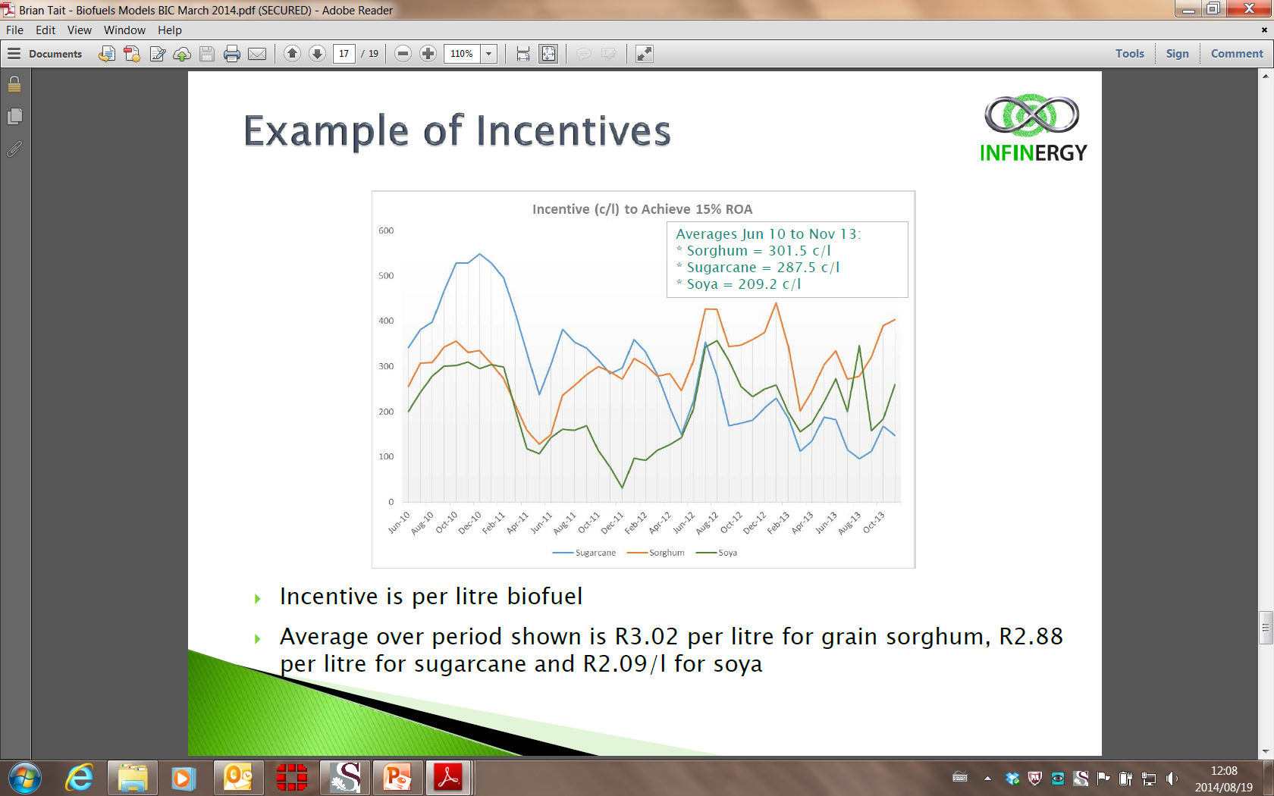
SA Biofuels subsidy route
Mandatory blending targets - 1 Oct 2015
Subsidy to guarantee a 15% ROA
Calculations by Brian Tait (2014):

Slide 12
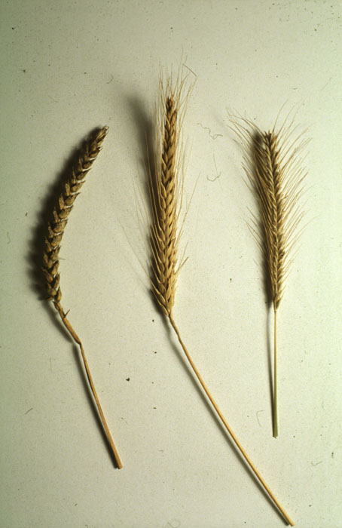
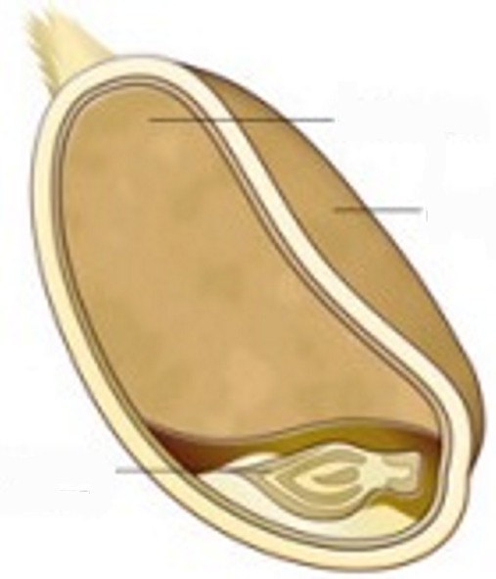
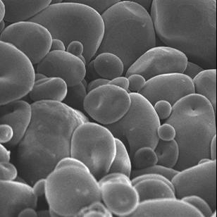
Starch crops
Wheat
Triticale
Rye
Endosperm
Bran
Wheat
germ

Slide 13
Additional subsidy considerations
There is a focus on large scale producers
  Typically 160 million litres / year
There is a focus on developing new agriculture
  Job creation
  Rural upliftment
Limited to 1G projects
  Cheaper
  Dedicated energy crops such as grain sorghum; new agriculture
  Avoid fossil fuels for grains conversion!

Slide 14
1G Environmental Issues
1G ethanol – from sugar cane
  Brazil has shown that social and economic benefits are significant
  Very positive carbon balance
  Sugar cane bagasse available for energy
  BUT a specific climate required to grow sugar cane
1G ethanol – from starch e.g. grain sorghum
  Potential food vs fuel issues - land use
  Carbon balance issues – process energy for conversion should not be supplied by fossil fuels (coal)
1G biodiesel
  Also food vs fuel issues
  Water required for product purification and catalyst removal

Slide 15
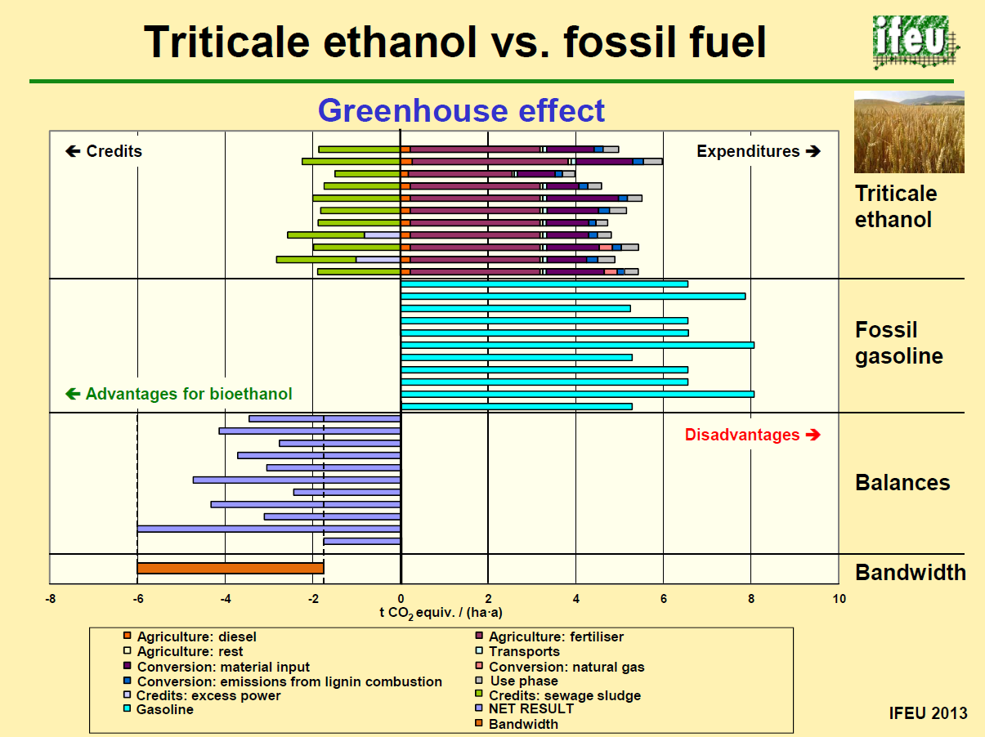

Slide 16
Biofuels not PRIORITISED in subsidy Scheme

Slide 17
2G Conversion Technologies
Pretreatment
Enzymatic hydrolysis
Fermentation
Transportation fuel
Distillation
Biological conversion
Residues for thermo-chemical conversion
Biomass feedstock or residue
High pressure steam
Steam turbine
Electricity
Combustion in boiler
Thermo-chemical routes
Surplus heat
Pyrolysis
Pyrolysis oils
Catalytic Upgrading
Refining
Gasification
Products
Transportation fuels
Product gas or syngas
Product gas
Combustion for heat/electricity
Syngas
Synthesis
Refining

Slide 18
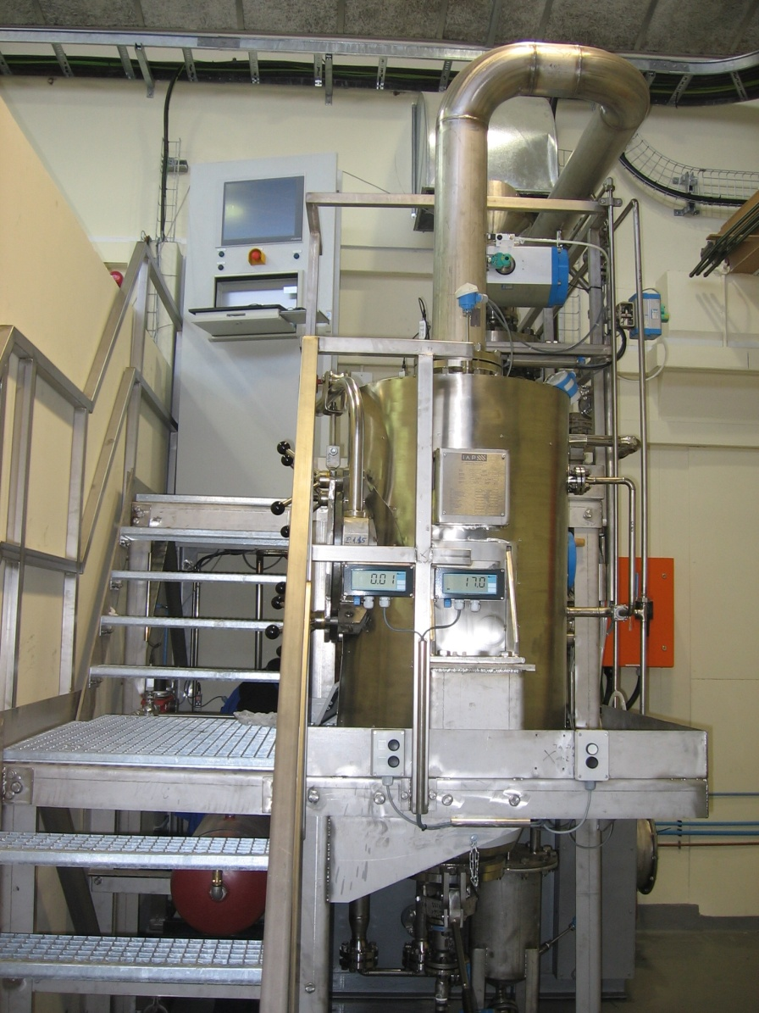
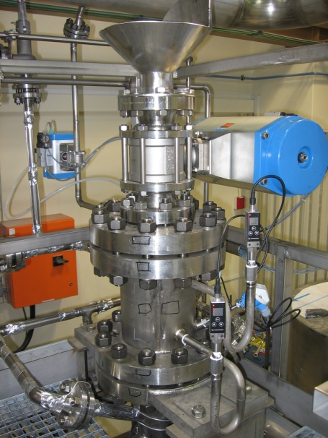
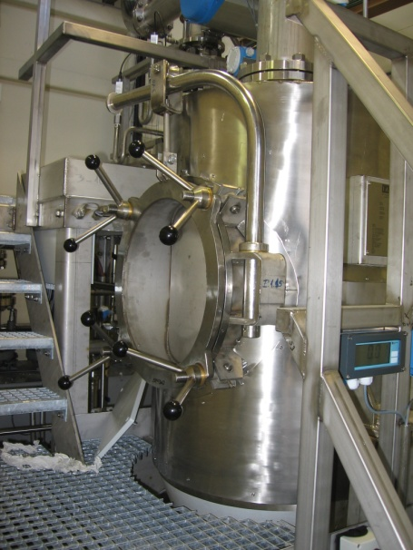
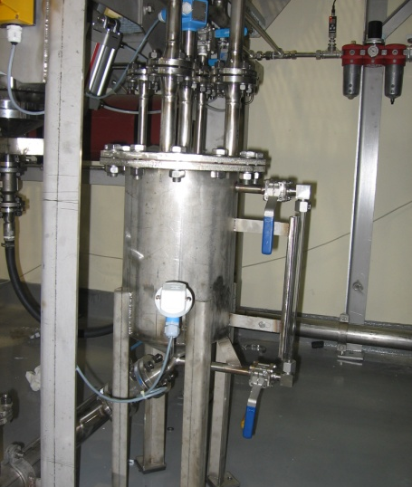
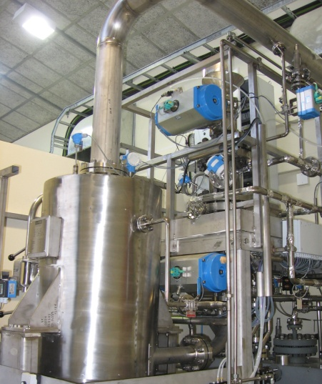
Steamgun Pretreatment
of Lignocellulose

Slide 19
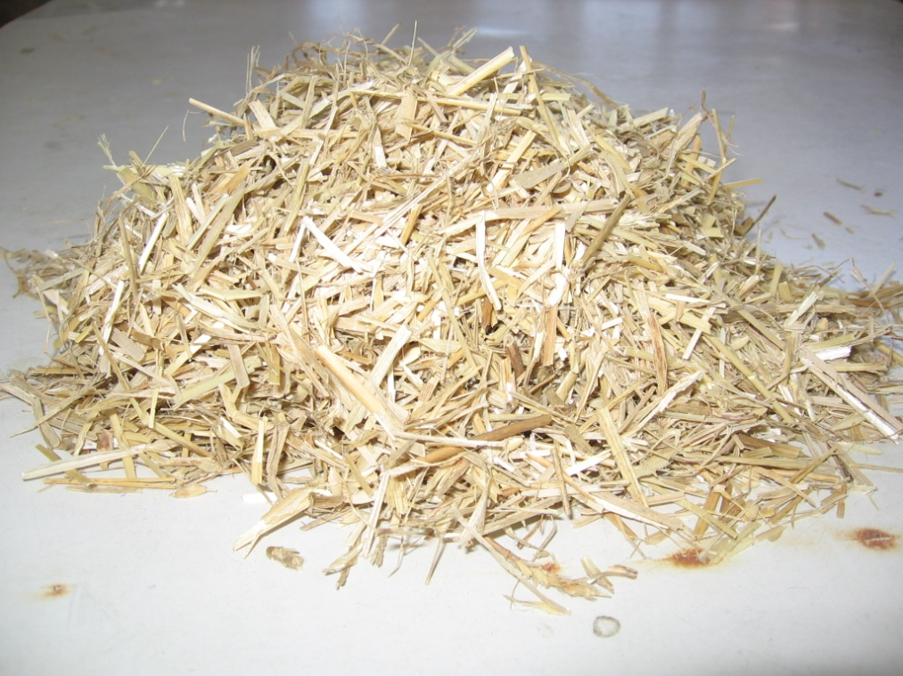
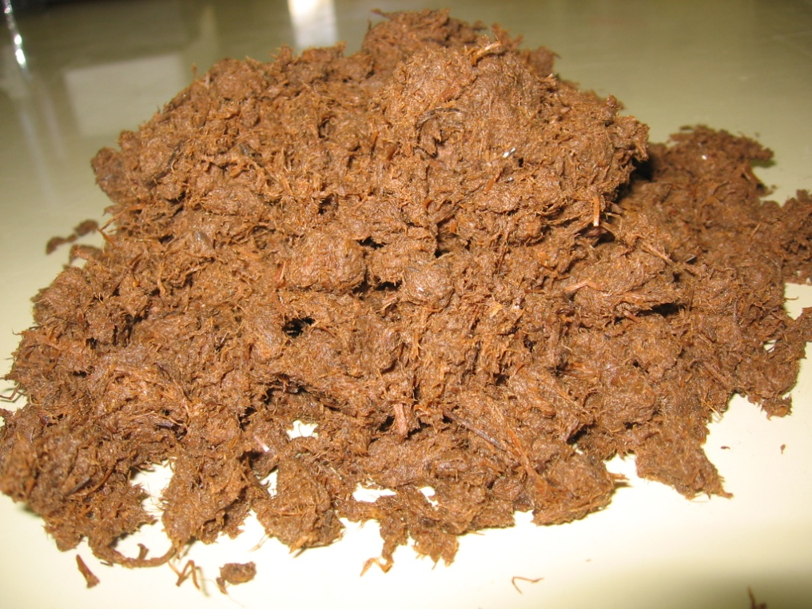
Steam Explosion Pretreatment
Raw Triticale straw before steam explosion
Exploded Triticale straw

Slide 20
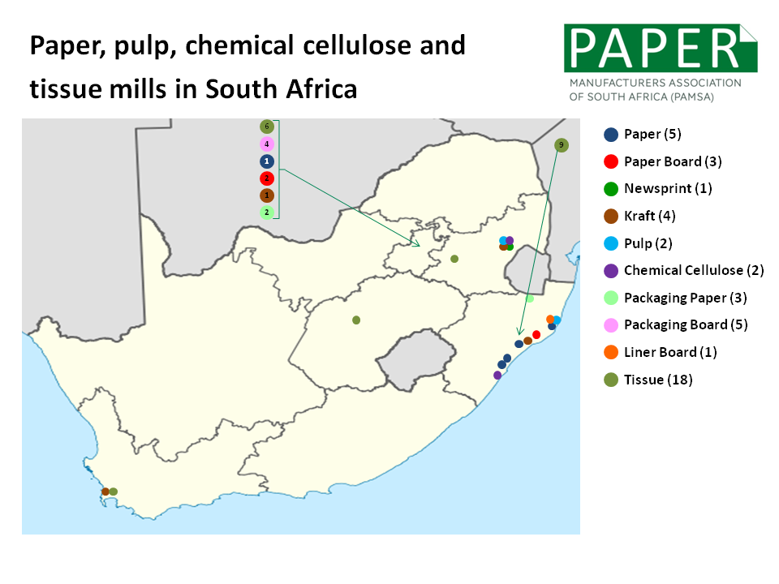
What about industrial waste?
Approximately 550-1500 dry tons paper sludge /day
Degraded cellulose fibres → ethanol

Slide 21
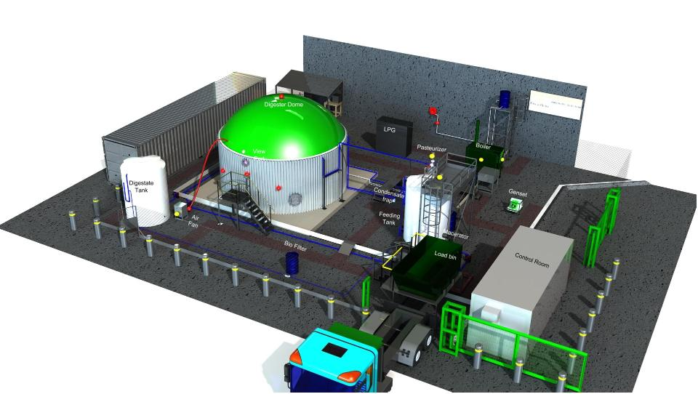
Waste to Energy by Biogas
Anaerobic Digestion
  Well Proven
  Can be utilised for all 3 types of energy offtakes
  Requires minimum of 15 tons/day
  Balance Nitrogen and Carbon
  High Digestate volume
2

Slide 22
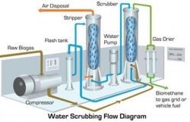
Biogas in Transport as Offtake option
Transportation Fuel
  Diesel R 1.18/ kWh
  Wide Application
  Upgrading required
  Compressed Methane
  Dual Fuel Conversion
  Diesel & Petrol
2

Slide 23
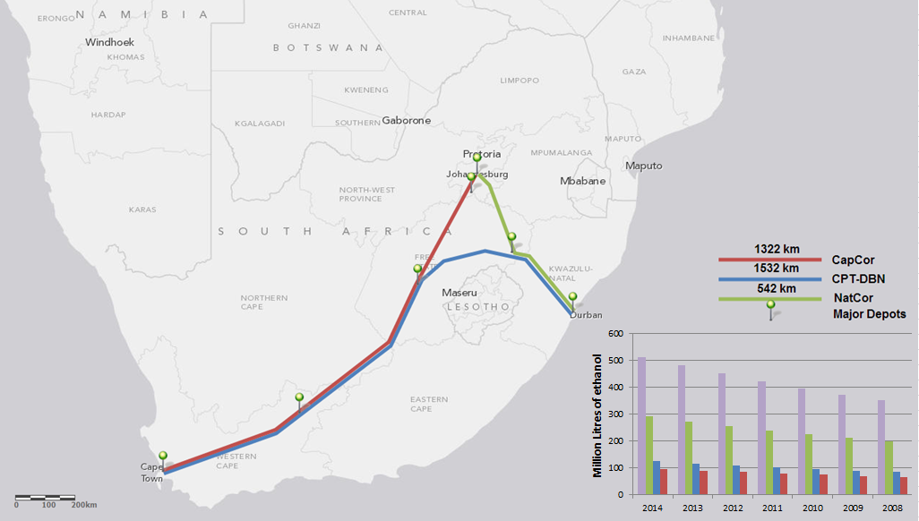
Bio-ethanol/Diesel blending
Economic Pre-feasibility study on ethanol diesel blending in South Africa – BP Greyling
Basic idea:
Pioneered by South-African’s in 1980’s as possible alternative agricultural fuel
Blend Bio-Ethanol with diesel 16% (v/v)
Ethanol production – Industrial first generation Tech @ 1, 80 or 160 million l/annum
have been shown to be economically viable production volumes
Approach:
Blending of ethanol at fuel Depot level - Safety and Vehicle limitations
Supply to dedicated vehicle fleet i.e. Logistics operators
Localized production of Bio-ethanol allows regional bio-feedstock
South African logistics operations
Blending based at major logistics depot locations.
Current model - up to 513 million l/annum
ethanol demand for blending via this approach.
(2.08% of Bio-fuels Target)

Slide 24
Biofuels FOR AVIATION

Slide 25
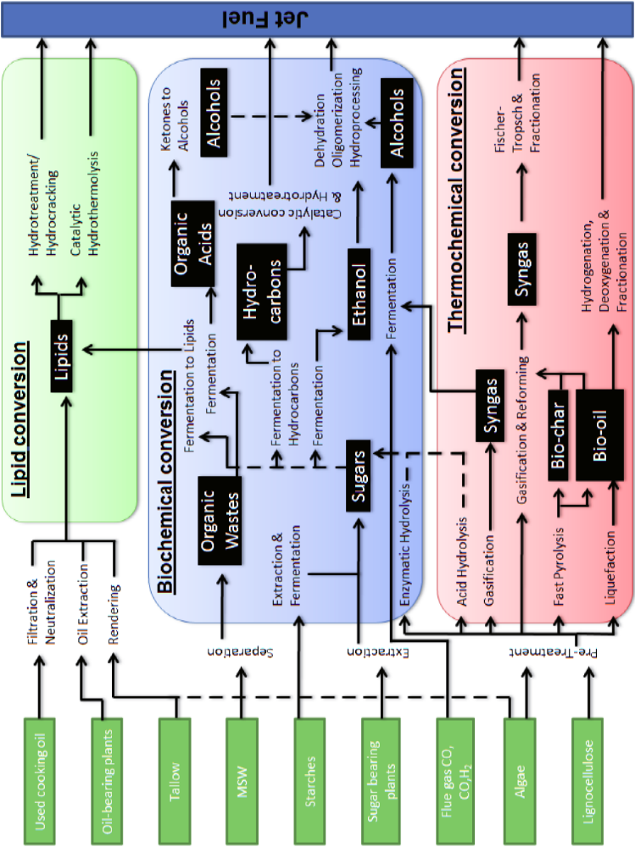

Slide 26
Technology Comparisons
Process Route | Mass Yield Jet on Biomass | Aviation Fuel Energy Yield | Jet Fraction in Fuel Products
HEFA | 0.37 to 0.56 | 0.73 (0.06) | 50-76%
Alcohol-to-jet | 0.12 | 0.44 (0.29) | 88%
Gasification-FT | 0.06 | 0.21 to 0.36 | 56%
Pyrolysis oil for upgrading | 0.05 | 0.11 | 25%
Lipid to jet | 0.05 | ?? | 77%
Mixed alcohols | 0.06 | ?? | 26%
Sugars to hydrocarbons | ?? | ?? | ??
Differences in certification
Prices in excess of R10/liter
Huge variability in comparisons due to unsubstantiated technical/economic performance

Slide 27
BioMASS is MULTIFUNCTIONAL

Slide 28
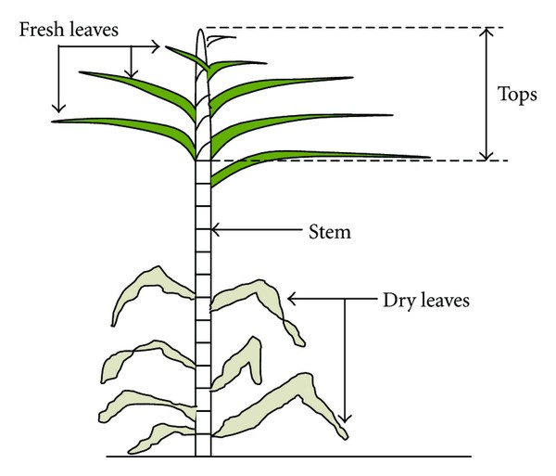
Biorefinery
Sugar Cane
Leaves
& Tops
CHP
Electricity
& Steam
Extraction
Bagasse
Molasses
Clarification
Ethanol
Sugar

Slide 29
Biorefinery
Sugar Cane
Leaves
& Tops
CHP
Electricity
& Steam
Extraction
Bagasse
Bagasse & trash are
Rich in Carbohydrate & don’t compete with food/feed demand
Molasses
Clarification
BIOREFINERY
Ethanol
Sugar

Slide 30
Biorefinery
Sugar Cane
Leaves
& Tops
CHP
Electricity
& Steam
Extraction
Bagasse
Bagasse & trash are
Rich in Carbohydrate & don’t compete with food/feed demand
Molasses
Clarification
BIOREFINERY
Bioenergy
Bioproducts
Ethanol
Sugar

Slide 31
Biorefinery
Sugar Cane
Leaves
& Tops
CHP
Electricity
& Steam
Extraction
Bagasse
Bagasse & trash are
Rich in Carbohydrate & don’t compete with food/feed demand
Molasses
Clarification
BIOREFINERY
Bioenergy
Bioproducts
Ethanol
Sugar
-liquid/gaseous
bulk chemicals
fine chemicals
animal feed
food
biomaterials
fertilizer
pulp & paper
gases
transport biofuels,
Sugarcane Bagasse(Lignocellulose)
Cellulose → C₆ 42%
Hemicellulose → C₅ 25%
Lignin 22%
Ash + Extractive + 11%
electricity
heat
solid fuels
tens of thousands of man-years of employments

Slide 32


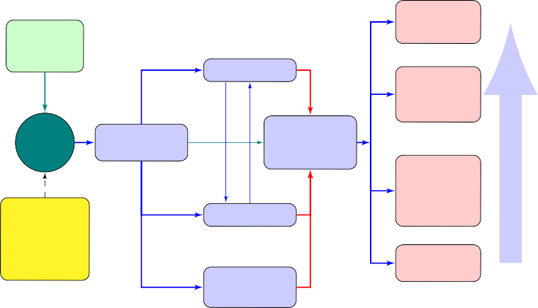
Biorefinery
1
A Biorefinery involves the Sustainable Processing of Biomass into a spectrum of valuable/marketable Products'V' replace fossil-derived products.
Biomaterial
Polymers Composites . . .
High
Sugar Cane Bagasse
Leaves
& Tops
Biochemical
transformation
Biochemical
Fine & Special-
ity Chemicals Monomers . . .
Biomass
Pre-processing
technologies
Product Separation and
Purification
Biomass
Biofuels Bioethanol Butanol
Creating Value
Wood Bark/forest residues Agricultural waste
Manucipal solid waste
Industrial waste Energy crops
Thermochemical
transformation
Biodiesel Biogas . . .
Bioenergy
Electricity
& Steam. . .
Chemical
& others Lignin Chemistry
Low
Lower Inherent Carbon Footprint (up to 52%)
compared to equivalent products obtained from conventional fossil flues
2
Rigorous Modeling of alternative processes with different combinations of products are considered → BIOREFINERY SCENARIOS

Slide 33
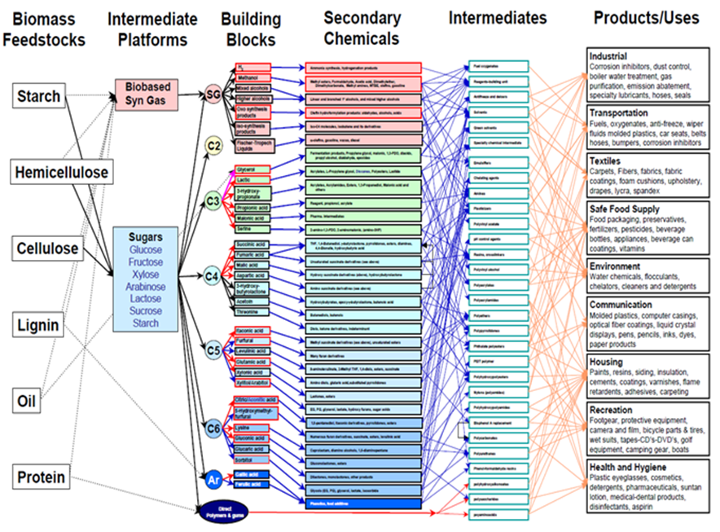
A Legio of Options

Slide 34
Biofuels: State of Affairs
Competition for multifunctional plant biomass:
  Food, animal feed higher priority than bio-energy
  Commercialisation of high value chemicals
  Biorefineries for optimised allocation
1G biofuels in SA is proceeding, probably grain-ethanol – limited agro impact
Aviation biofuels in SA driven by SAA and international partners
Uptake of 2G biofuel technology in SA is slow, because of perceived cost disadvantanges
Waste-to-energy could be expanded: Circular economy

